Slide 1
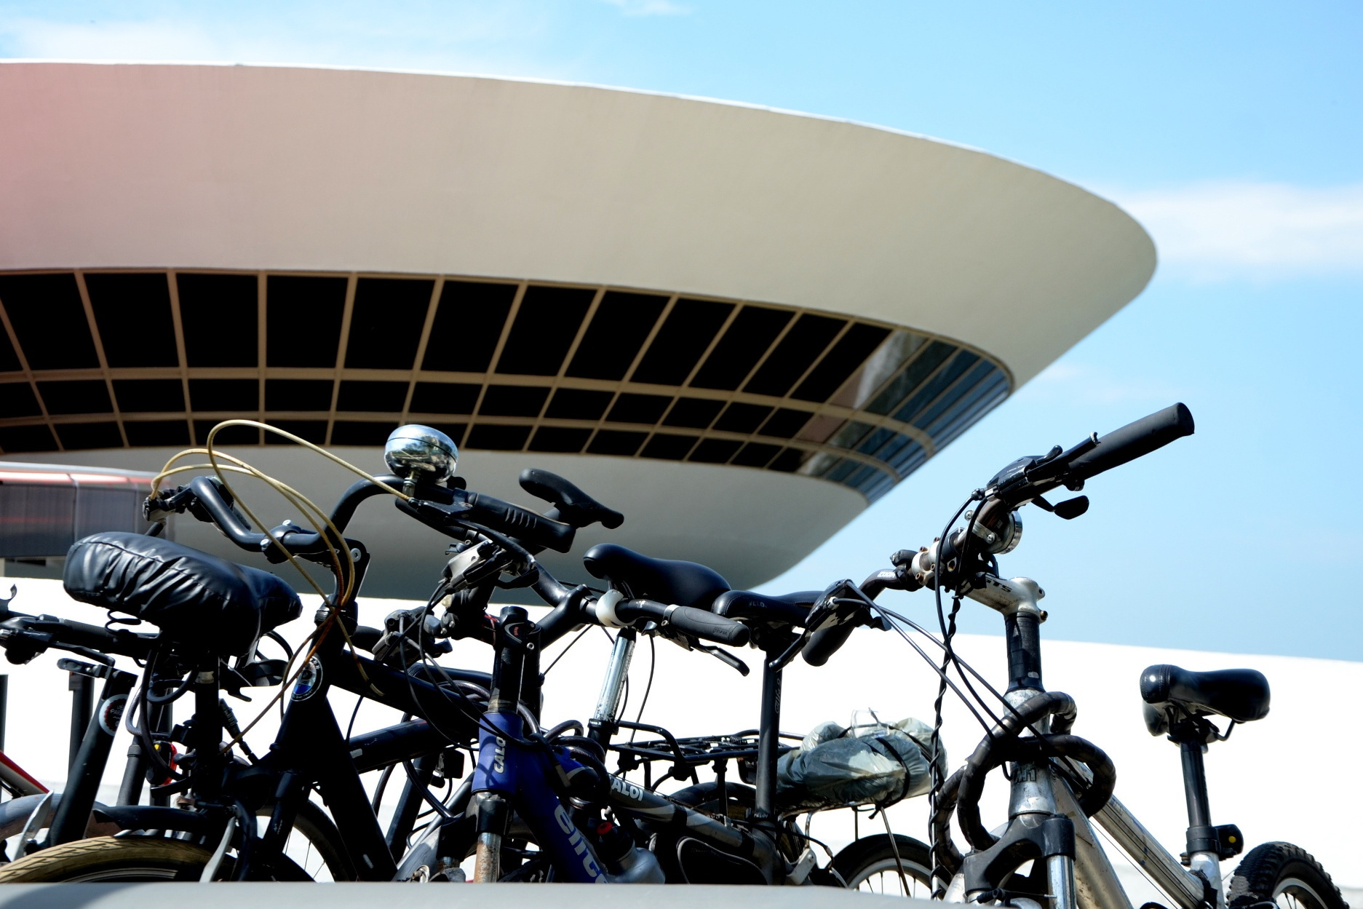


CYCLING CITY: NITERÓI
JOÃO PEDRO G. BOECHAT DE OLIVEIRA

Slide 2
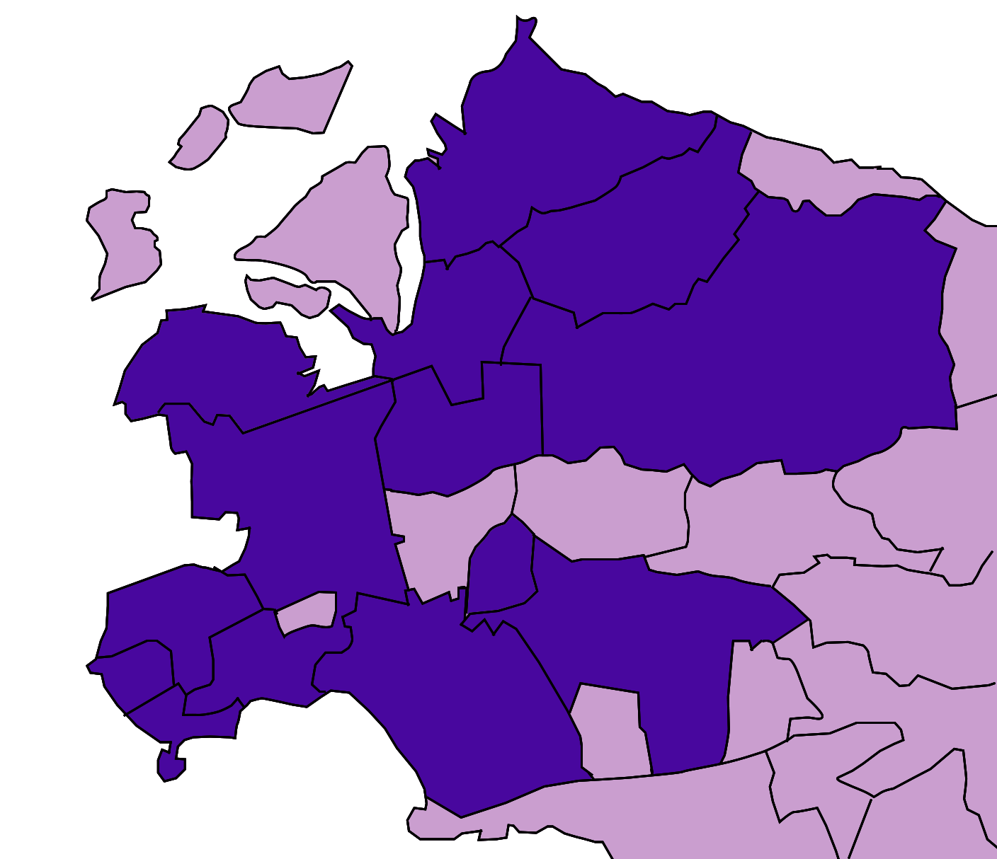

50
NITBIKE
BARRETO
STATIONS
ENGENHOCA
among 15 neighborhoods within 3km of the city’s center
PONTA D’AREIA
SANTANA
FONSECA
SÃO LOURENÇO
CENTRO
PÉ PEQUENO
SÃO DOMINGOS
SANTA ROSA
INGÁ
GRAGOATÁ
ICARAÍ
VITAL
BRAZIL
BOA VIAGEM

Slide 3
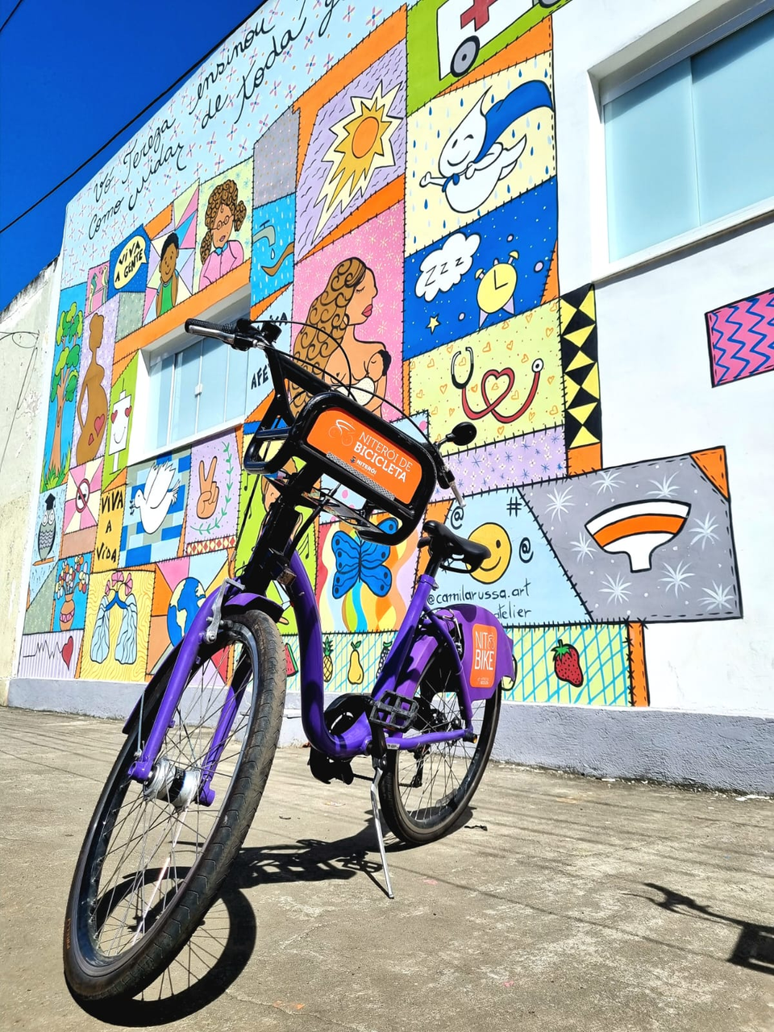
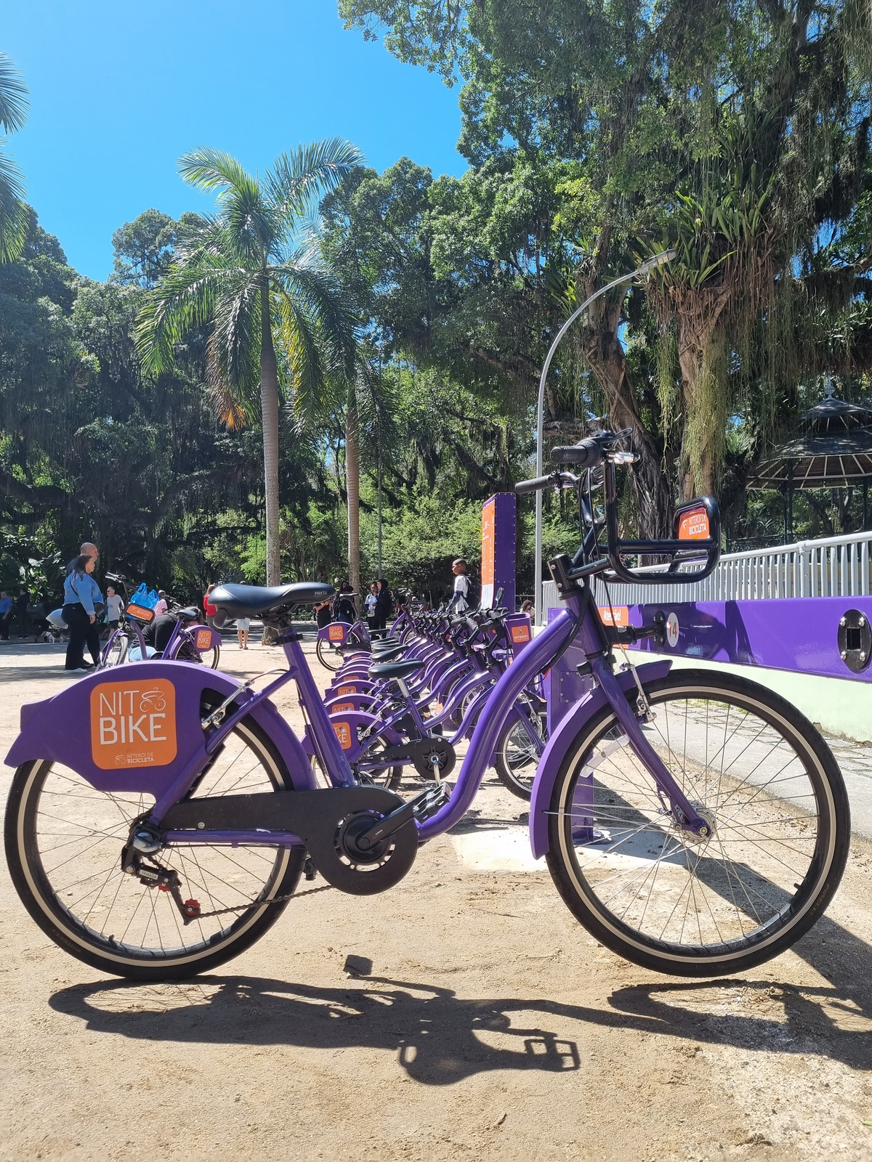
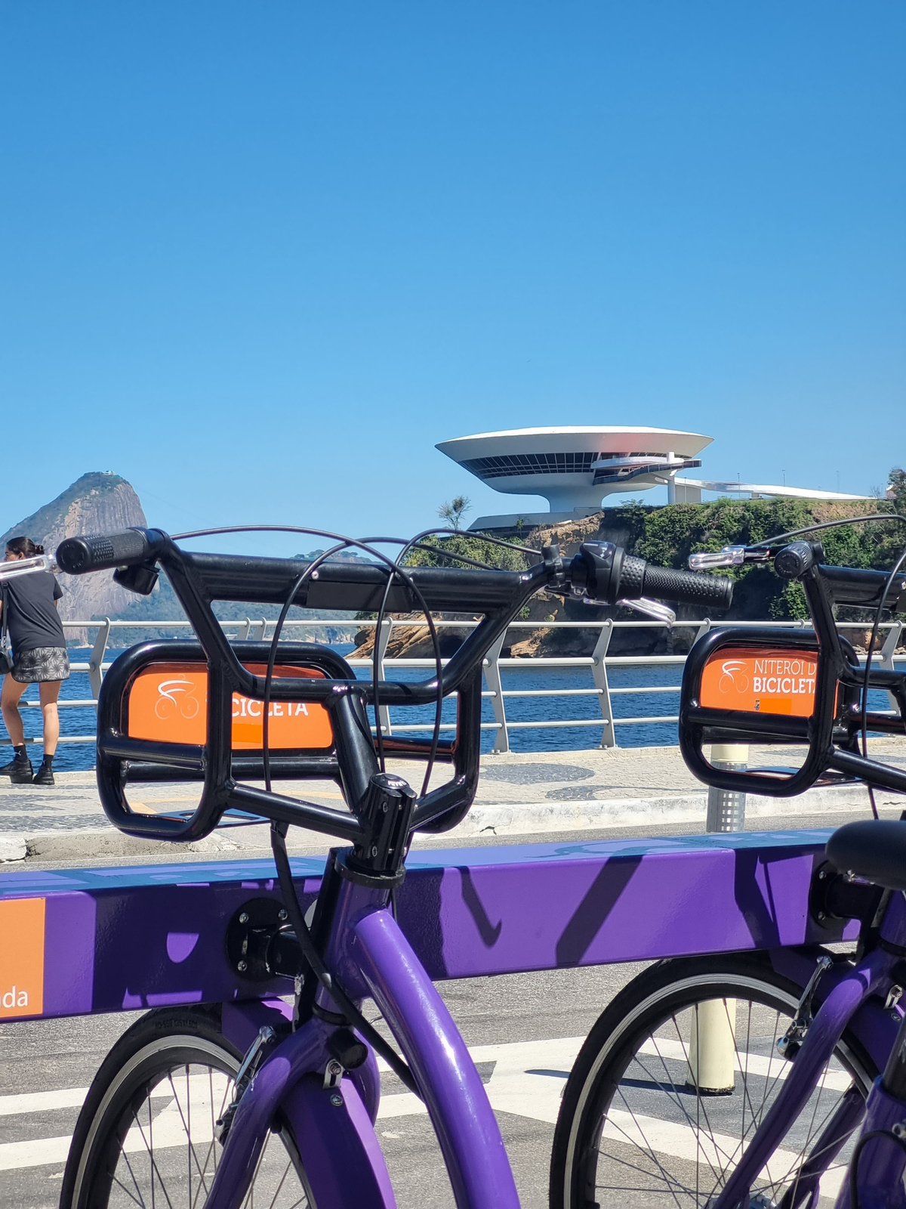
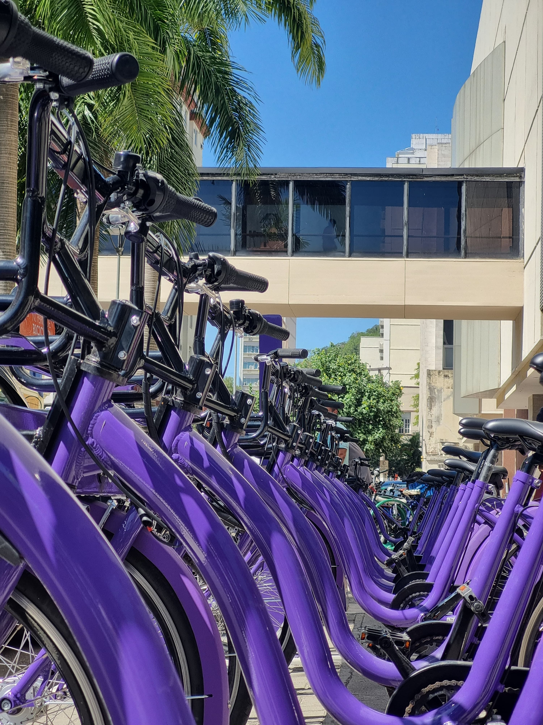
65
+
+
6.200
daily trips
thousand
+383.000
total trips
subscribers
144+
tons
of CO2
saved

Slide 4
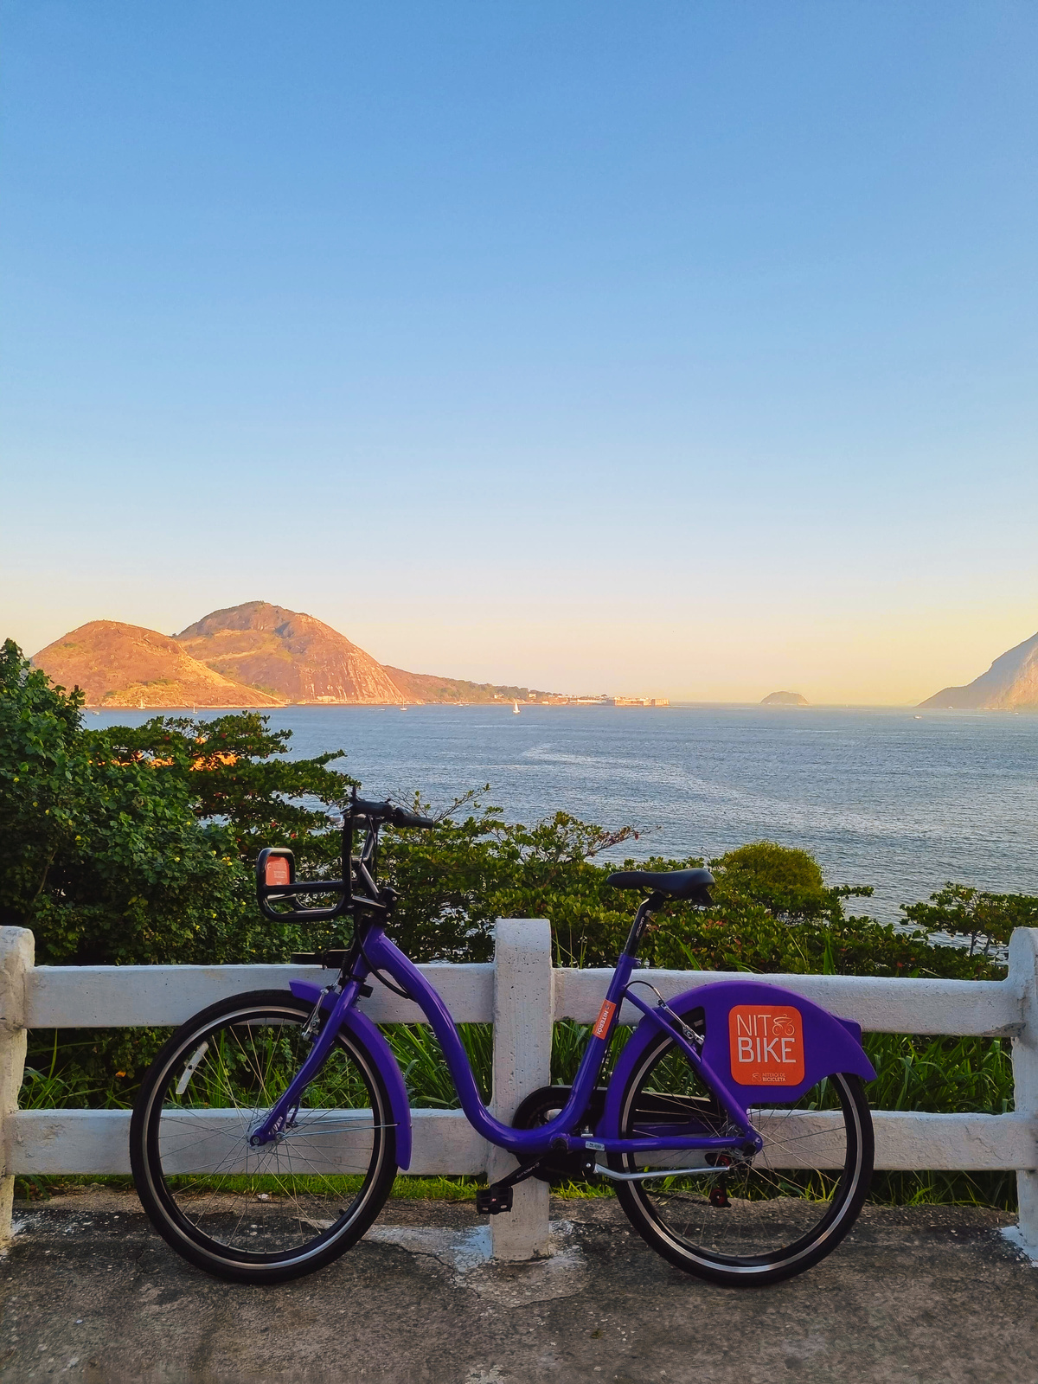
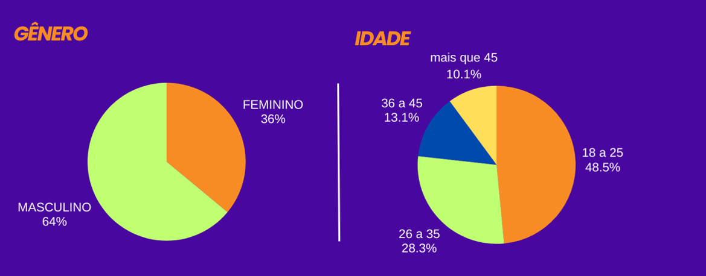
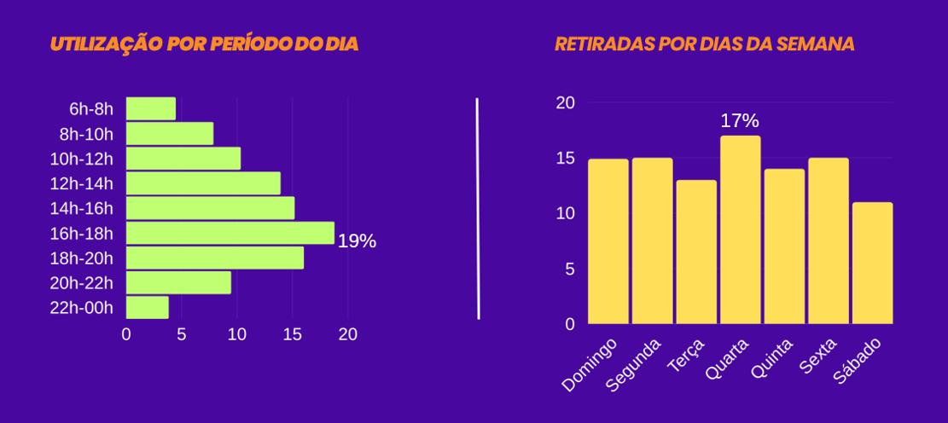

Slide 5
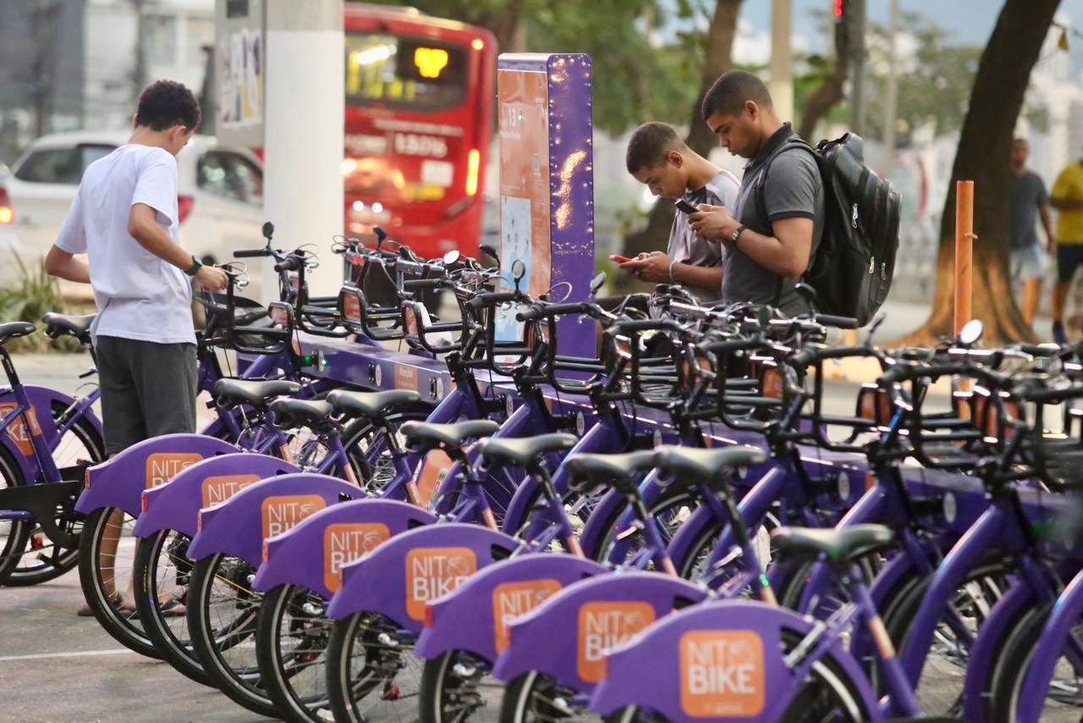


JOÃO PEDRO G. BOECHAT DE OLIVEIRA
DIRECTOR OF CYCLING INFRASTRUCTURE
Thank you for your time! For further information, feel free to contact
joaopedro.niteroidebicicleta@gmail.com

