Slide 1
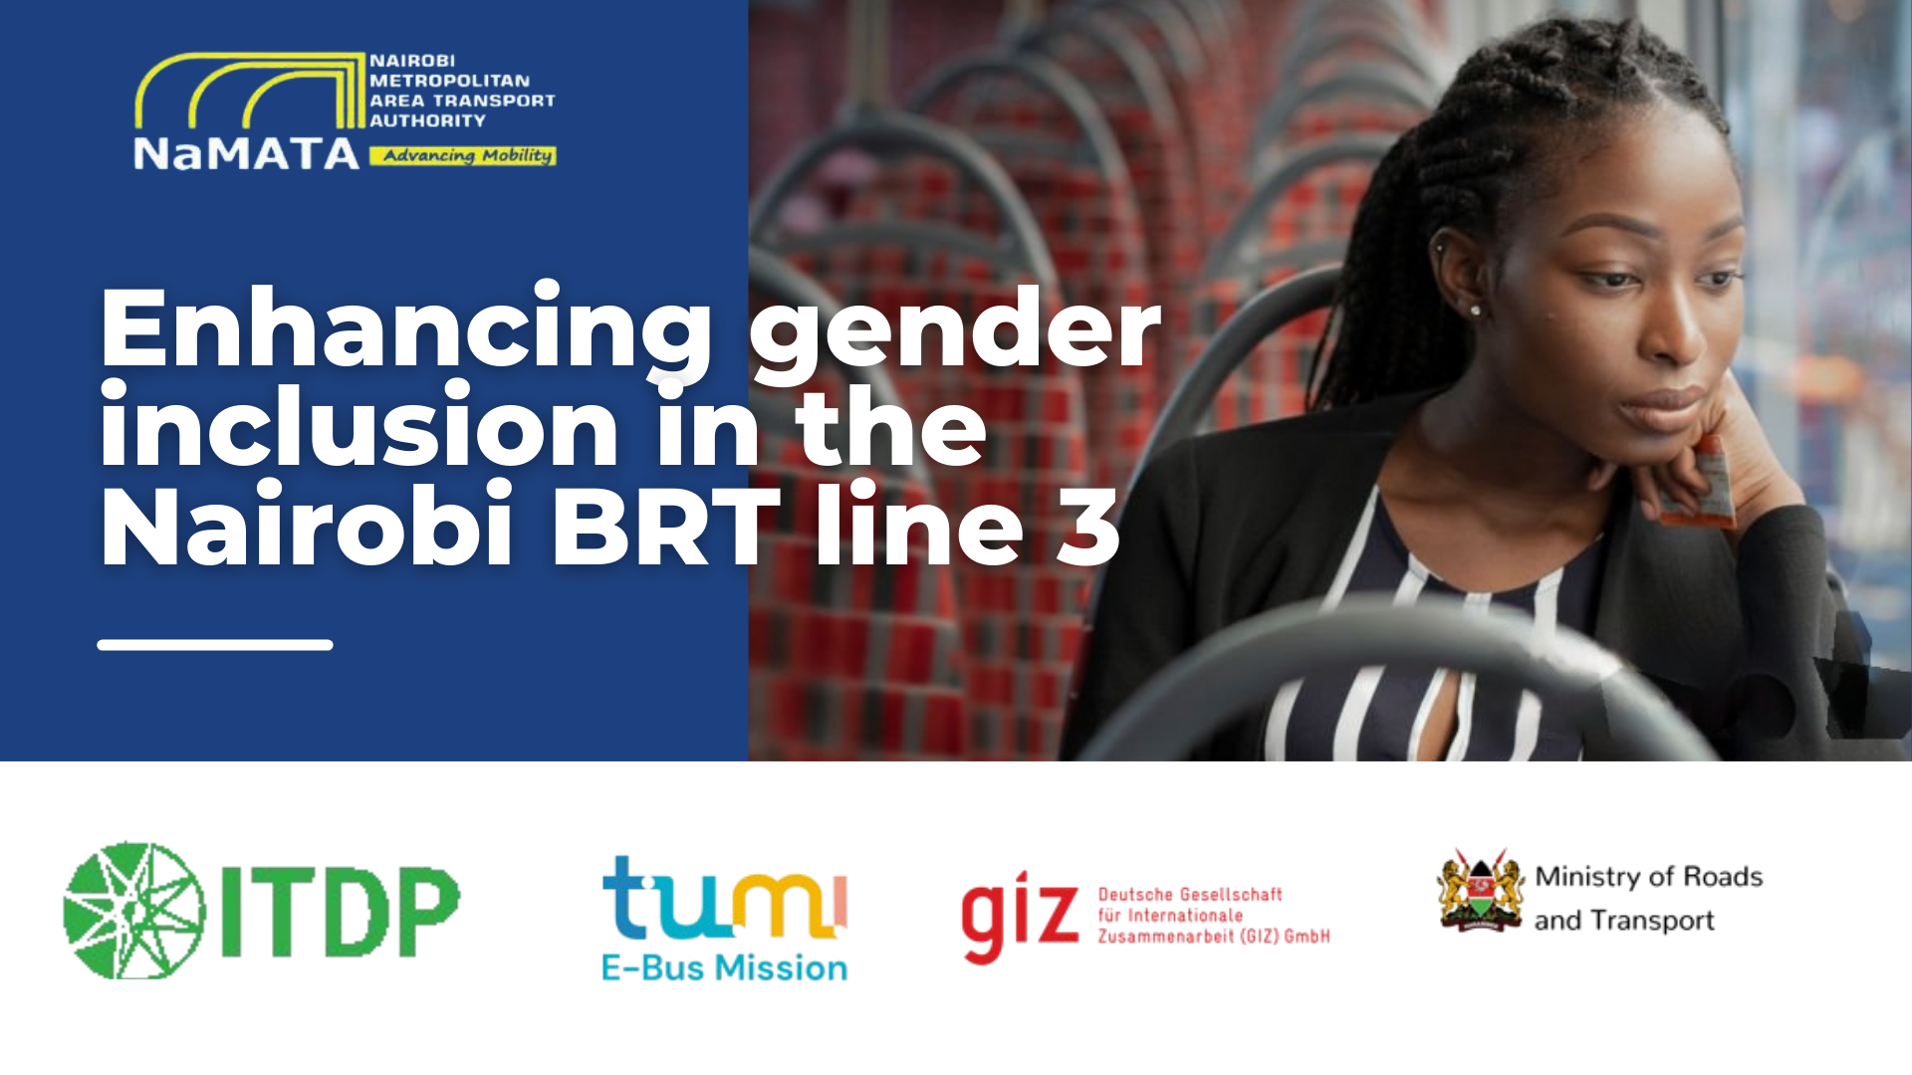

Slide 2






Transformative Urban Mobility Initiative - TUMI Phase II Electric Bus Mission

Slide 3

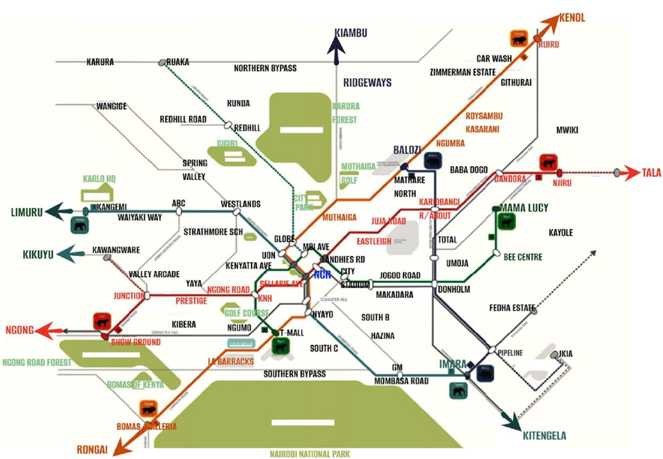




Nairobi BRT Network
Line 1: Preliminary designs completed
Line 2: Construction ongoing
Line 3: Detailed designs completed
Line 4: Detailed designs ongoing
Line 5: Detailed designs completed

Slide 4
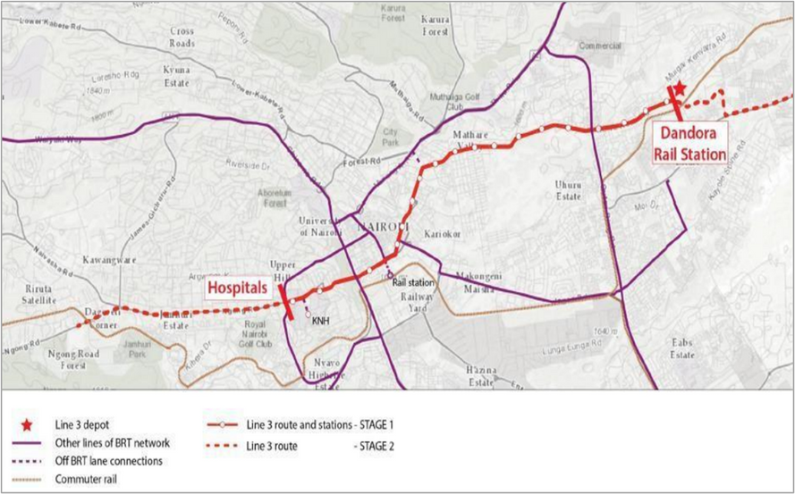


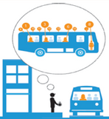


Core BRT Line 3 - Situational Survey
Physical assessment of existing transport facilities
Focus Group Discussions
On- and off- Board Gender disaggregated Occupancy Counts
Operator interviews
Interviews on travel patterns and preferences
  Length 12.5 km Hospitals - Dandora
  300,000 boardings per day
  Designed for 120- 18m buses
  Intent to finance EIB, EU, AFD

Slide 5
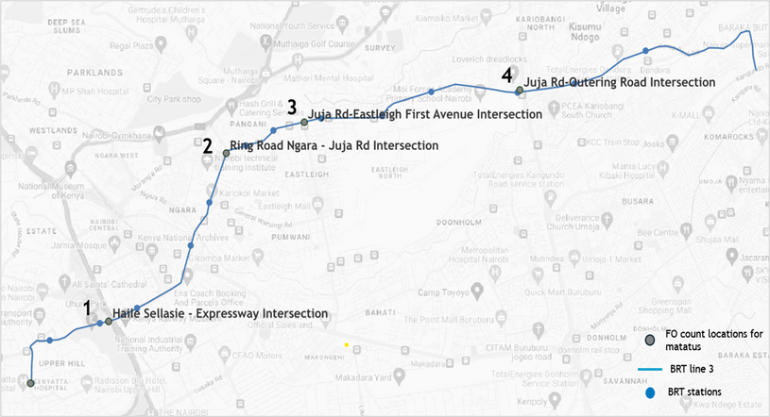
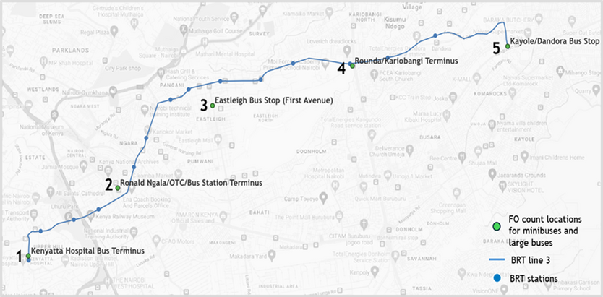
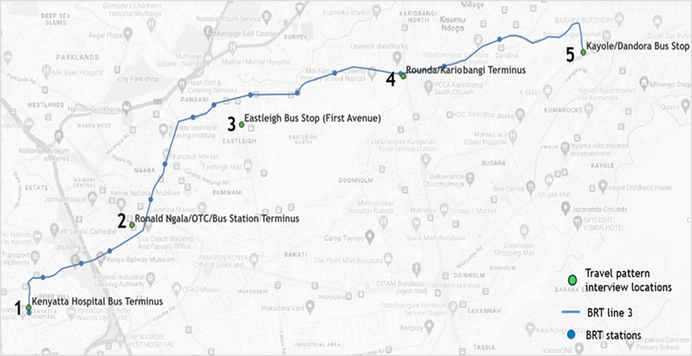
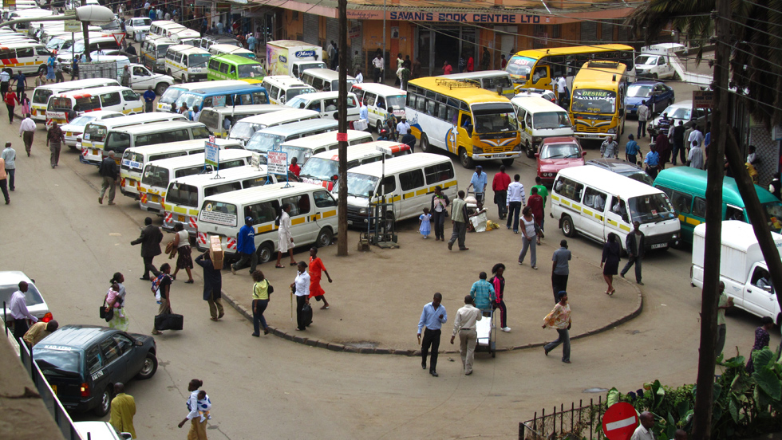
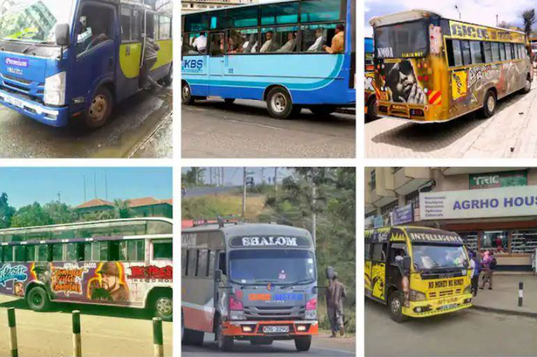
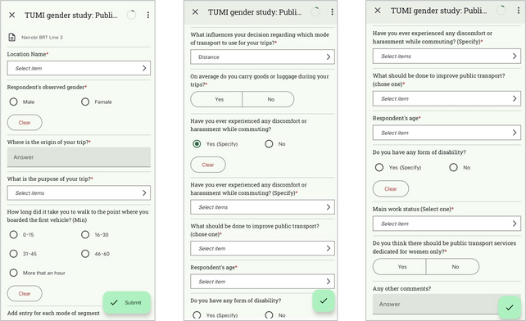
Travel patterns and preferences
Frequency Occupancy & Interviews Locations
Matatus
Midi and large buses
Travel patterns and preferences

Slide 6
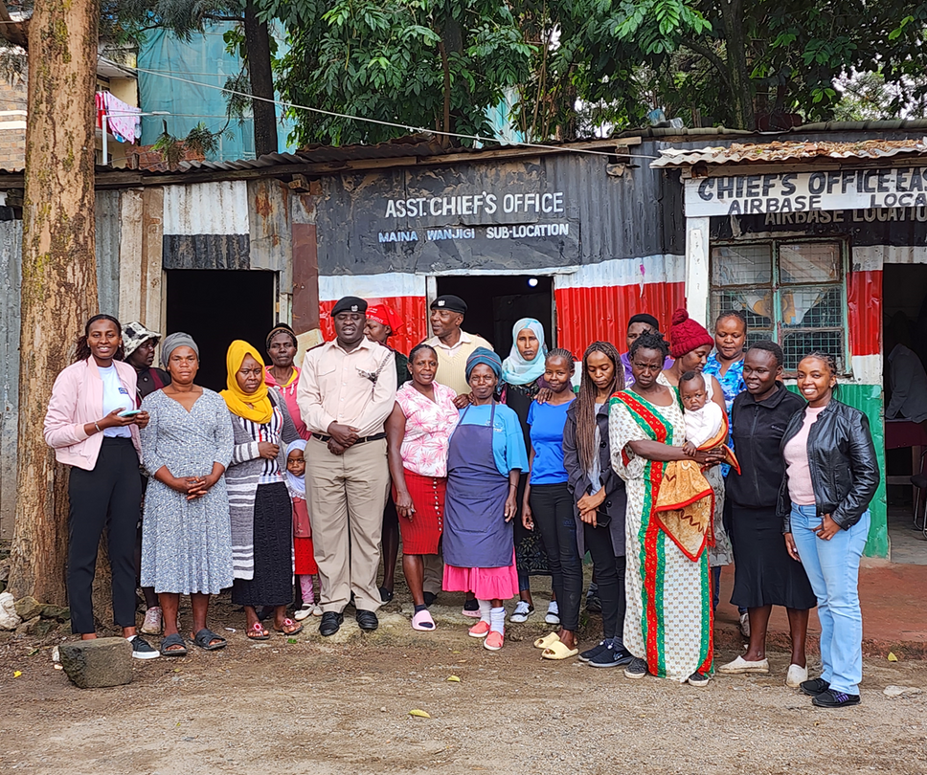
SURVEY | LOCATION | SAMPLE SIZE
On and off board gender disaggregated occupancy counts | 10 locations | Observed matatus = 6,474
Interviews on travel patterns and preferences | 5 locations | Female = 857 Male = 816 Total = 1,673
Focus group | 4 locations | 60 pax (15 per location)
Physical assessment of existing transport facilities | 18 feeder roads | Approx. 50 km covered
Operator Interviews | Line 3 terminals and stops | Female Operators: Drivers - 5 Nos, Conductors - 15 Nos Sacco Heads: 15 Saccos (Male and Female)
Sample Size Achieved

Slide 7
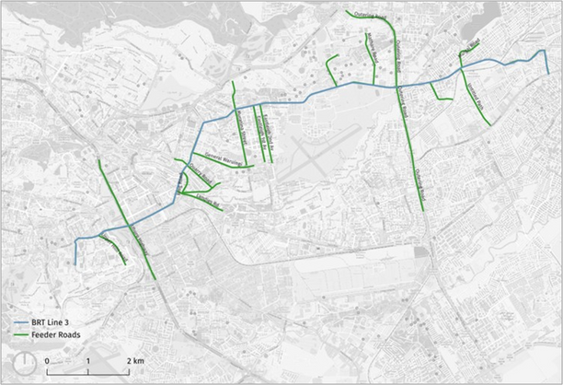
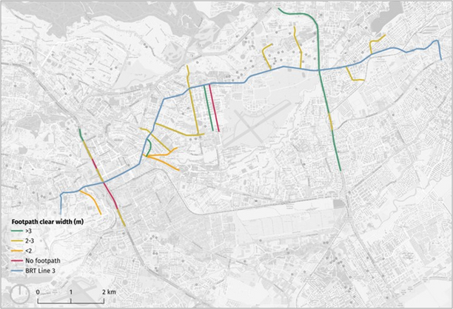
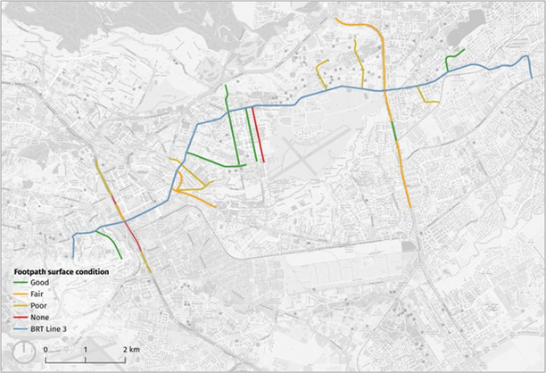
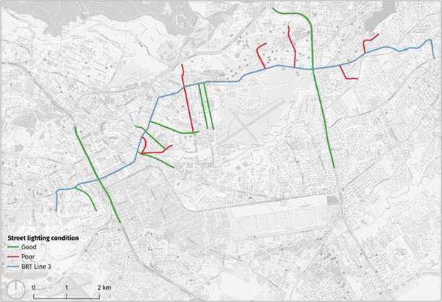
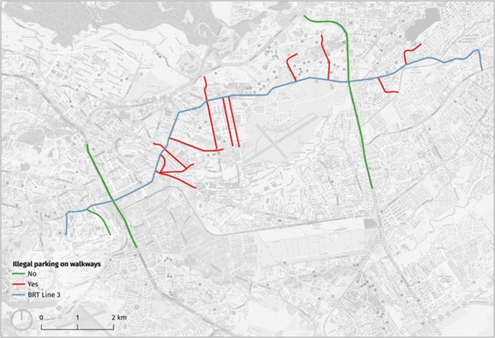
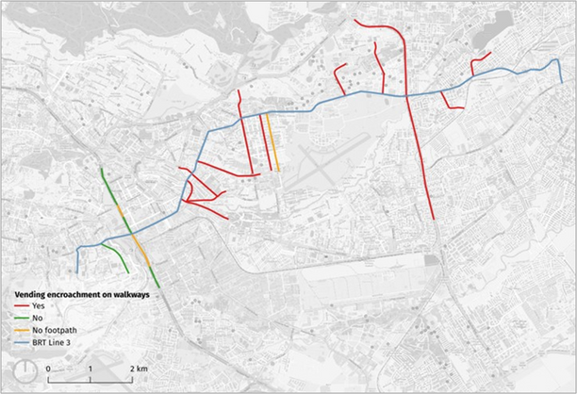
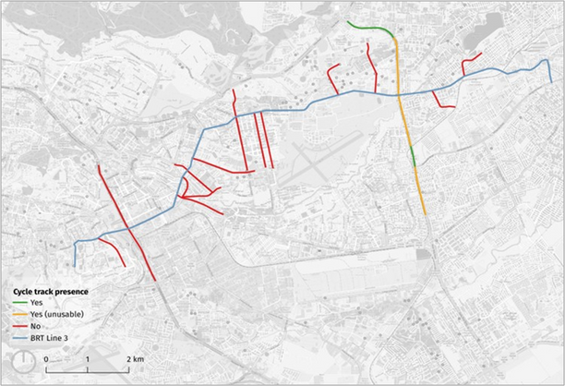
Infrastructure Condition on CBRT Line 3 Corridor
CBRTL3 + Feeder roads
Footpaths with clear width
Footpaths Surface condition
Street light presence
Presence of illegal parking
Vending Encroachment
Cycle track presence

Slide 8
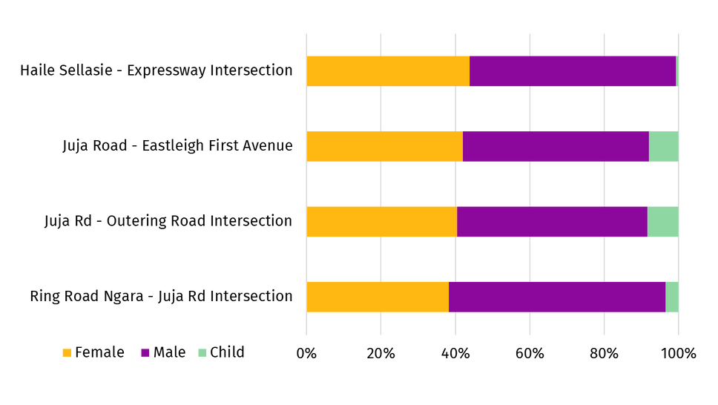
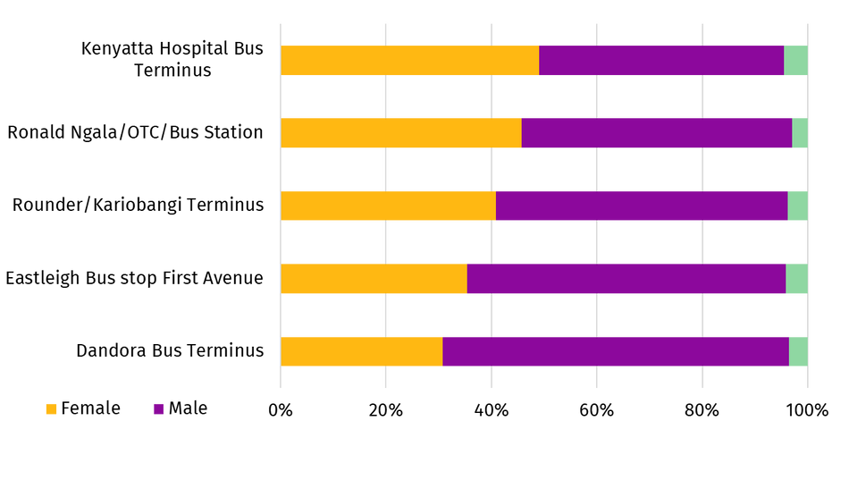
Gender Composition of Passengers
Matatus
Midi and large buses

Slide 9
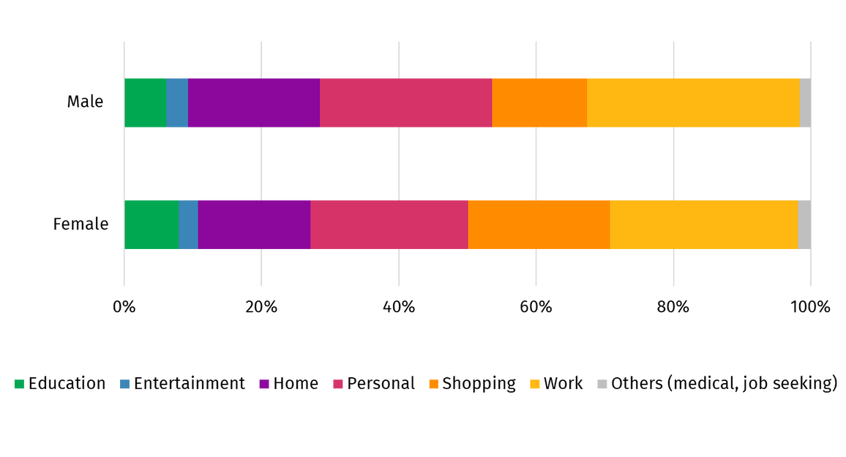
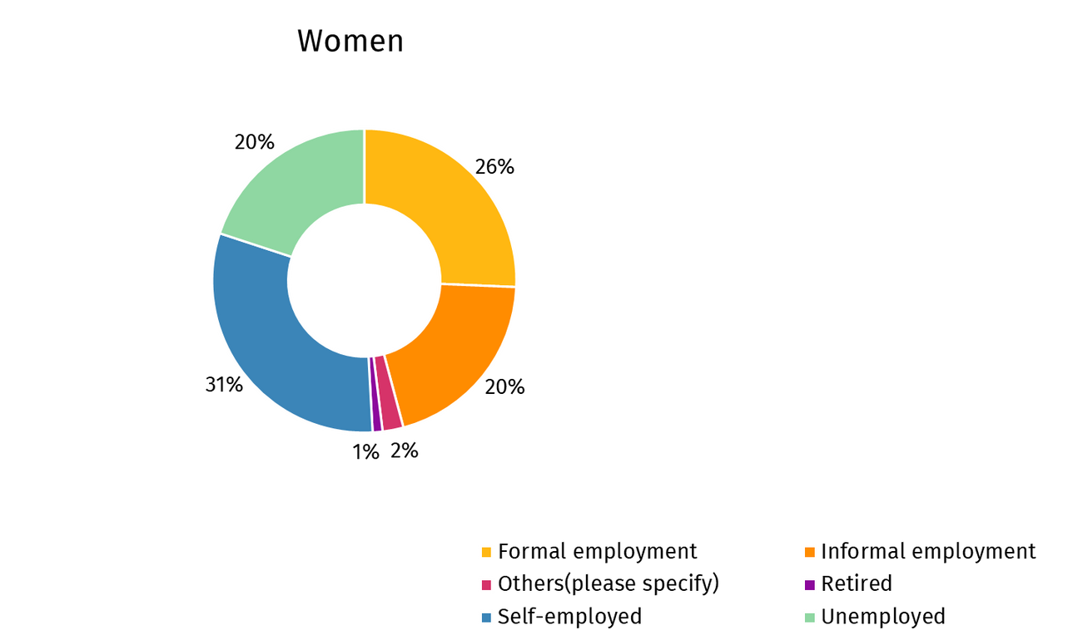
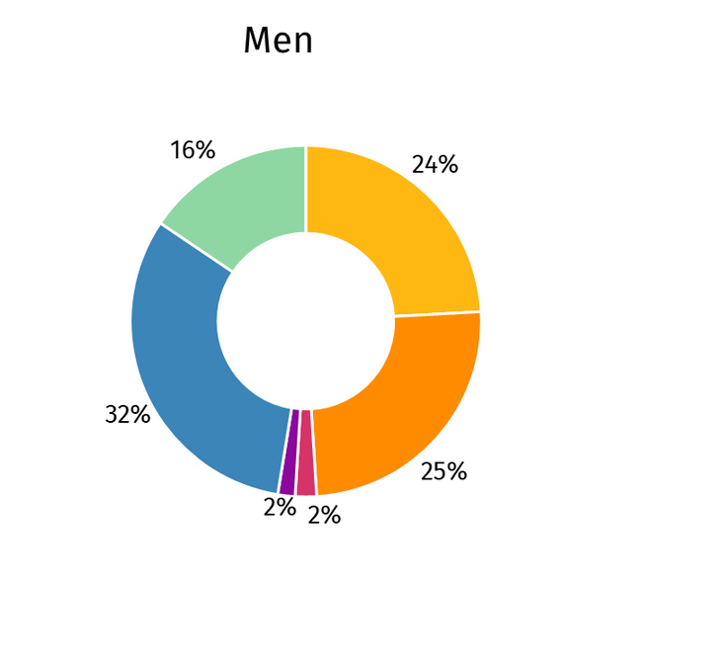
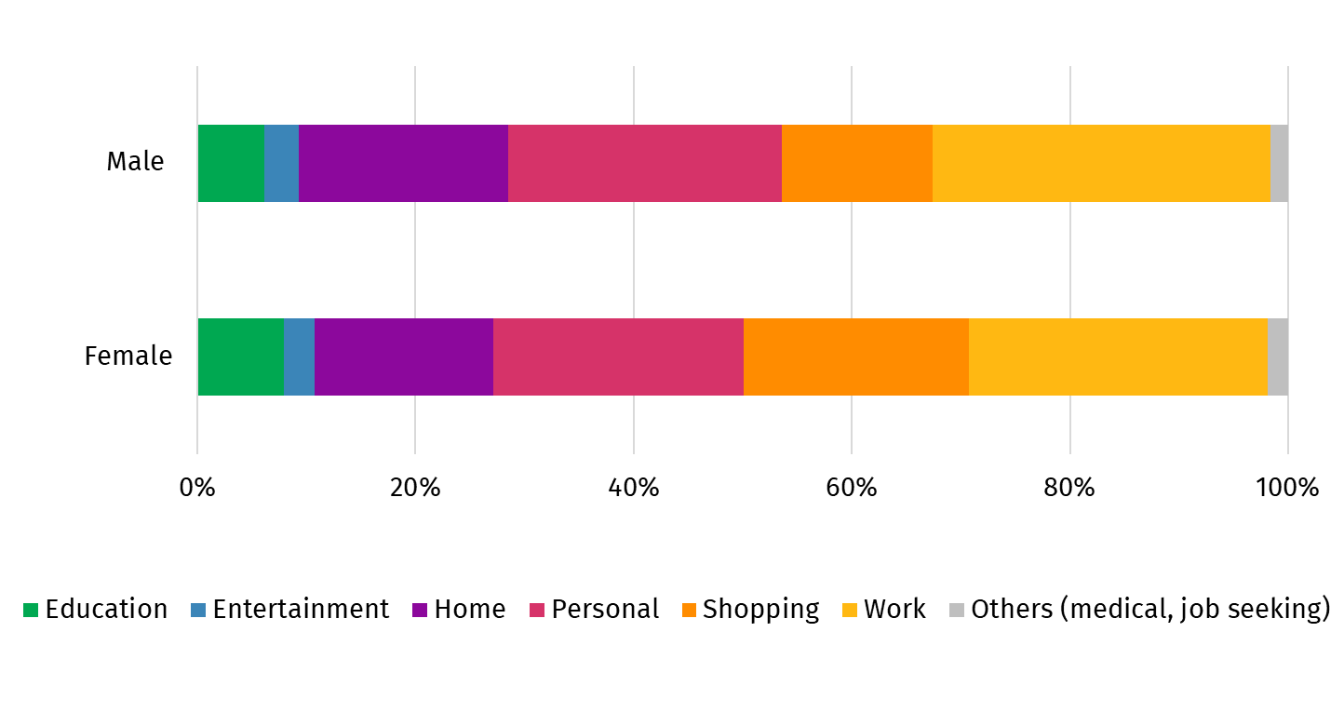
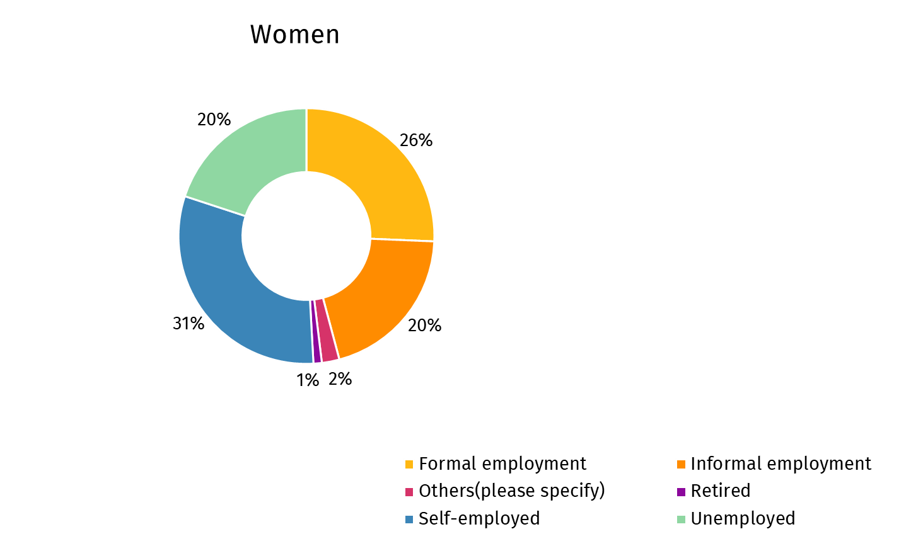
Trip Purpose by Gender
Work Status of Respondents

Slide 10
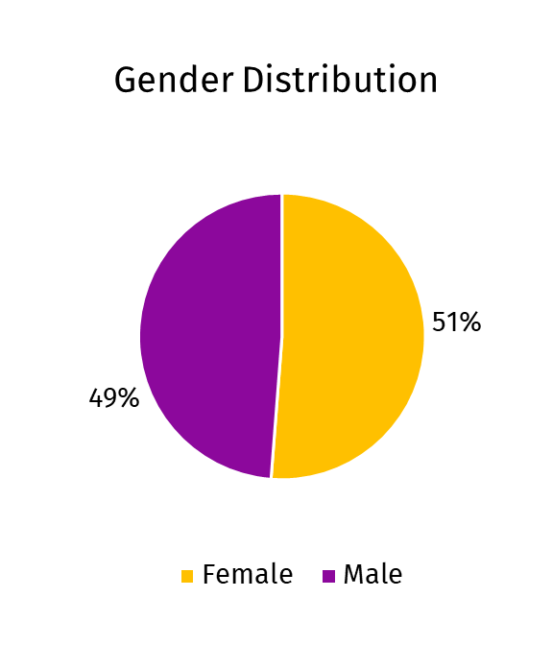
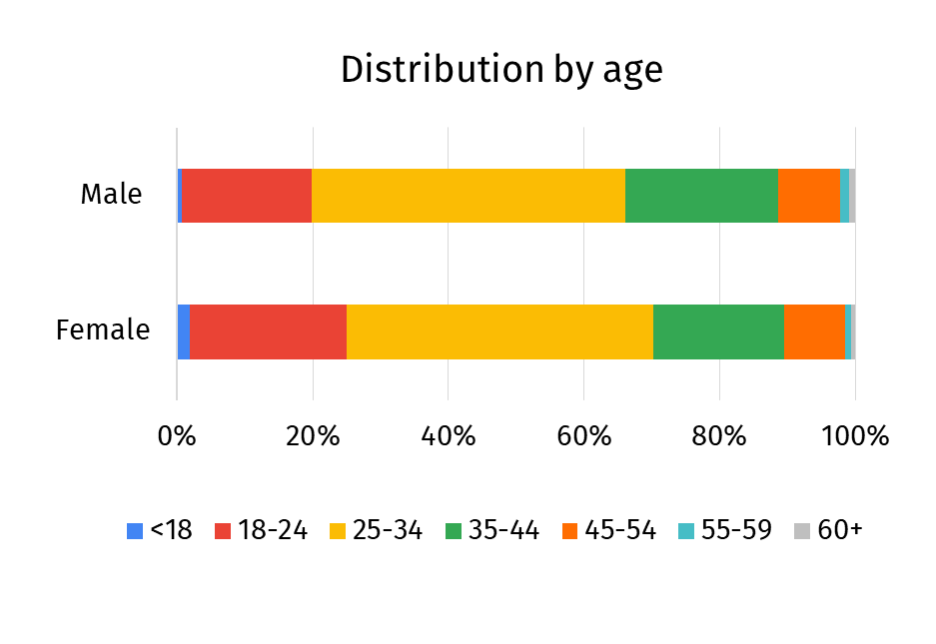
Gender Distribution and Age of Respondents

Slide 11
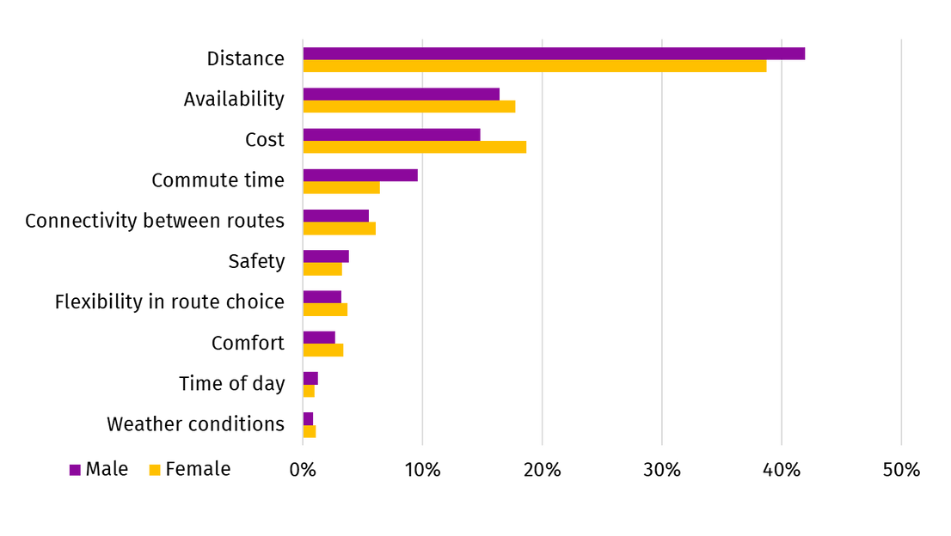
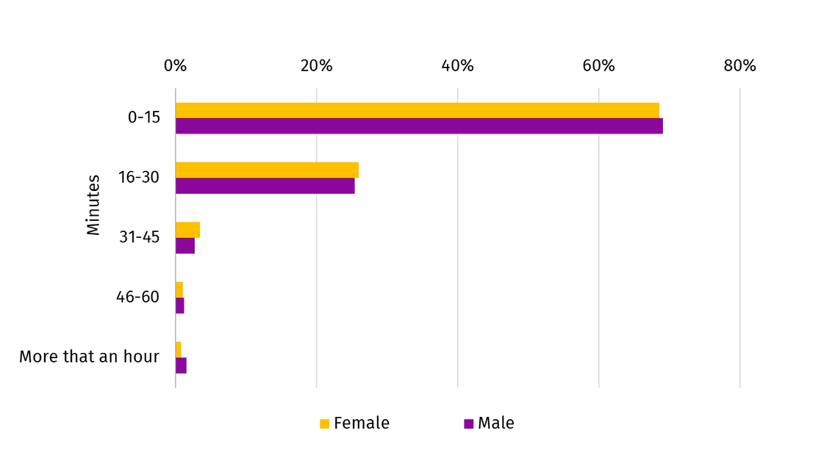
Factors Influencing Mode Choice
Walk Time to Public Transport

Slide 12
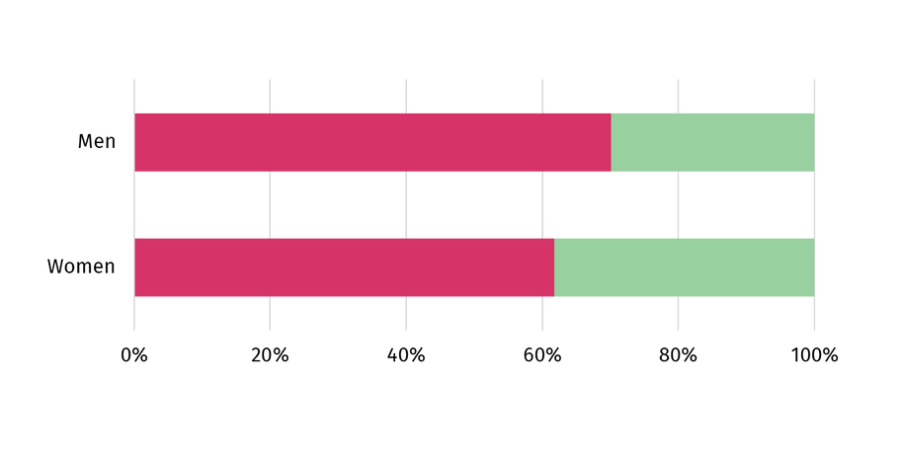
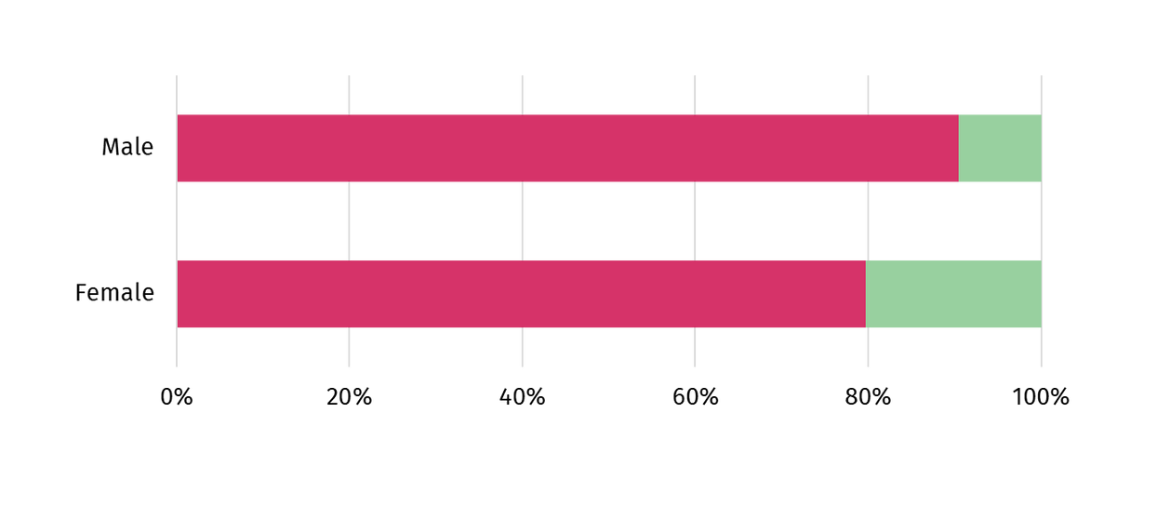
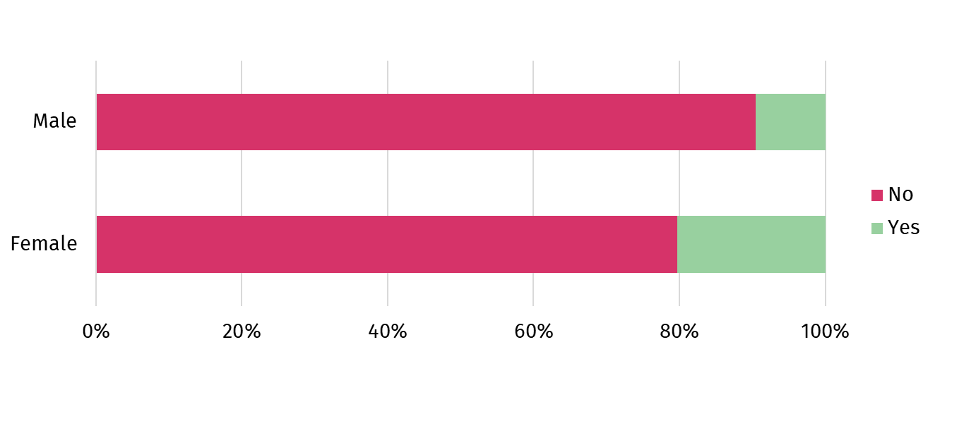
Carrying of Goods and Luggage During Trips
Dedicated Sections for Women in Public Transport

Slide 13
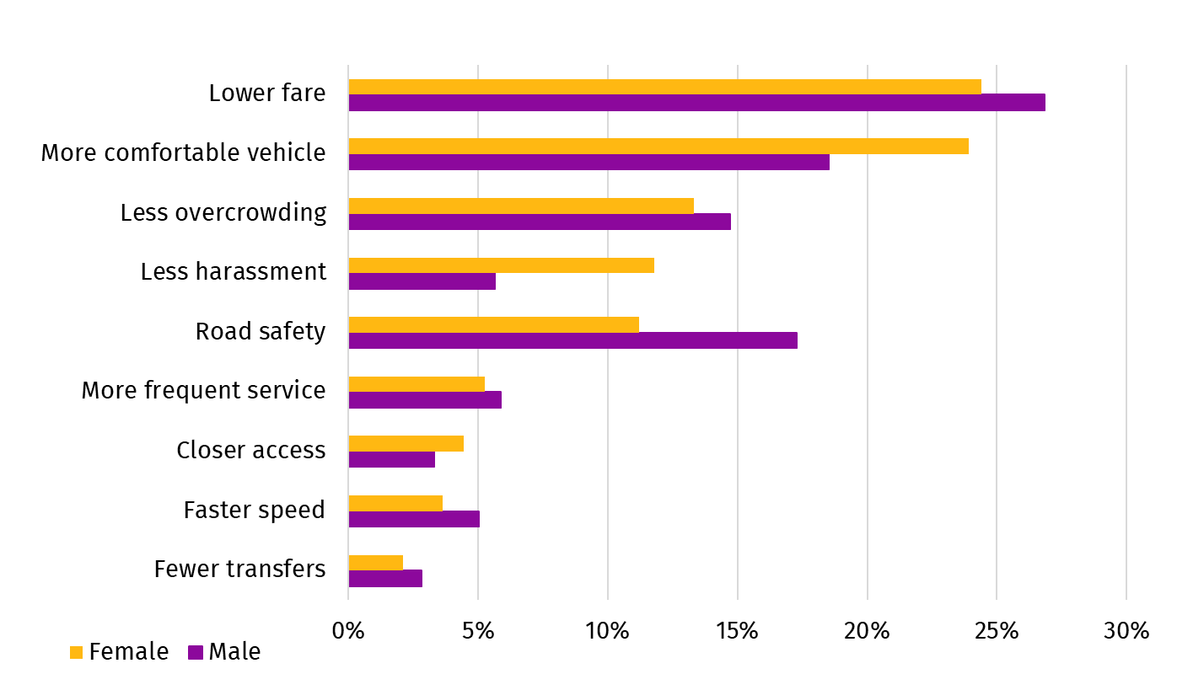
Public Transport Interventions

Slide 14
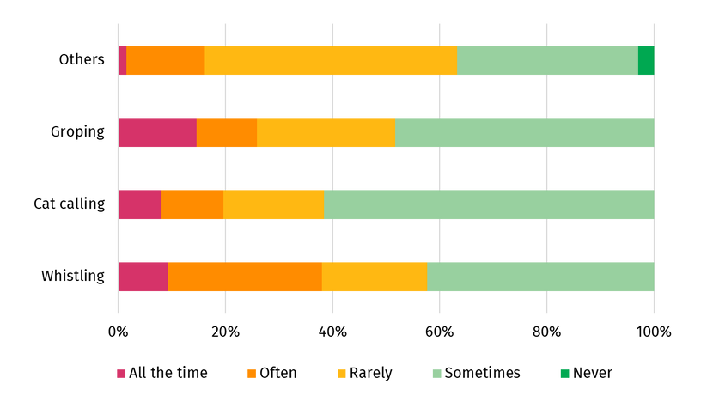
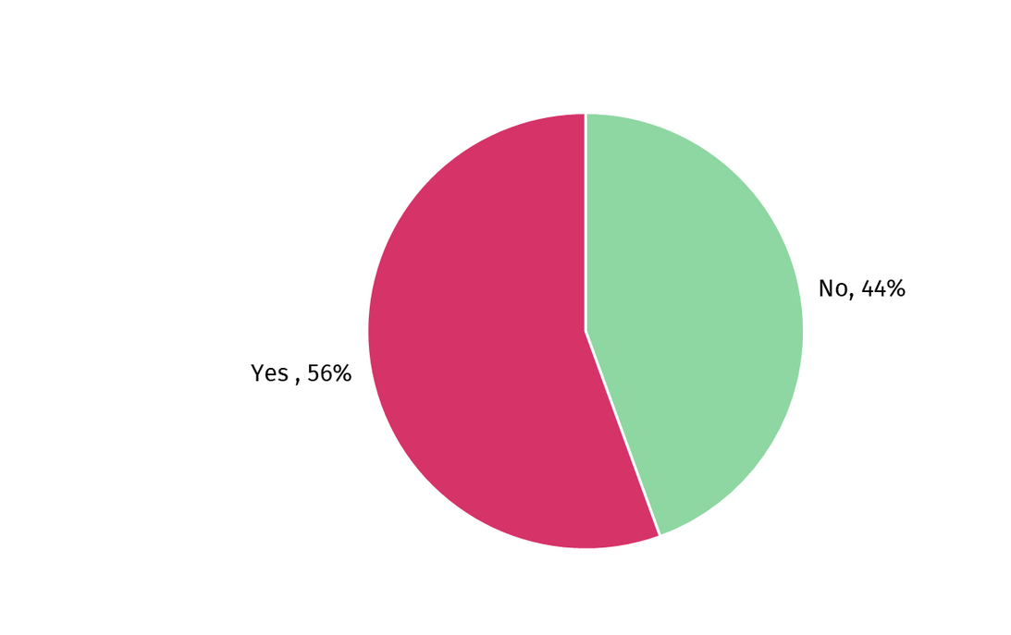
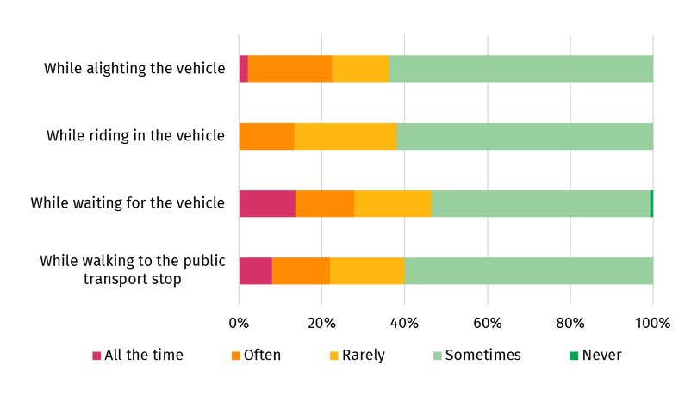
Personal Security - Harassment of Female Passengers
Frequency of Harassment
Harassment of Female Passengers
Places of Harassment

Slide 15
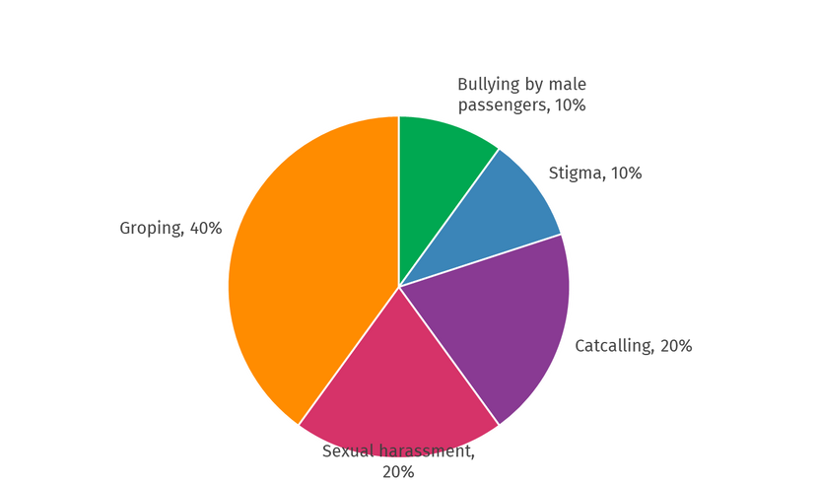
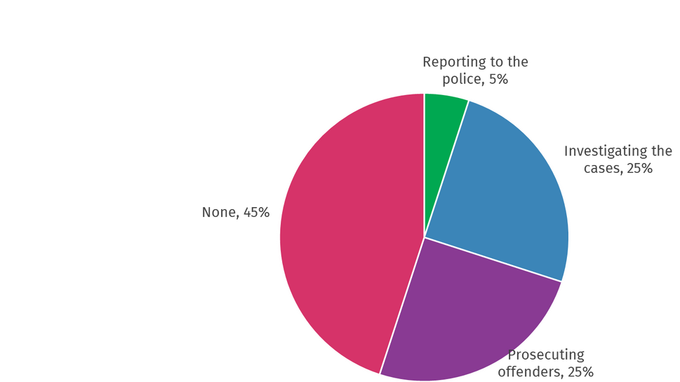
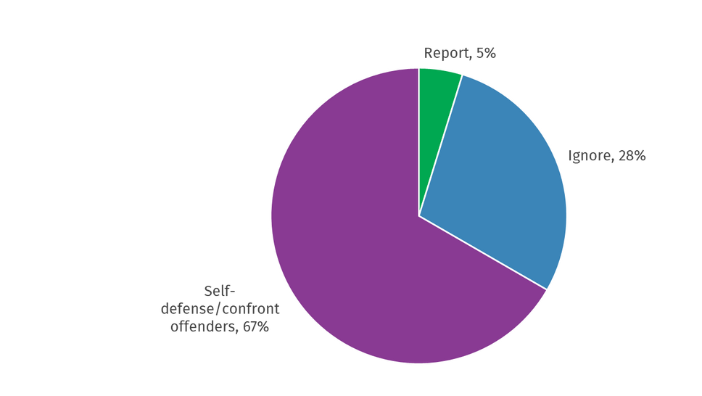
Personal Security - Harassment of Female Operators
Forms of Harassment
Action Taken by Sacco
Action Taken

Slide 16
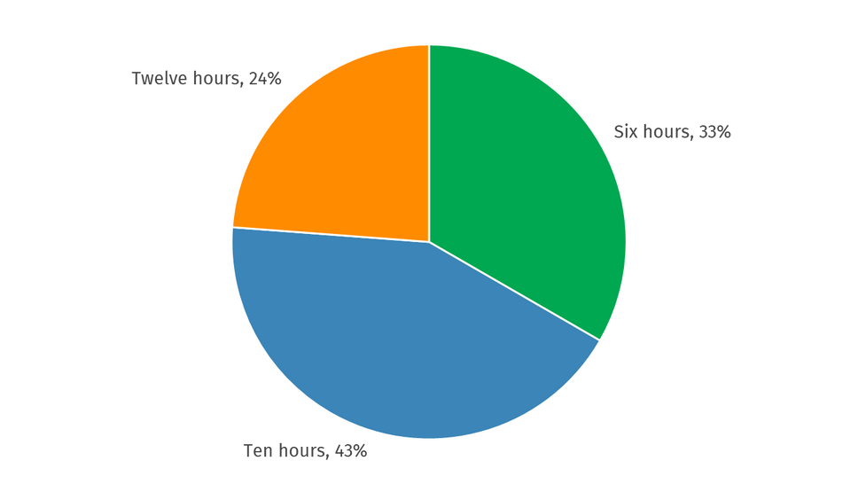
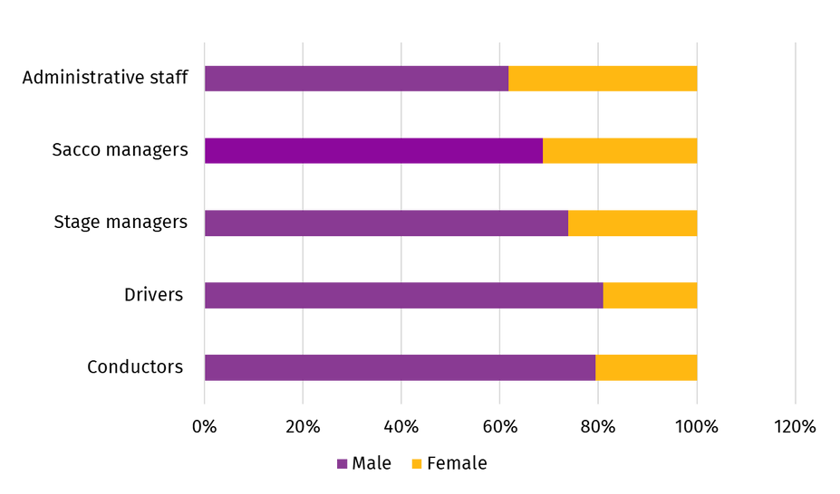
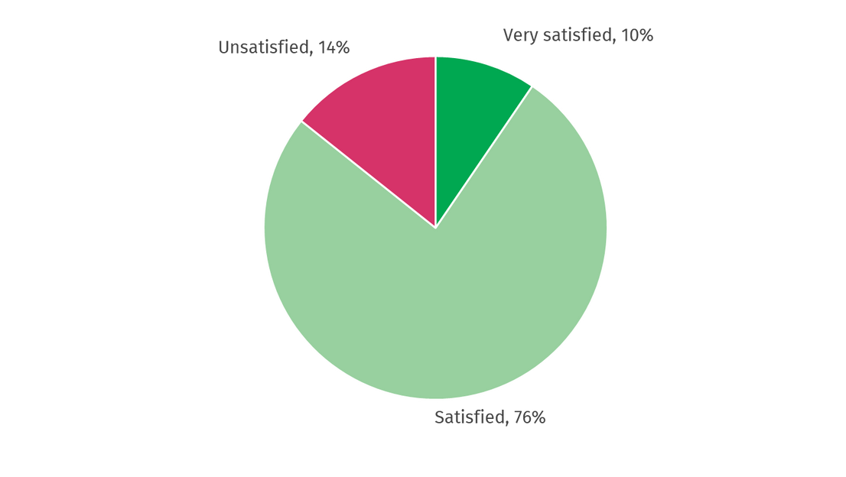
Labour Force
Operator Working Hours
Job Satisfaction in Public Transport Industry
Staff Composition Disaggregated by Gender

Slide 17
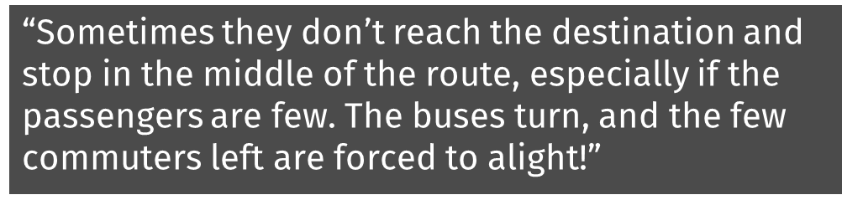
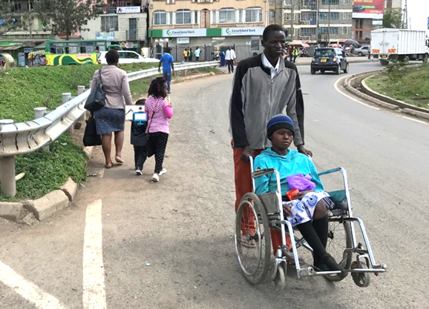
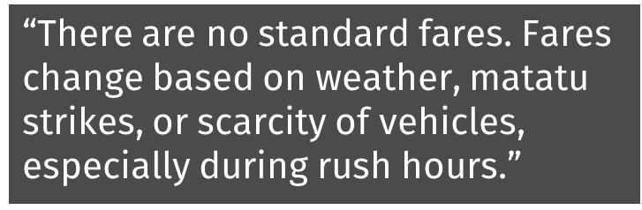
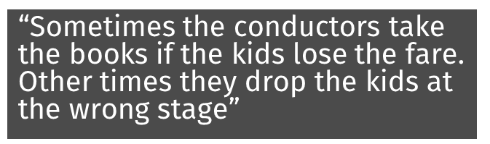
Challenges of VRU’s in PT
  Lack of universal accessibility for PWDs
  Poor first and last mile connectivity
  Overcrowding at terminals prompting PWDs to travel early morning and late evening

Slide 18

Opportunities for Women with Introduction of BRT
  Frequent Services will shorten trip time
  Universally accessible infrastructure making boarding and alighting easier
  Direct Services for BRT would improve las mile accessibility
  Improved first and last mile connectivity through pedestrian walkways
  Improved working conditions lead to increased employment opportunities for women in the sector

Slide 19





Let's Connect
www.namata.go.ke
Abigail Muigai
A transport system designed for the most vulnerable members of the community benefits everyone
abigailmuigai@gmail.com

