Slide 1
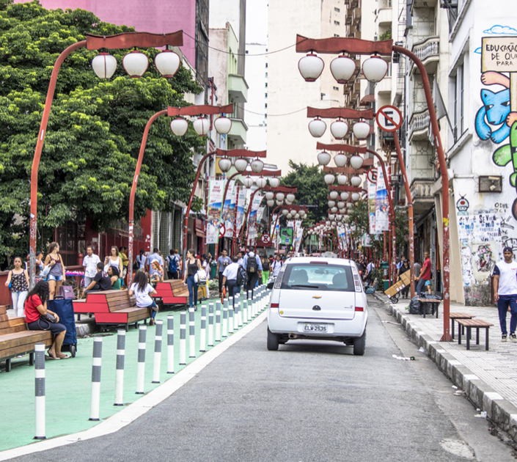
Success Factors for On-street Parking Management in Cities
Dana Yanocha, ITDP
20 September, 2022

Slide 2
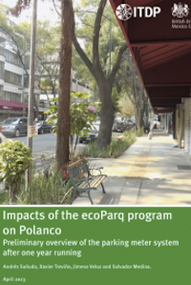
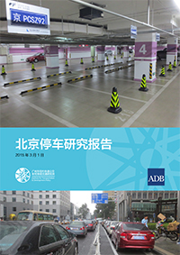
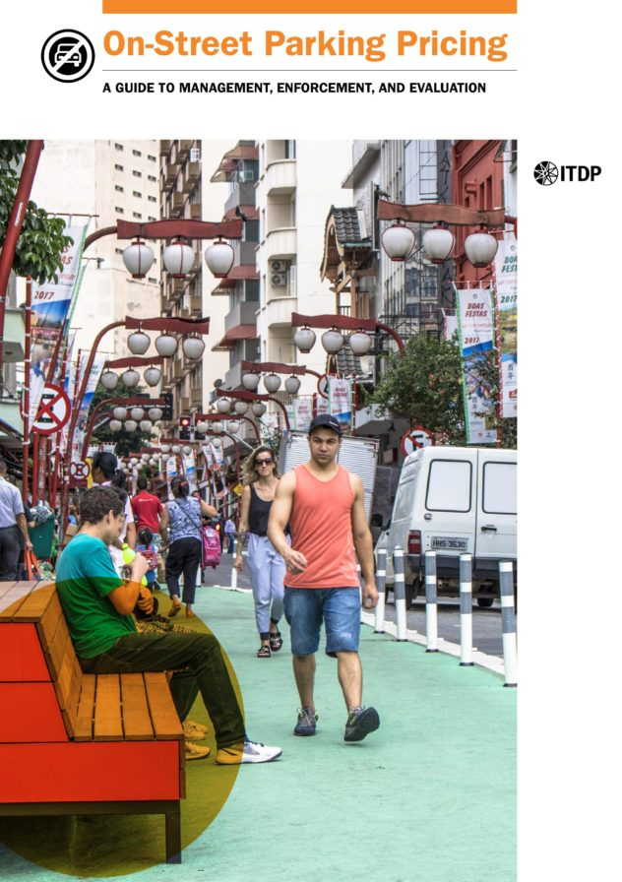
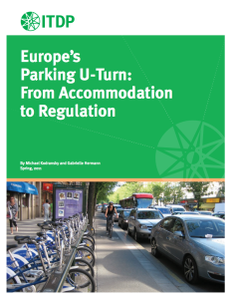
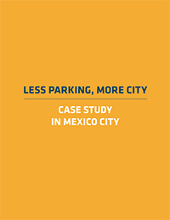
ITDP + Parking
Linking parking reform to sustainable mobility, and working with cities to reallocate parking space to more efficient, equitable uses
2011
2013
2014
2015
2021
2021

Slide 3
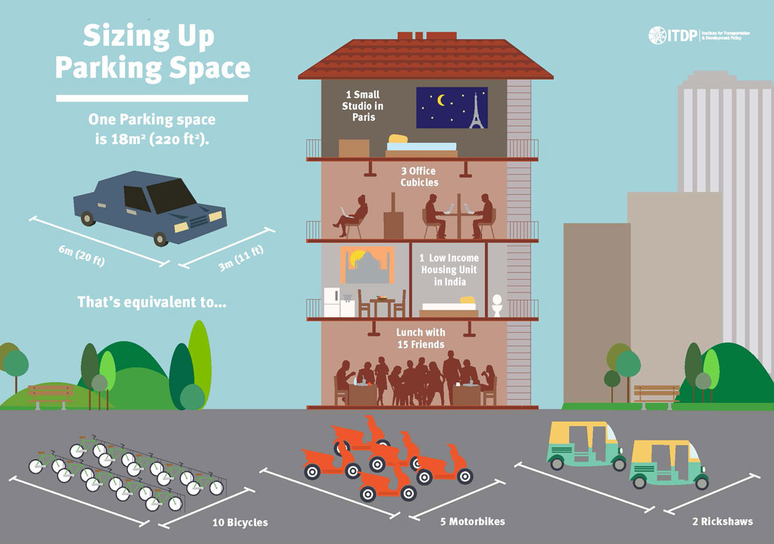
Context for on-street parking reform
Notes:
Many cities and countries have been experiencing rapid motorization in recent decades
More driving means more air and noise pollution, traffic-related injuries and deaths, and inequity.
More driving means more demand for storing vehicles in precious public space
Managing parking is a powerful tool to ensure more equitable use of public space
Equitable use of public space means that high-volume, low-emitting, affordable modes get priority - transit, cycling, walking
The other important contextual element here is how the COVID-19 pandemic highlighted the need for more and better spaces for walking and cycling, and gathering outdoors
Saw what was possible when space is reallocated in ways that work for more people: outdoor dining spaces, expanded sidewalks, temporary cycle lanes.
Effective parking management can help maintain and scale these interventions.
Ultimately, if you come away from this webinar with one idea, its that more efficient parking management enables cities to prioritize valuable urban space for people instead of cars, resulting in more equitable, healthy communities.

Slide 4
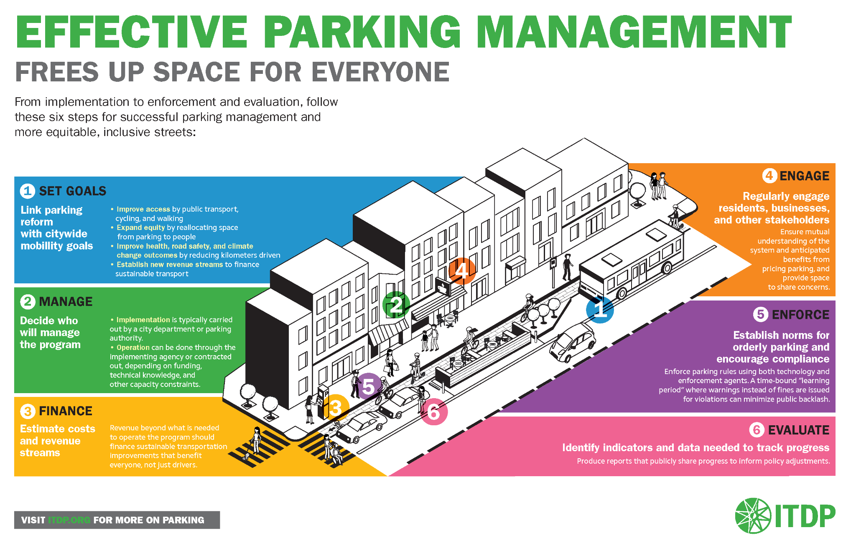
Notes:
Today we’ll be doing a deep dive into what we call effective parking management
There’s a lot in the guide that we don't have time to talk about, so I encourage you to consult the guide if you want to learn more about any of these topics
The idea for this presentation is to give you a sense of what to think about if you’re looking to take up on-street parking reform but aren’t sure where to start

Slide 5
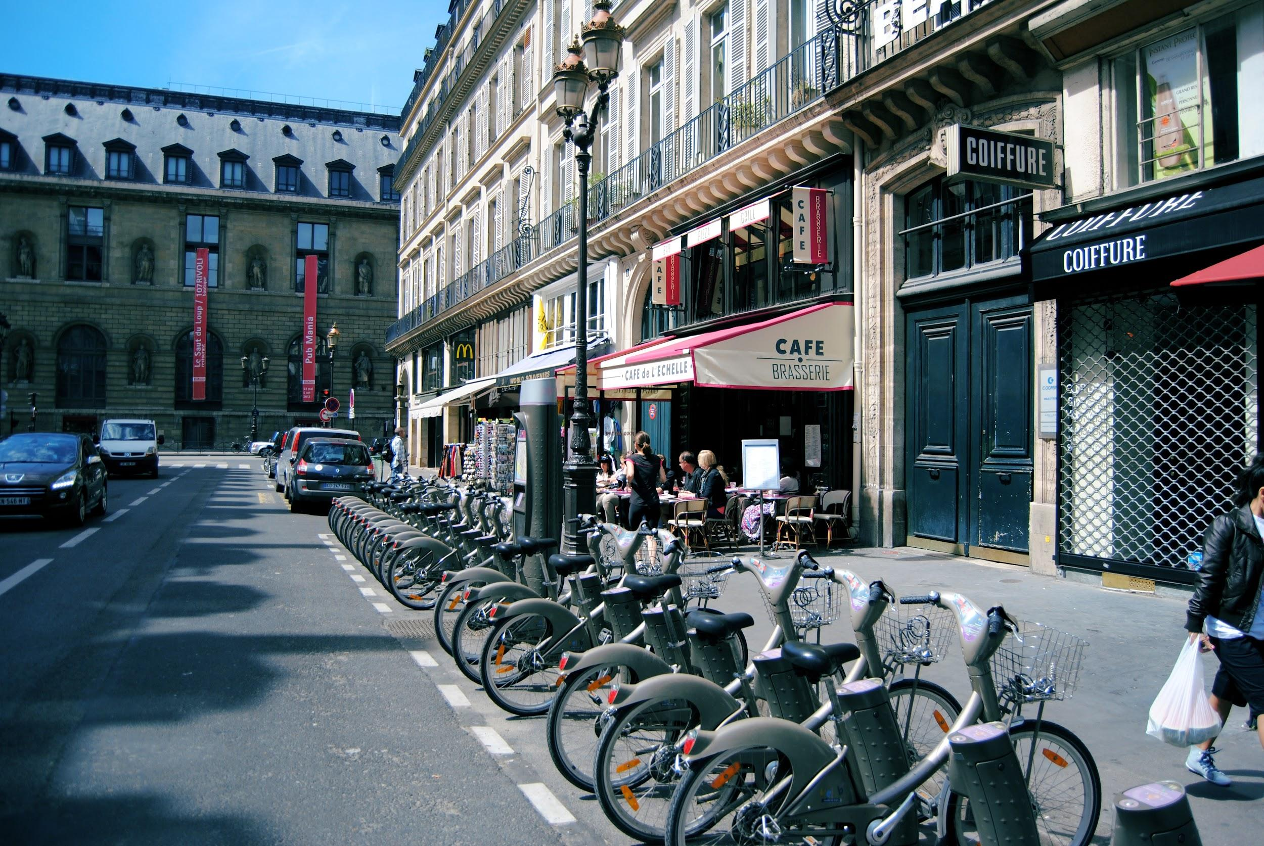
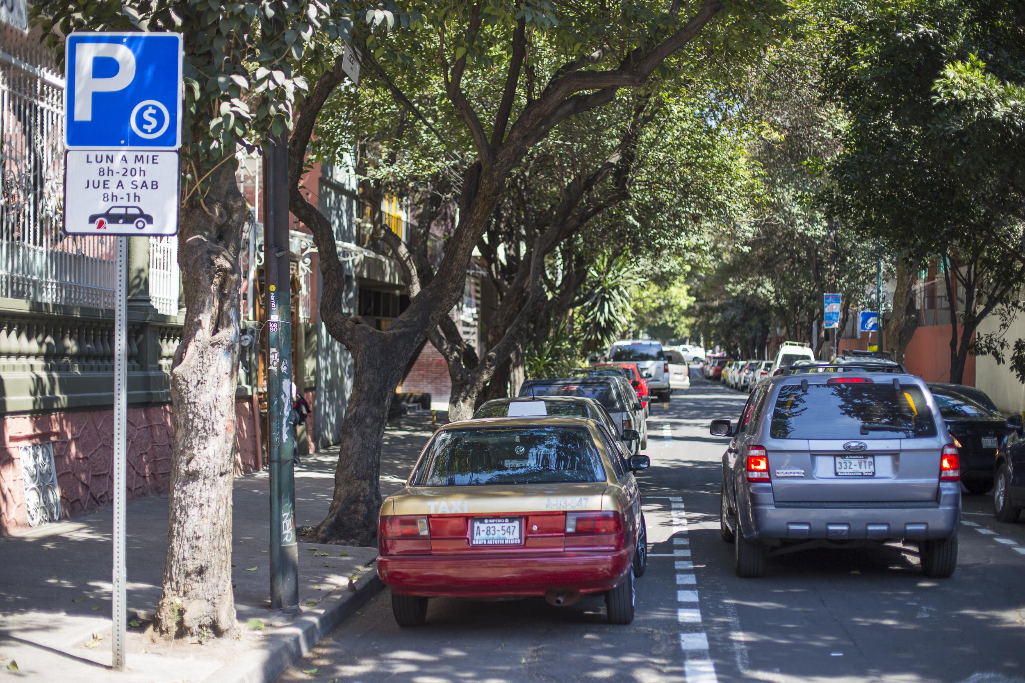
Paris: reduce air pollution
1
Set Goals
Mexico City: reduce congestion
Notes:
So a great place to start is aligning parking reforms with citywide goals.
Parking hasn’t always been viewed as a tool to achieve a more sustainable transportation system. Parking management and transportation planning has often happened separately and in some cases contradicts each other.
And there have been long-standing trends where local governments and businesses supply lots of space for roads and ample parking, and this has subsidized vehicle use and vehicle storage.
But there are good examples from cities that have identified parking reform as a way to take back space from cars.
Paris
been working to remove private cars from the city center specifically as a means of combating air pollution. Paris set a goal to remove 60,000 on-street spaces downtown and reallocate that space for public uses and for low emission and shared modes like public bikeshare stations; bicycle parking; and parking for carshare, electric, and hybrid vehicles
Mexico City wanted to reduce traffic congestion, and implemented parking meters in congested neighborhoods.
Parking meters successfully reduced cruising time, increased parking turnover, and reduced instances of double-parking, all of which had contributed to traffic congestion

Slide 6
2
Implementing agency
Manage
Operator
City department
Private operator
Contract
Concession
Notes:
Step 2 is choosing a structure for parking management - this means thinking about who will be responsible for designing and implementing vs. operating the parking program, what form that program operation will take, and how to develop contracts to ensure operators provide high quality services
This is a good time for cities to think about their capacity to manage operations and contracting
cities with limited capacity might prefer a single private operator which minimizes the number of contracts needed, and reduces administrative overhead and financial risk.
As capacity to manage parking grows, cities can reevaluate the operating structure and their ability to take on more financial risk or direct operations

Slide 7
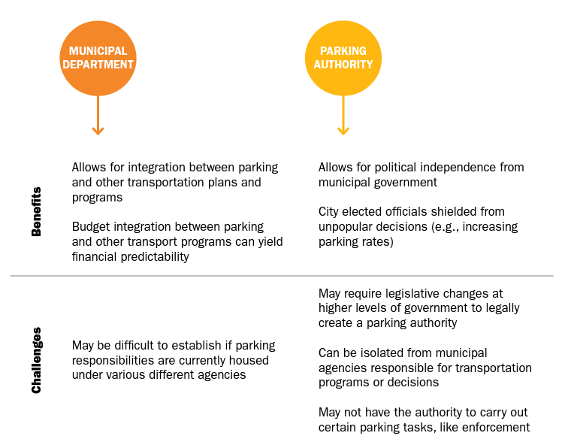
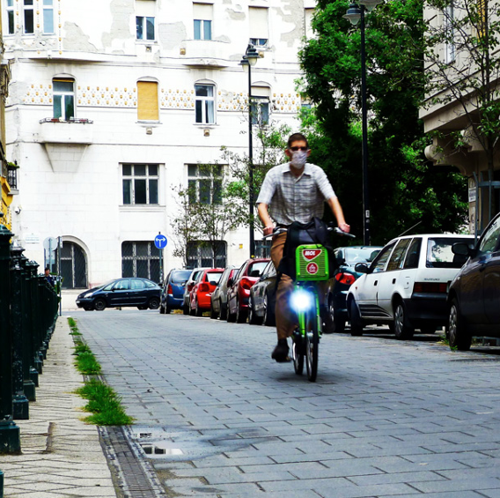
Implementing Agency
Notes:
On-street parking management should be centralized under one entity
Helps to ensure a comprehensive vision, accountability and helps to ensure connection and collaboration with other transport decision-making happening in the city.
A good example of a municipal department serving as the implementing agency is in Budapest
The city established the BKK Centre for Budapest Transport in 2010, which is a municipal entity that oversees urban transport planning and implementation
BKK took over responsibilities for parking management from a private operator, isolated from other urban transport departments.
BKK also enabled Budapest to develop an integrated transport budget, which helped to make funding for transport operations more predictable. Revenues from parking and other programs are directed to BKK and then distributed across its transportation portfolio

Slide 8
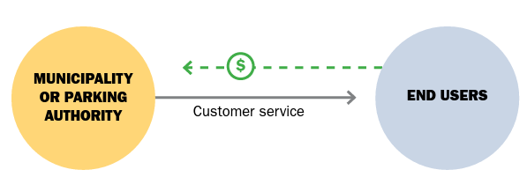
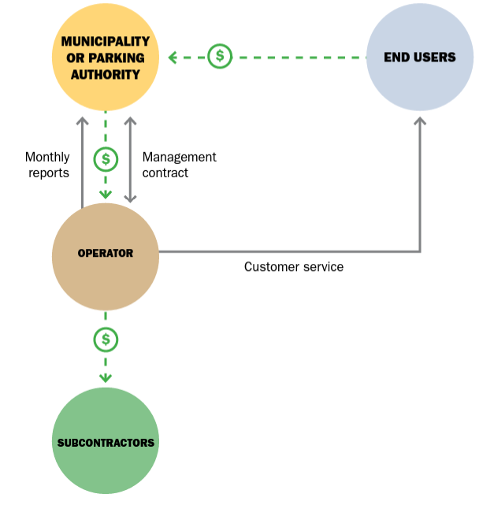
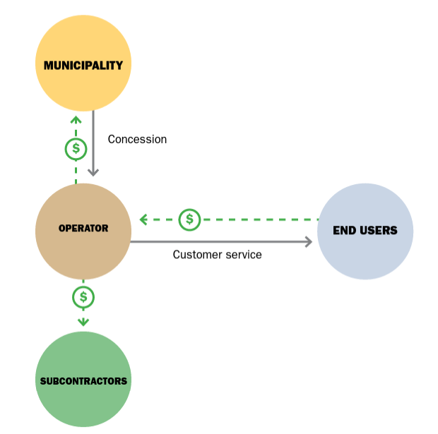
Operations
Direct operation
by implementing agency
Private operation
Contract
Concession
Notes:
Direct operation
City has complete control over parking operations and receives all system revenues
Can align things like branding with other city services
This structure requires highest capacity among city staff and the city assumes maximum financial risk (capital and operating costs)
Contract
City can still have some control of day-to-day system operations, but benefits from the experience of parking service provider
Particularly attractive to cities with little internal technical knowledge about parking operations
Some risk around service provision esp if the operator isn’t meeting service level standards program operations could be disrupted
Concession
“Hands-off” approach means lowest financial risk to the city, but it could lead to low quality of service
City misses out on potentially large revenue stream, but concessioned operators are incentivized to run a good program and even invest money back into the system to maximize their profit potential

Slide 9
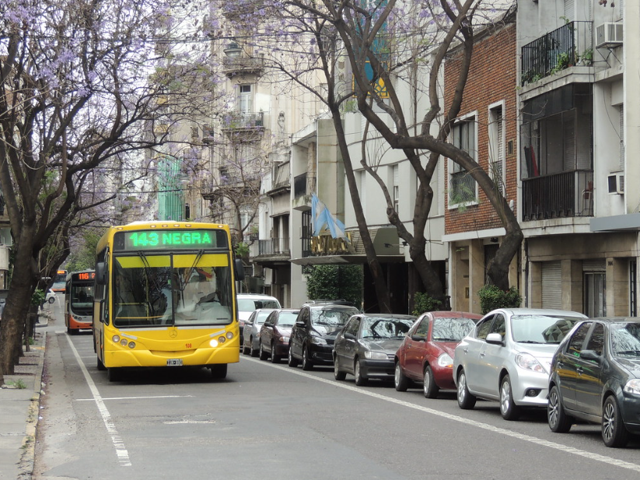
Mini case study
Rosario, Argentina
Concessionaire: Tránsito Rosario
Concession term: 2009 - 2026
Concession
Notes:
In 2018, TR spent $45 million to update the meters, which they own, but this upgrade enabled compatibility with the city’s transit card

Slide 10
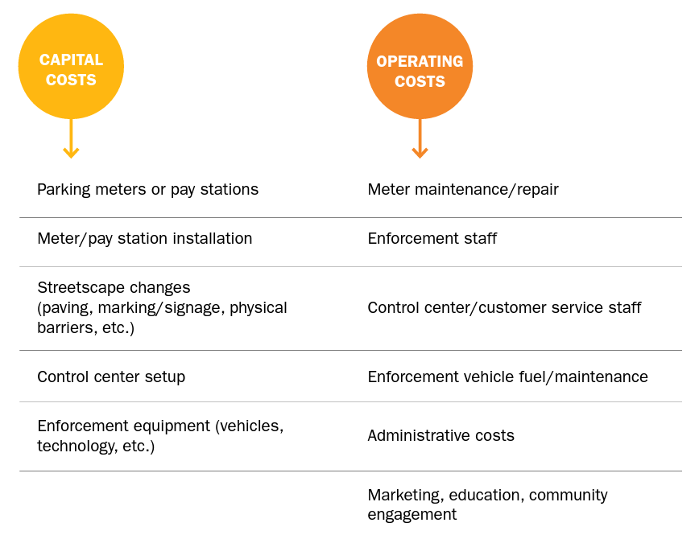
3
Finance
Notes:
Step 3 - develop a financial model
This includes estimating capital costs: meters? Install new signage? Control center?
Operating costs: staffing for enforcement and control center, marketing and educational programs
And the financial model will also include estimation of revenues

Slide 11
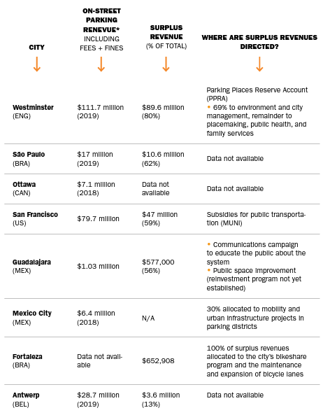
Reinvesting Surplus Revenues
Notes:
A priced parking program can generate significant revenues beyond what it costs to operate the program
Surplus revenue should be allocated to a fund used exclusively for sustainable transport and related public space improvement projects.

Slide 12
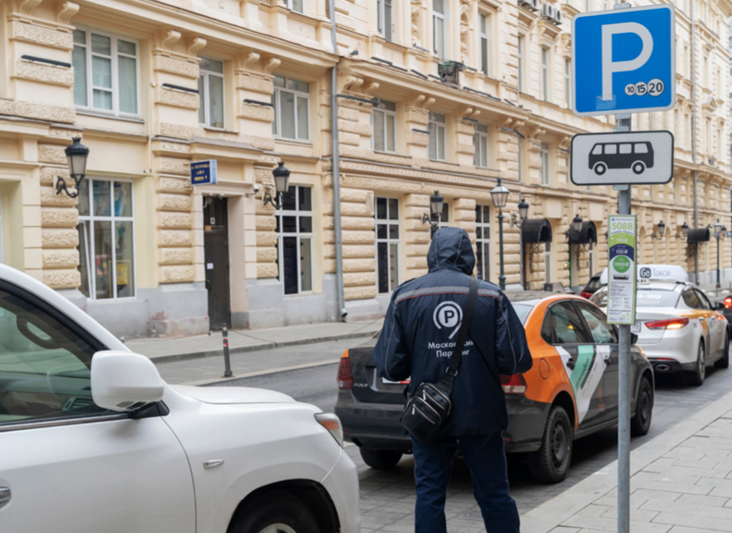
Mini case study: Moscow
Moscow, Russia
Operation funded by: city budget
Parking revenues directed: public space + streetscape improvements, accessibility enhancements
Notes:
In Moscow,
Parking revenue is reinvested at the district level
Each district has an executive body that decides which projects receive funding, referencing local plans, and working with elected district representatives
Parking revenues have been used to improve and maintain parks, and other public spaces; improve access for people with limited mobility; and improve and maintain streetscapes

Slide 13
4
Engage
Community engagement
Education
Marketing and branding
Notes:
Next you want to think about developing an outreach plan. THis communicates the vision of the parking program and the new parking rules with the public.
Outreach and engagement needs to happen before, during and after the parking program is implemented.
There are three key pieces of an outreach plan -
Community engagement - Use focus groups and other engagement strategies to involve local stakeholders in the process of conceptualizing and planning the system
Education - making sure the public understands new parking rules
Marketing and branding - aligning the parking system with a broader vision and promoting parking reform as a way to achieve city goals around livability

Slide 14
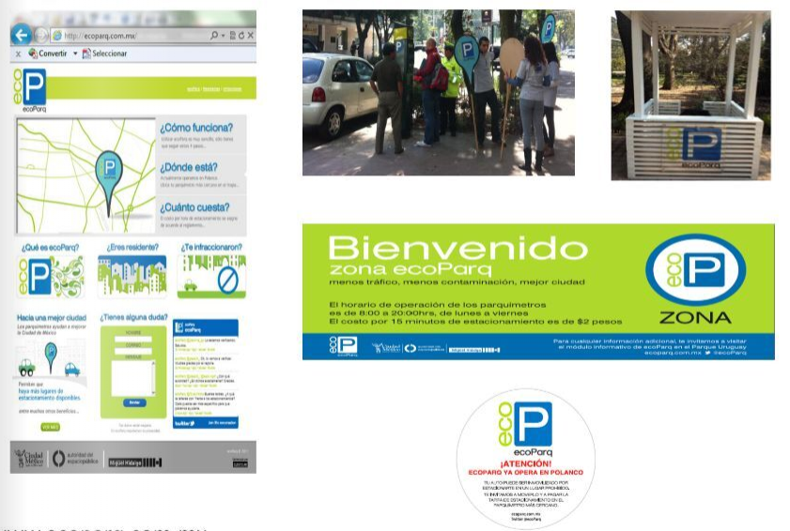
Mini case study: Mexico City
Notes:
A good example of the power of branding is in Mexico City
When Mexico City’s ecoParq program was developed in 2011 and 2012, it purposefully used green branding and “eco” in the name to communicate to the public that it is part of a larger environmental initiative to improve air quality.
Ecoparq also had an outreach plan that included sending flyers to notify residents of parking changes in their neighborhood, distributing informational kits in public places, and launching a website.

Slide 15
5
Enforce
Enforcement agents
Technological solutions
Physical barriers
Penalties
Notes:
Develop a parking enforcement plan that anticipates and addresses enforcement challenges. This includes designating an appropriate number of enforcement agents, technological or physical solutions to support enforcement, as well as penalties or other means of encouraging compliance with the new parking system.

Slide 16
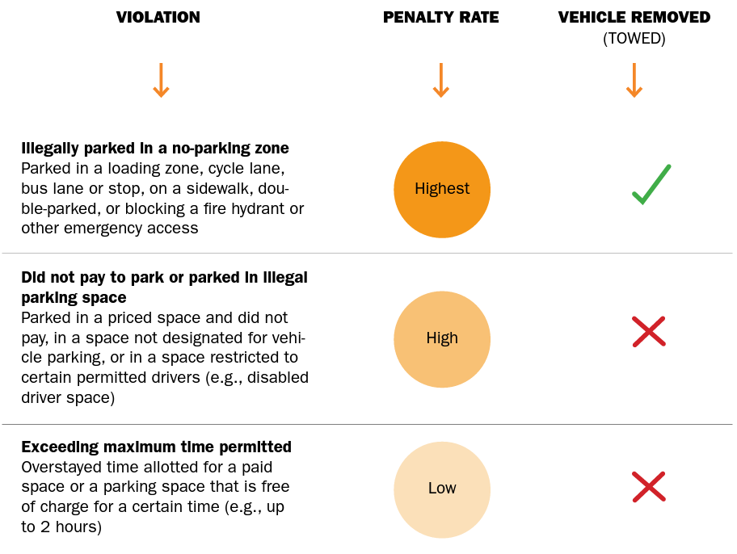
Parking penalties: fines
Notes:
An important part of the enforcement plan is establishing the city’s ability to issue penalties for illegally parked vehicles. Violations should be categorized as part of a hierarchy, where the most severe violations carry the highest penalties.
Penalties, and parking fines in particular, should be set high enough to be a deterrent, or in other words to encourage compliance, but should not be set so high that drivers feel the system is set up to take advantage of them. payment plans or other mechanisms to relieve disproportionate economic burden from parking fines on low-income drivers can also help to build trust and compliance with the system

Slide 17
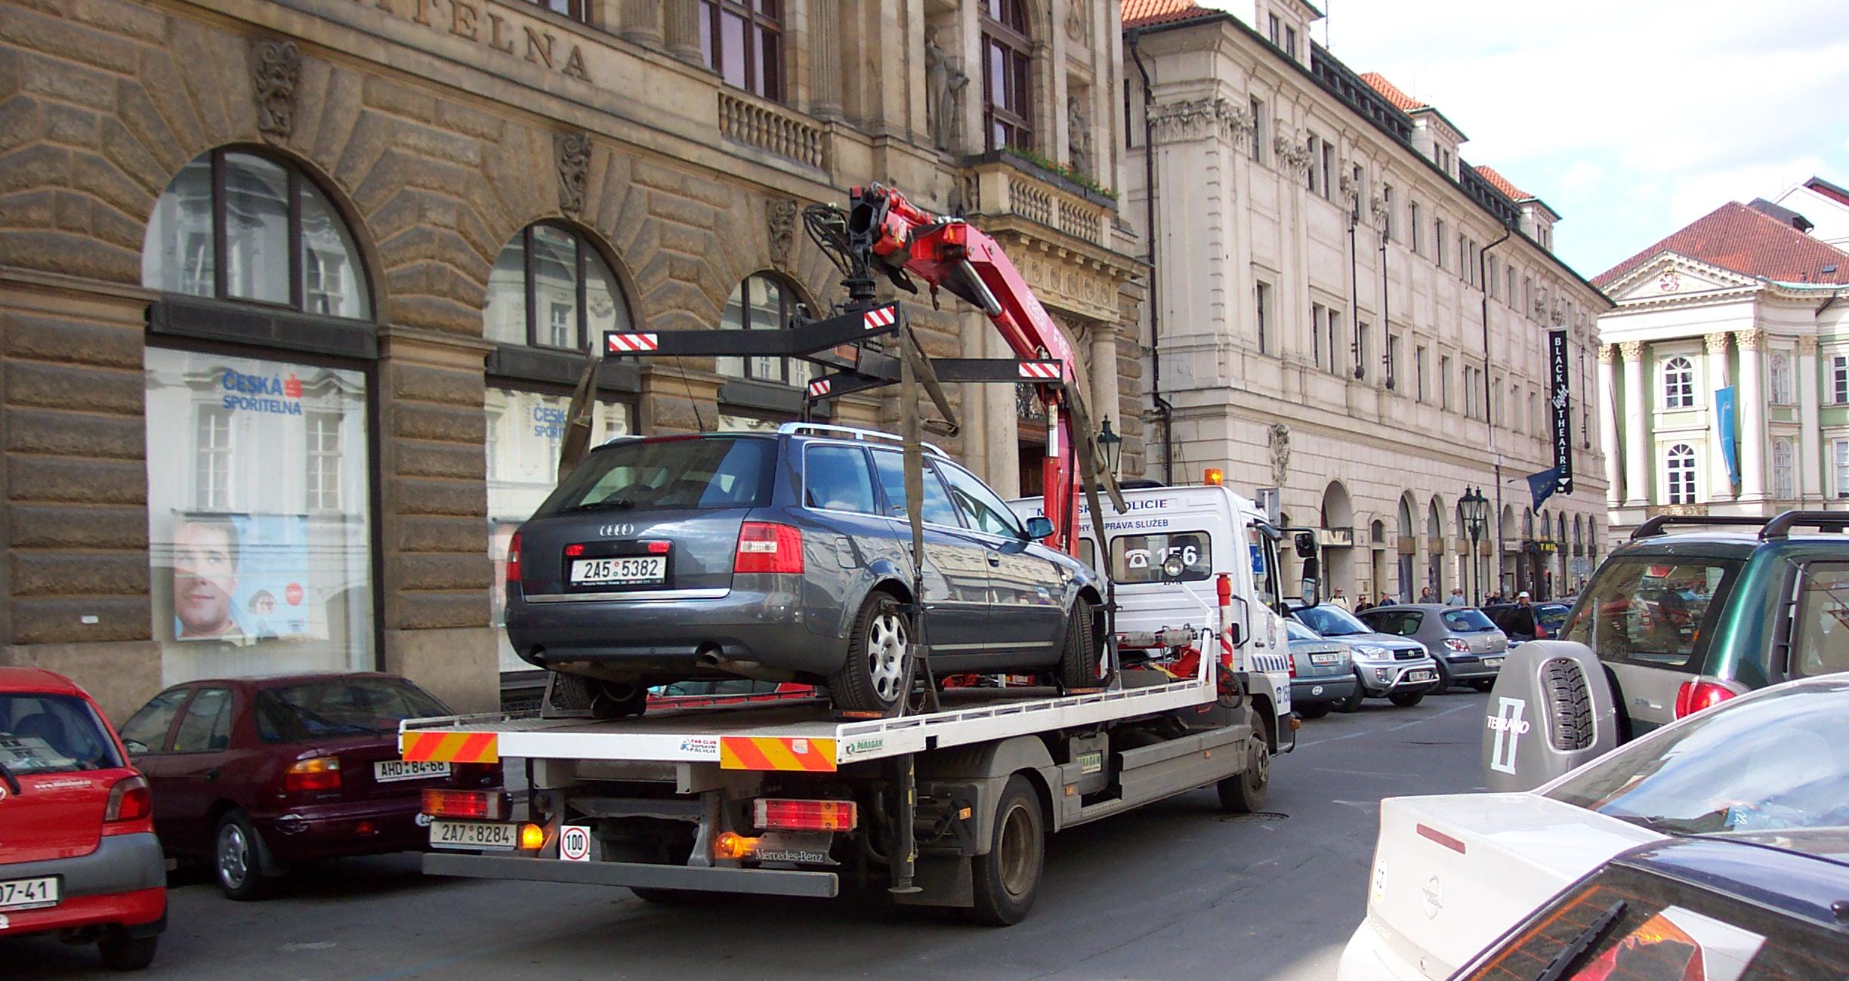
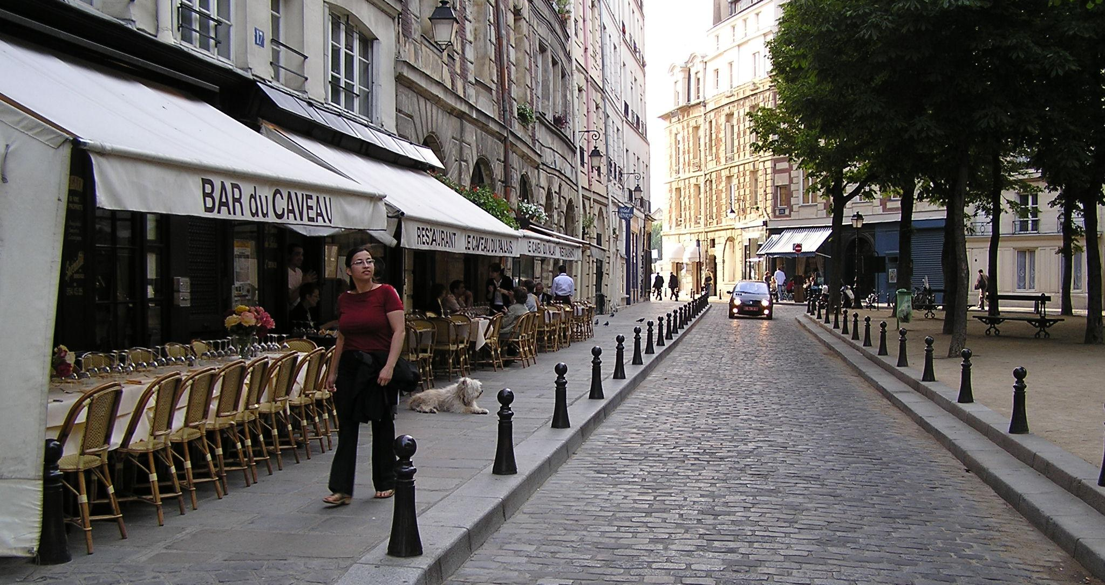
Enforcement: Penalties + Physical Solutions
Fines
Wheel clamping
Towing
Restricting vehicle access
Notes:
Other penalties, aside from fines, which can support enforcement by deterring parking violations are wheel clamping and towing
Physical barriers like bollards, high curbs, or other obstacles can also support enforcement by physically preventing vehicles from accessing spaces where they should not be parking

Slide 18
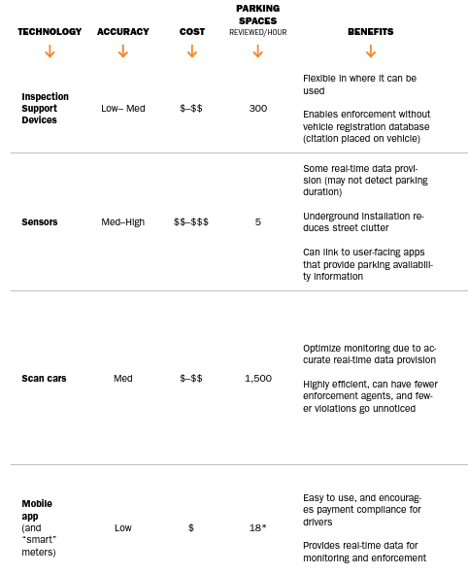
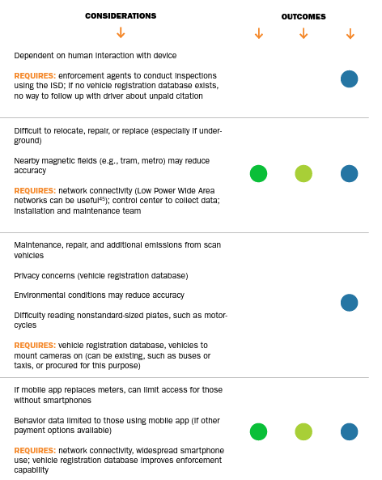
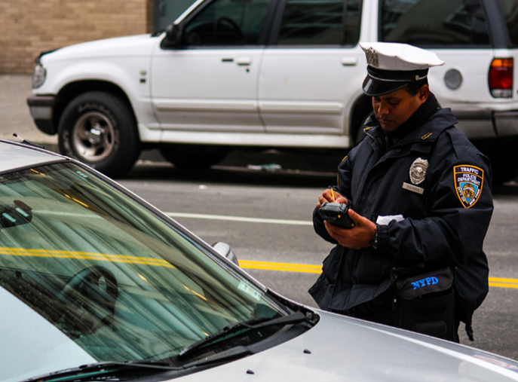
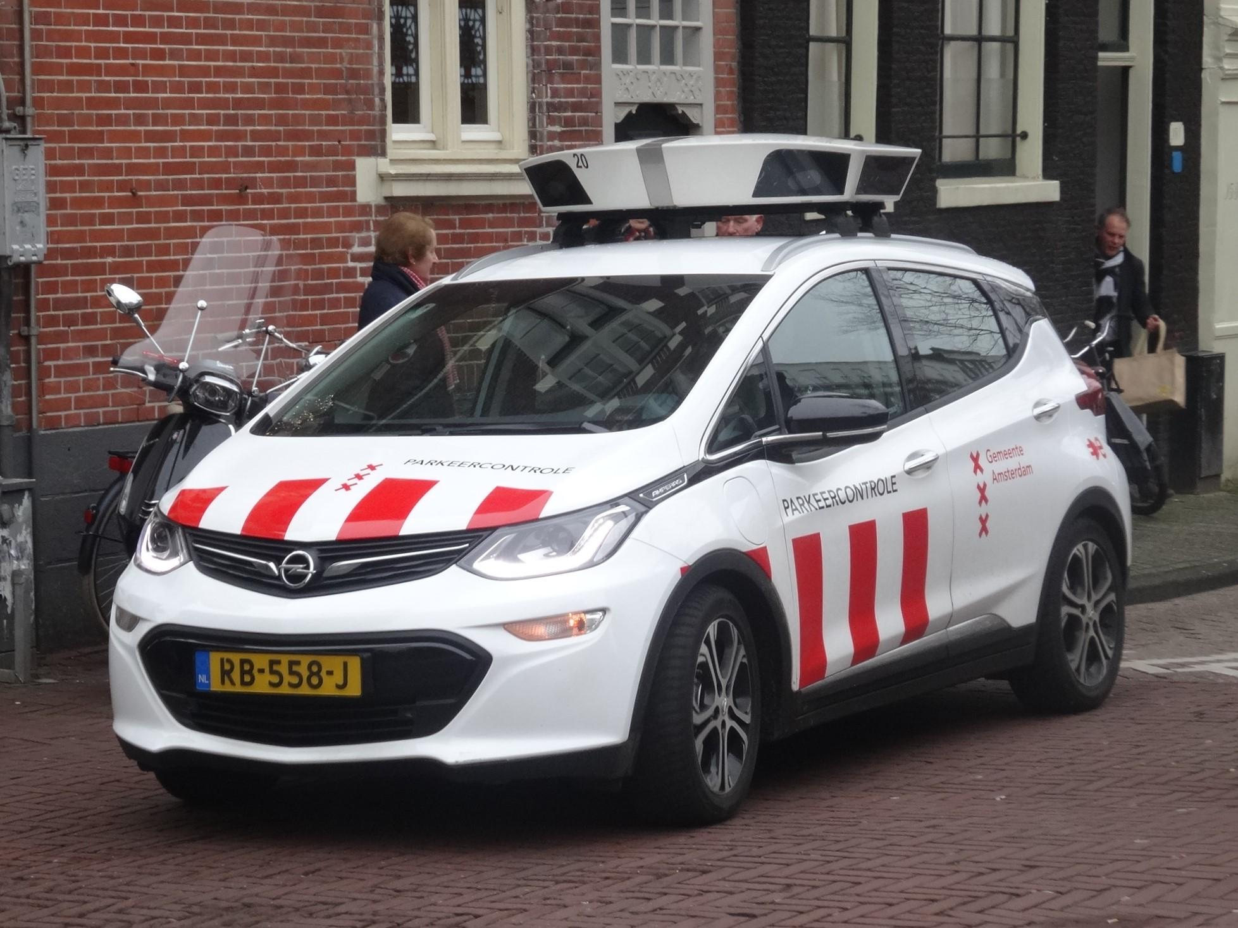
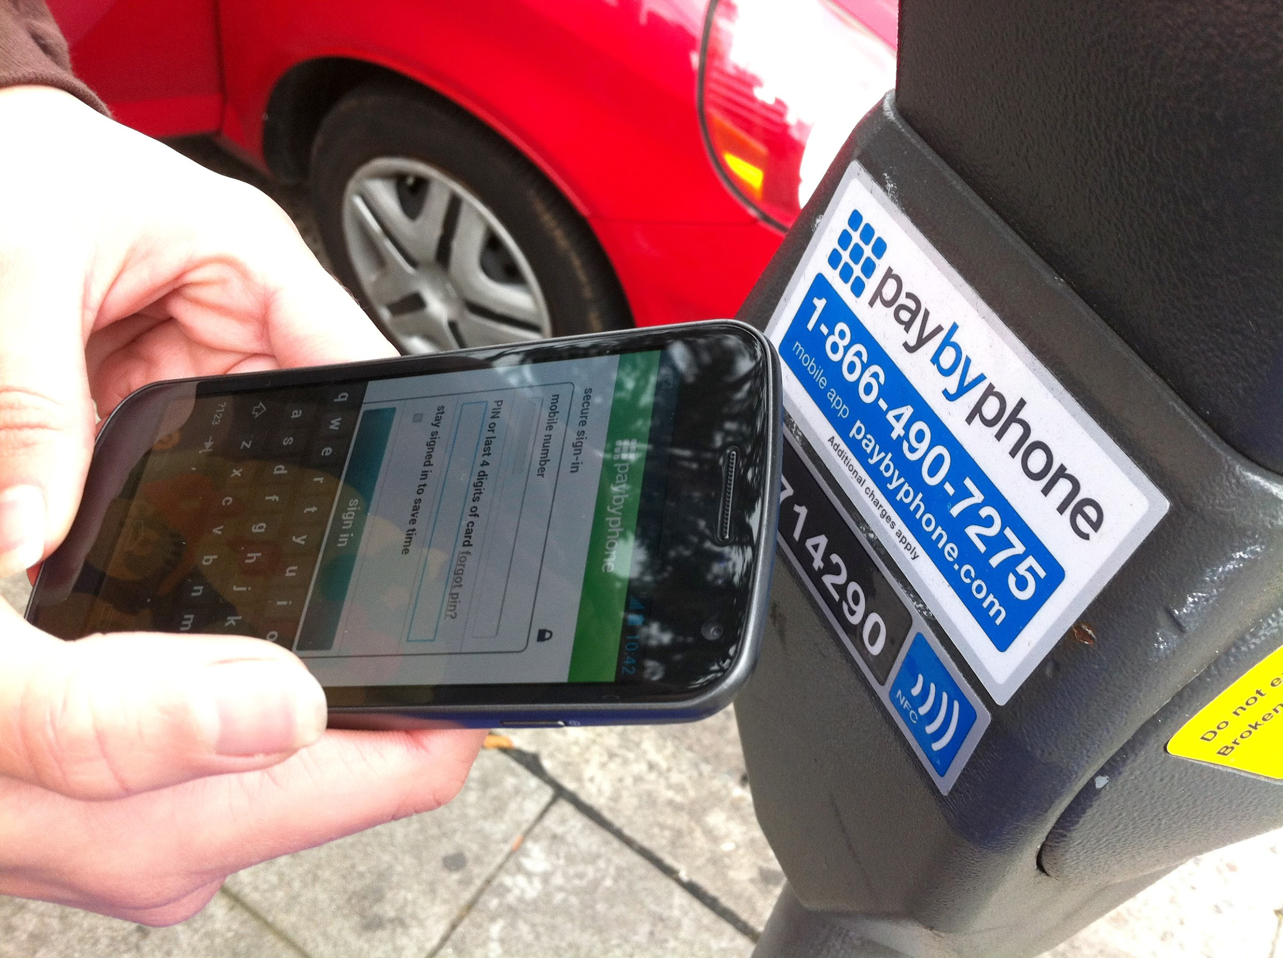
Enforcement: Technological Solutions
Notes:
Technological solutions not only help to support enforcement, but they can reduce corruption, and allow for easy and transparent data collection on things like parking infractions, payments, occupancy rates, and parking behavior.
Technological solutions can also improve payment compliance by allowing enforcement agents to be more efficient and responsive to parking violations
But these can pose additional costs which need to be considered

Slide 19
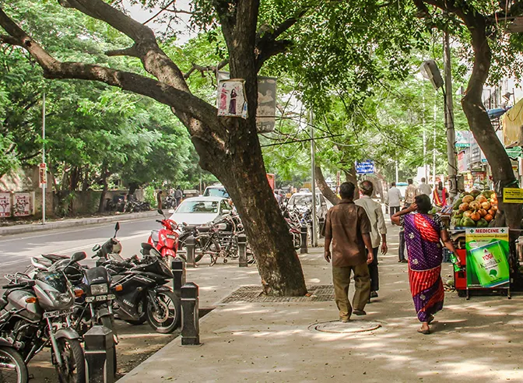
Mini case study: Chennai
Chennai, India
Enforcement technology used: Mobile application Cameras
# of enforcement agents: ~58
Goals:
Reduce corruption
Reduce vehicle use
Notes:
In Chennai, one of the major goals for the city’s updated smart parking system was to address corruption observed under the city's previous parking system.
The new system in Chennai does not use on-street parking meters or pay stations.
The parking operator handles enforcement using two mobile applications: one for users to pay for parking, and one for enforcement agents to conduct enforcement and collect parking fees. If someone parking does not have a smartphone, enforcement agents can collect cash from them and record the transaction in their app.
The back end of the applications is integrated with a Smart Parking Control Center, which provides revenue collection details in real time which is accessible to local authorities. A camera-based system also helps enforcement agents track which on-street spaces are occupied or vacant.
Fare collection and penalties are separated: enforcement agents alert the police if wheel clamping or issuing a ticket to someone who has violated the parking rules

Slide 20
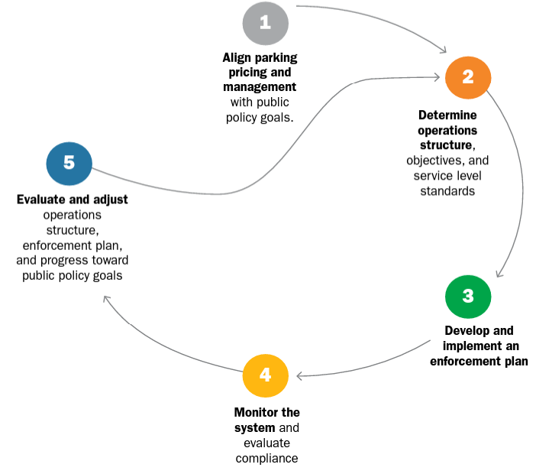
6
Evaluate
Notes:
Define indicators that will be used to evaluate impacts of the parking program and progress toward broader public goals.
Opportunity to evaluate capacity - does it make sense to continue with the same operating structure, has the financial model changed, maybe there is funding available to implement additional technological solutions to supplement enforcement
Conducting this evaluation can inform adjustments to the program so that it can grow and improve year to year

Slide 21
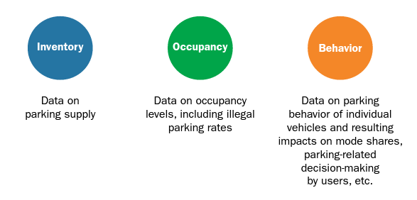
Collecting and using parking data
Notes:
Three main types of parking data and these help to build a comprehensive picture of parking needs and effective management:
It’s really important to understand that parking data has to be collected and analyzed on a hyper-local scale, not aggregated for the whole city
Inventory data is typically collected at the outset, and then occasionally thereafter. Occupancy data needs to be collected frequently to understand demand and potentially adjust rates
Collecting behavior data is important because it can show how the parking program is altering mobility decision-making at the individual level and to what extent the program is contributing to established citywide goals. Having this data on hand can help cities make more informed decisions for parking management, and it also provides important evidence to advocate for successful measures to be continued and less successful ones to be adjusted.
Collecting behavior data also requires a more sophisticated technology system compared to collecting inventory and occupancy data.
Some of this might need to be collected by or in collaboration with a private parking operator and shared with the city.

Slide 22
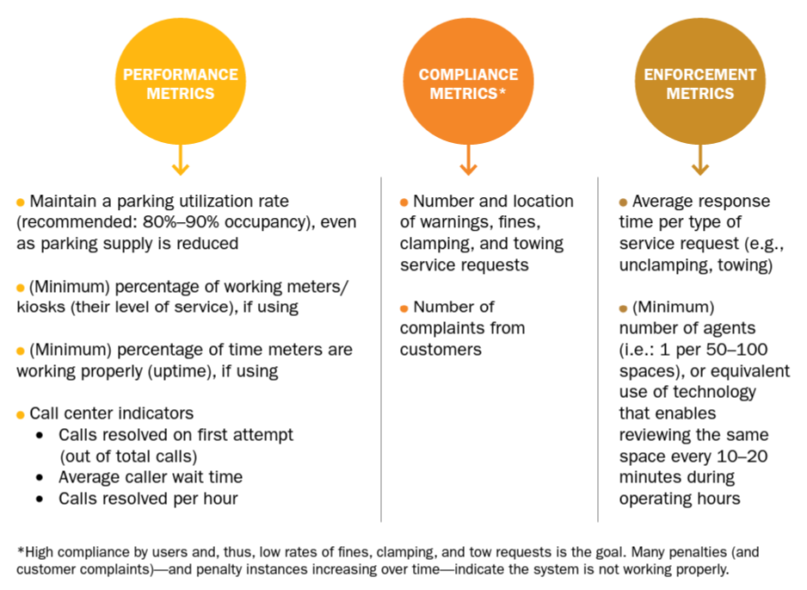
Operator evaluation
Notes:
There are two key levels at which evaluation needs to happen, the first is evaluation of the parking operator.
This evaluation is typically a review of the performance metrics built into the operating contract, and may trigger bonuses for the operator if certain standards are met or exceeded. On the flip side, if operations are consistently not meeting these standards, then the contract could be nullified.

Slide 23
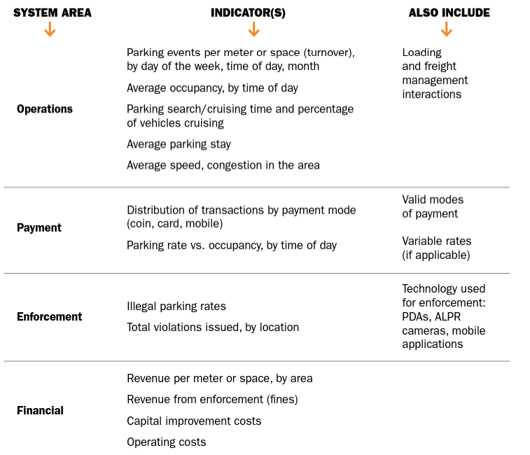
System evaluation
Notes:
The second level of evaluation happens at the system level. This includes reviewing operations but goes beyond that to evaluate other areas like payment, enforcement, and the financial model - financial indicators in particular will be important to demonstrate the long-term financial health of the system
This type of evaluation should happen annually and the results should be made publicly available
This helps minimize suspicions about things like misuse of revenues and increase public confidence in the system.

Slide 24
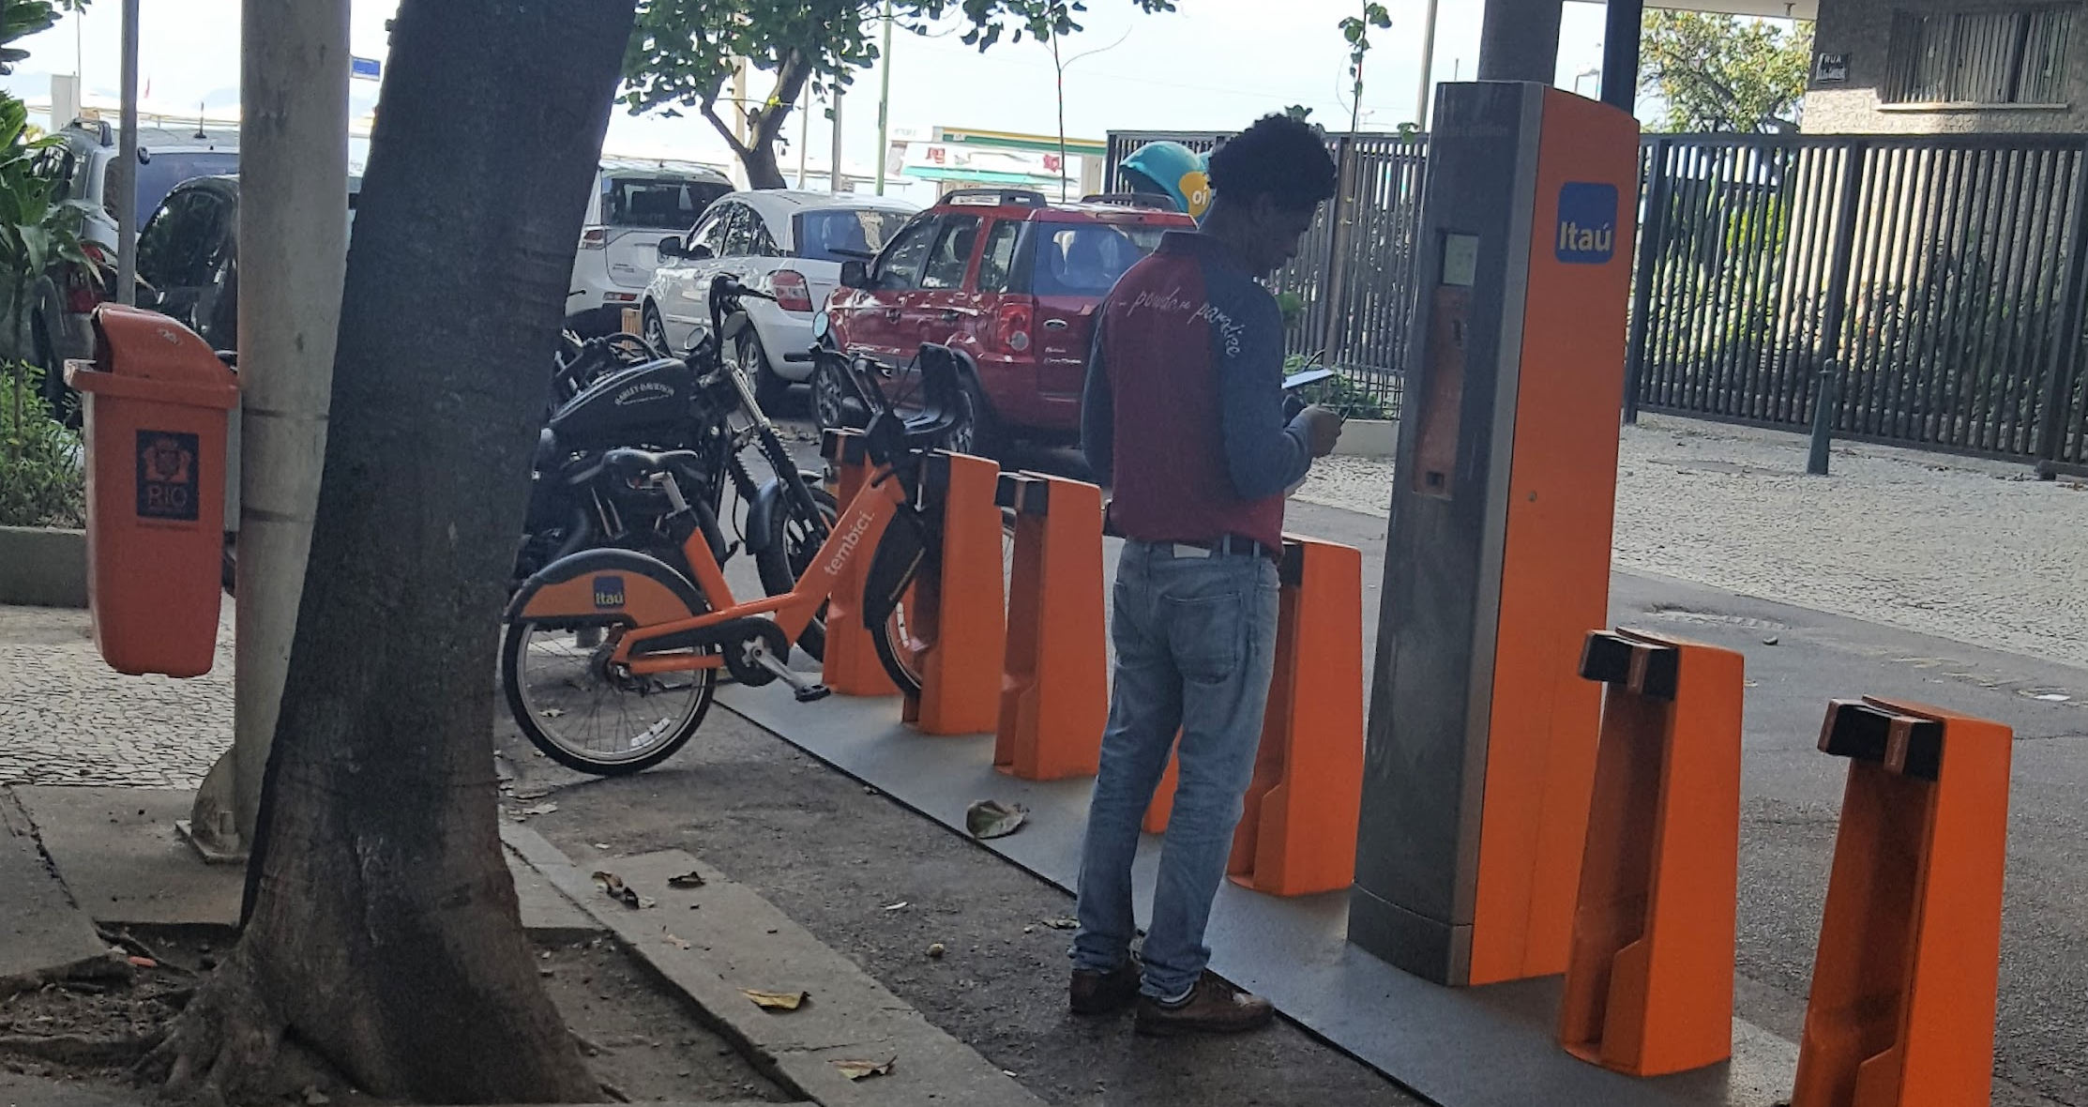
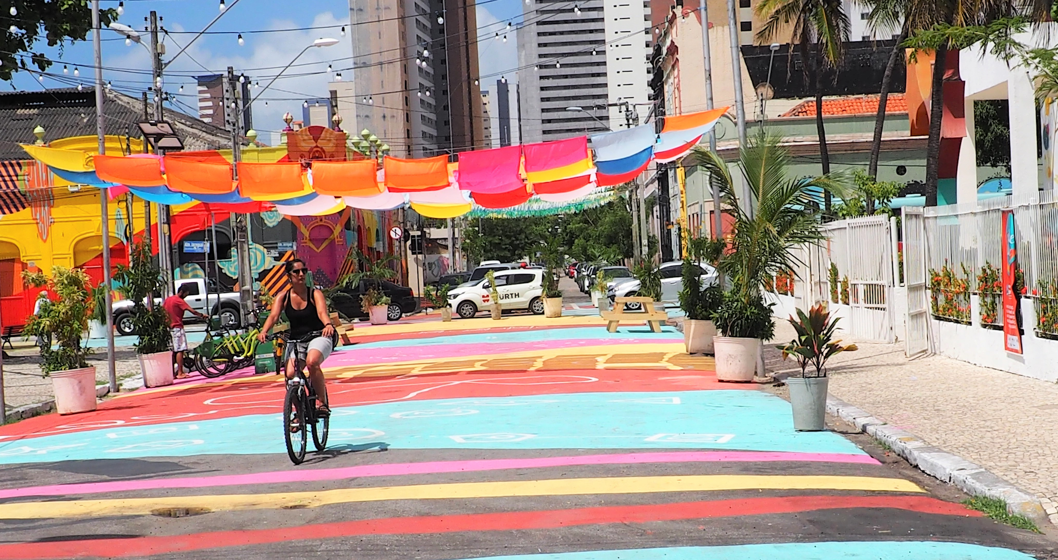
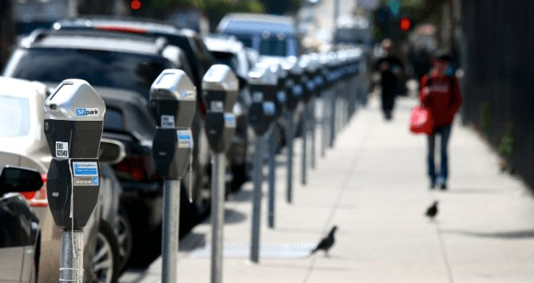
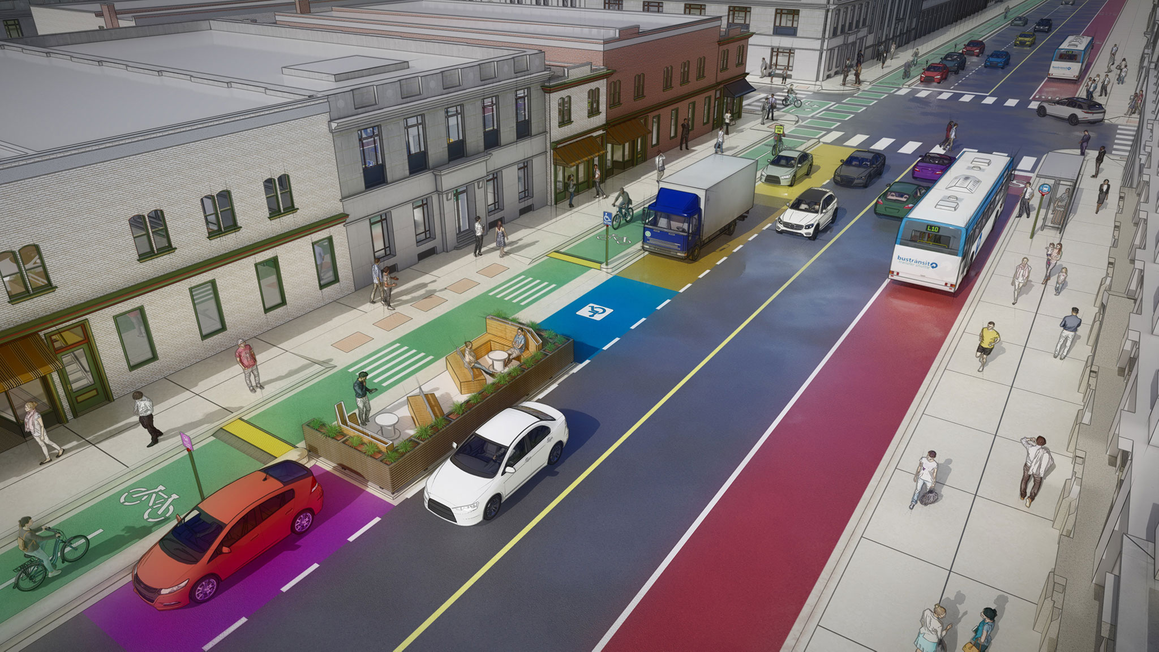
Supportive Parking Elements
Road space reallocation
Traffic reduction measures
Demand-based pricing
Flexible curb management

