Slide 1
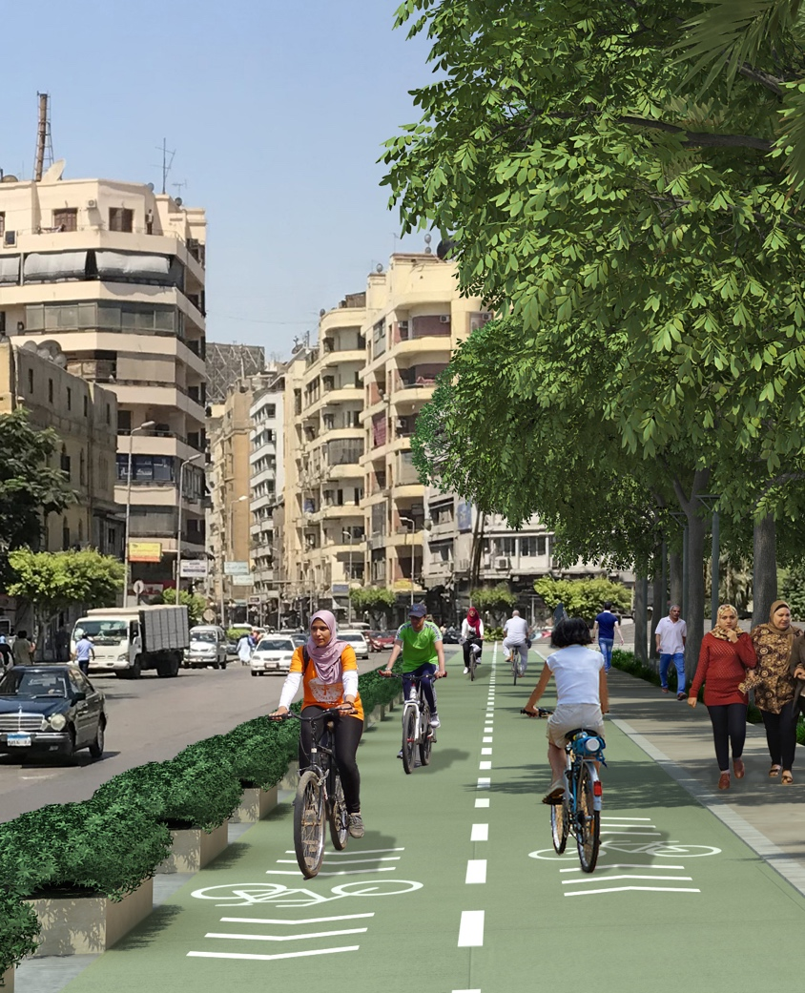




Cairo’s intersection treatment for cycle tracks
Nour ELDeeb
Transport Planning Consultant, ITDP Africa
March 11, 2020

Slide 2

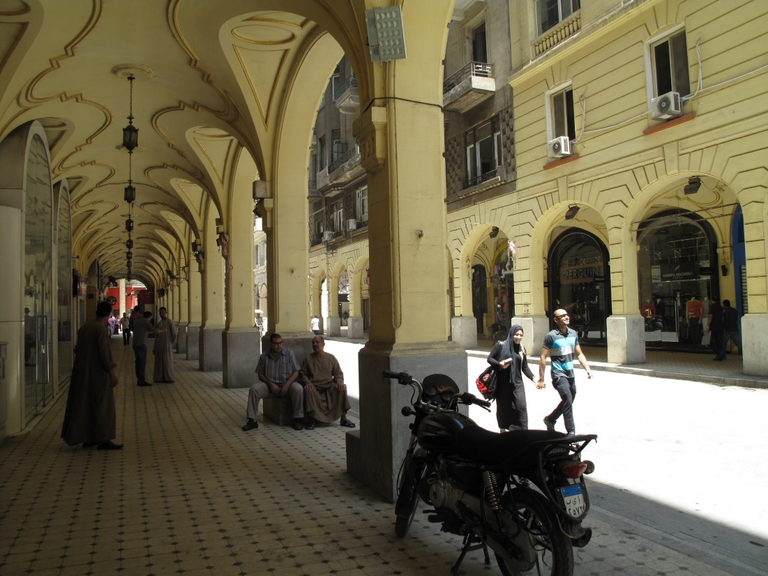
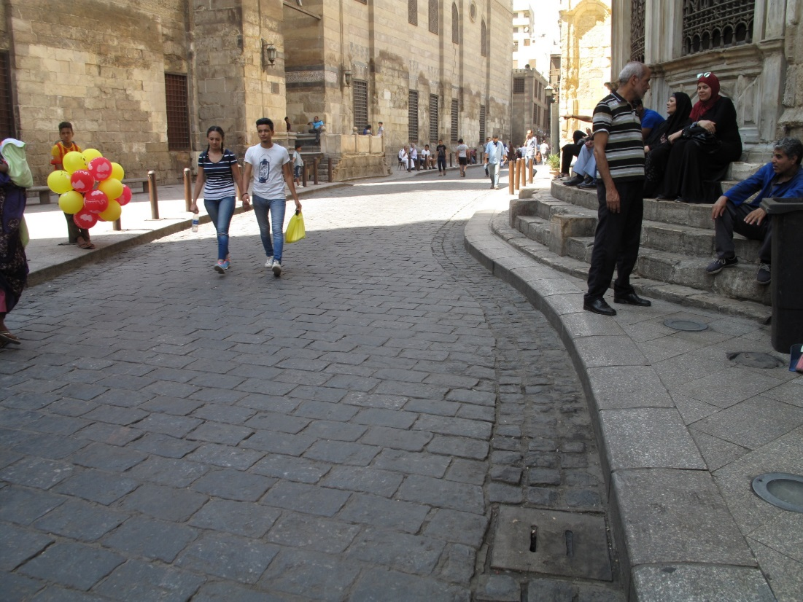
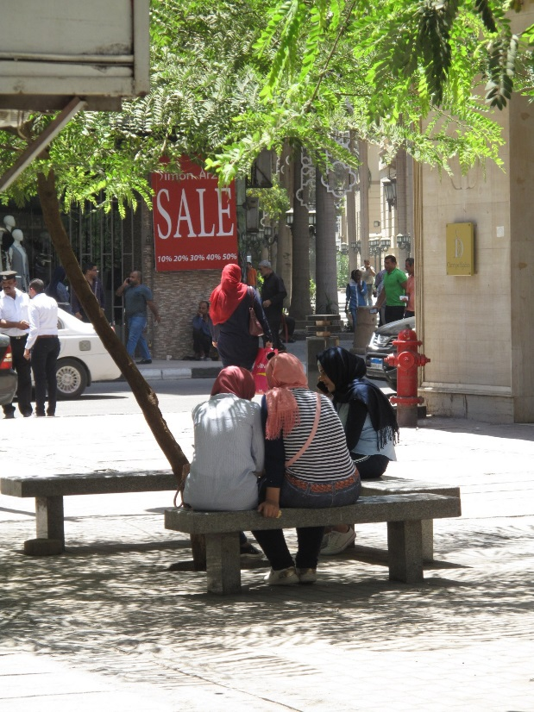
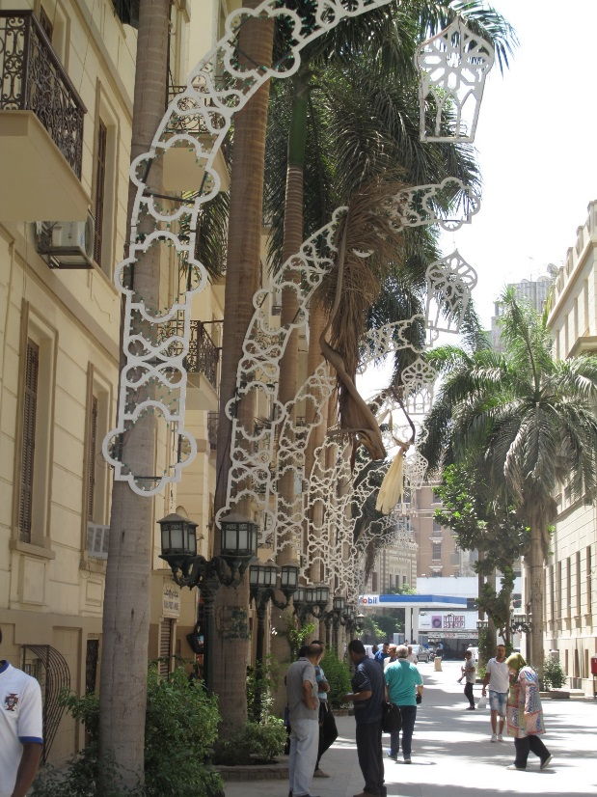
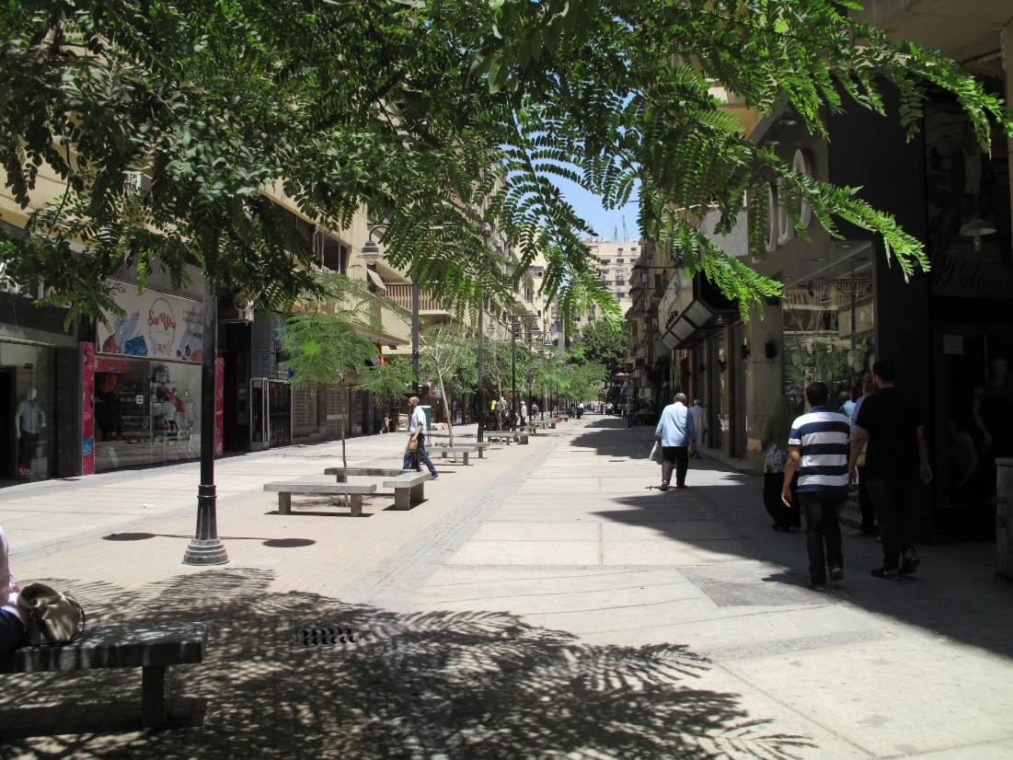
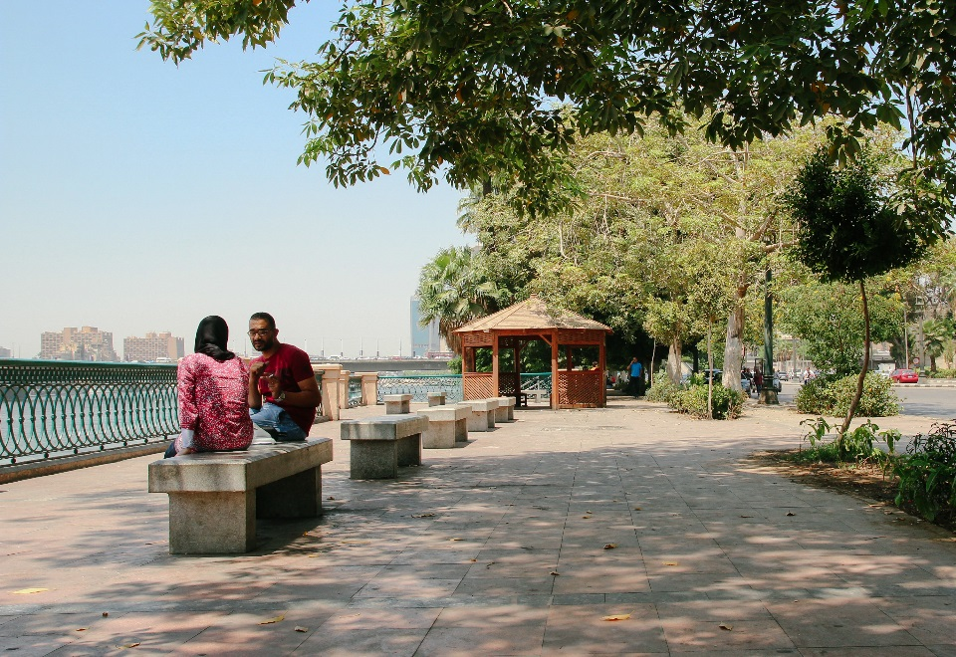
Downtown pedestrian friendly walkways

Slide 3
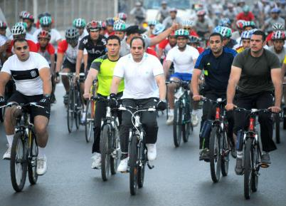
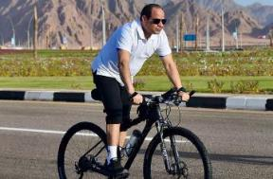
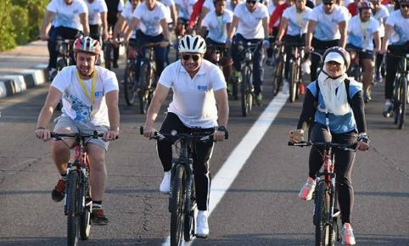
President Sisi calls on Egyptians to ride bicycles
“The President explained in his speech how the use of alternative transport solutions will save for the average Egyptian EGP 4 ($ 0.56) and the government EGP 8 ($ 1.12) per a 20 kilometer travel distance.”
“Former Cairo governor said that more start to opt for bicycles as an alternative to driving, especially after President Sisi had pushed for an initiative calling on Egyptians to ride bicycles.”

Slide 4
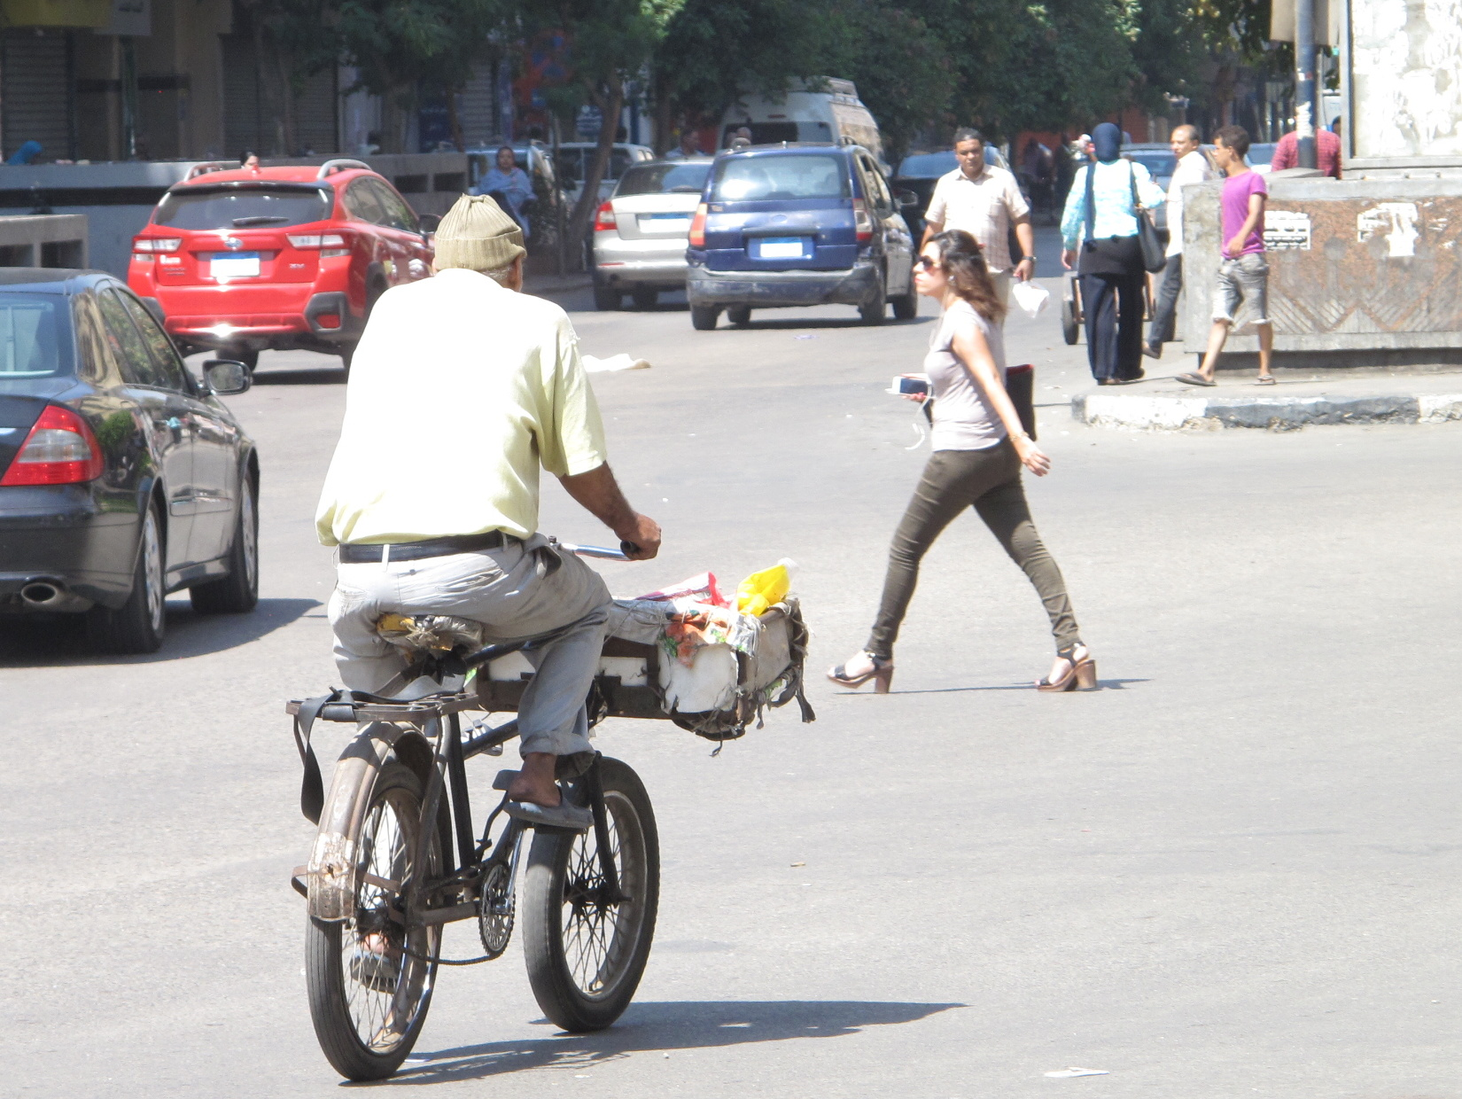
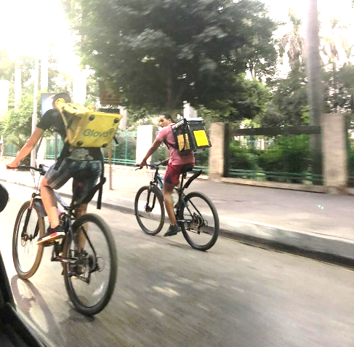
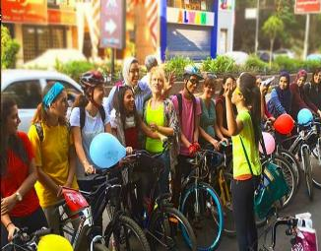
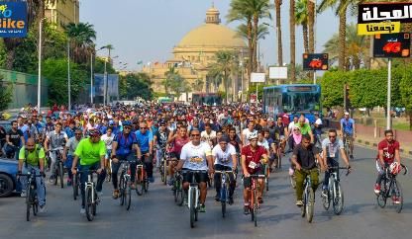
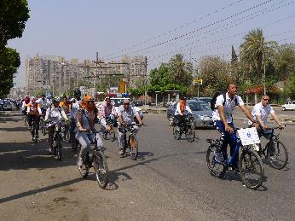
Cairo to use bicycles not only as a recreational medium, but also as a sustainable, cost-effective & rapid means of transportation..
Daily mode of transport
Courier service
Humanitarian purposes
Recreational sport

Slide 5
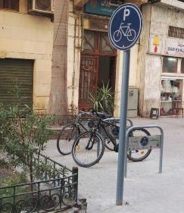
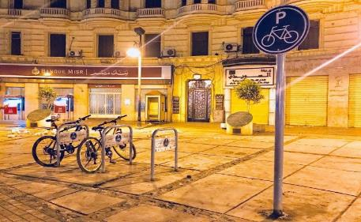
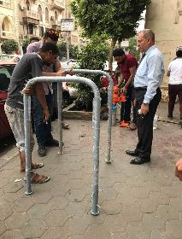
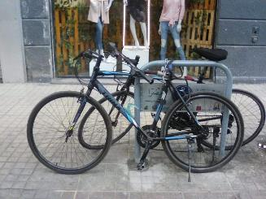
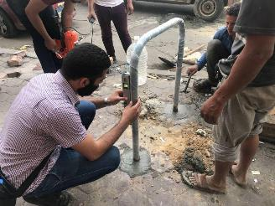
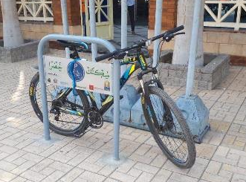
In 2017, Cairo governorate signed MoU to install 100 bicycle racks in Downtown and Heliopolis area

Slide 6
Making it easier to cycle in Cairo..

Slide 7
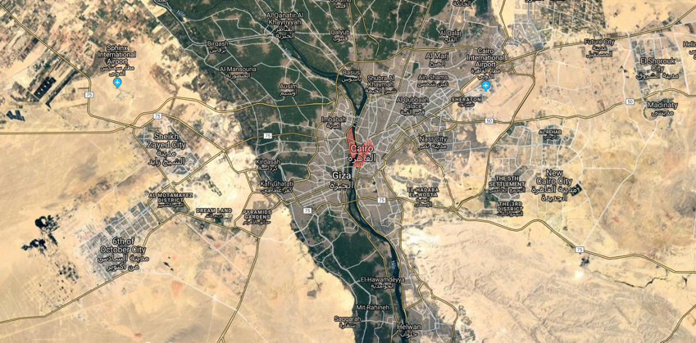
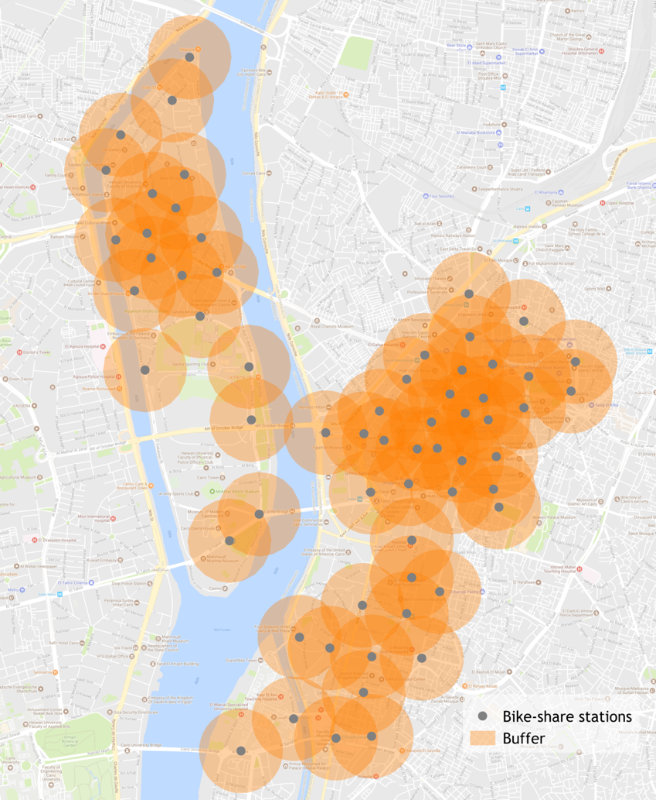
Cairo bicycle sharing system
Coverage area: 6.4 sq km, downtown &
Zamalek island
700 cycles
70 stations
(11 per sq km)
Integration with bus & metro systems

Slide 8
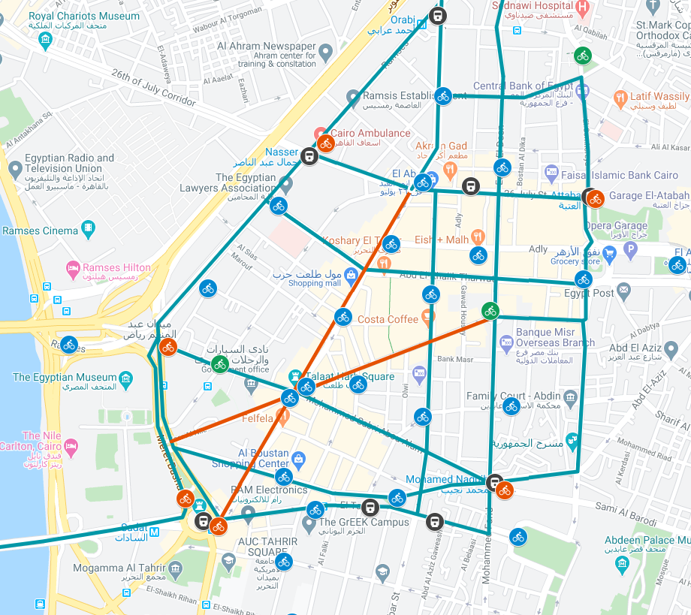


Cairo Downtown Bike lane network
Vision
Features
Metro
Implementing 15km 1-way bike lanes network
Integrated transportation system
Bike Sharing Station
Bike Lanes Pilot
Bike lanes full network
Parking
Piloting 2km of Bike Lanes
(red lines)
Pedestrian and cycle friendly
Accessible for those with disabilities
Integrating a Bike Share System
Lined with on-street greenery and street furniture
Re-designing the intersections to be safer and more accessible for pedestrians

Slide 9
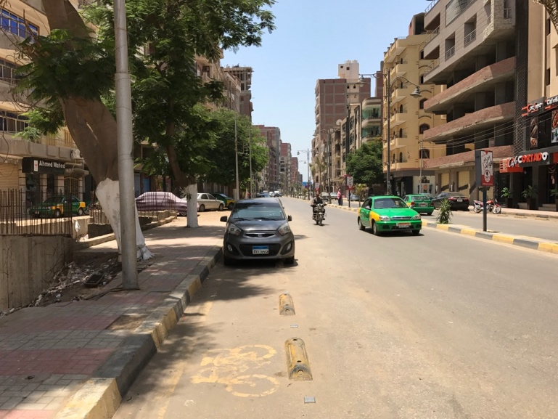
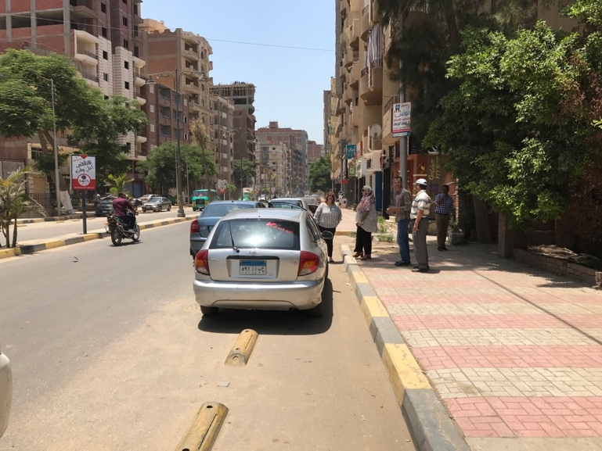
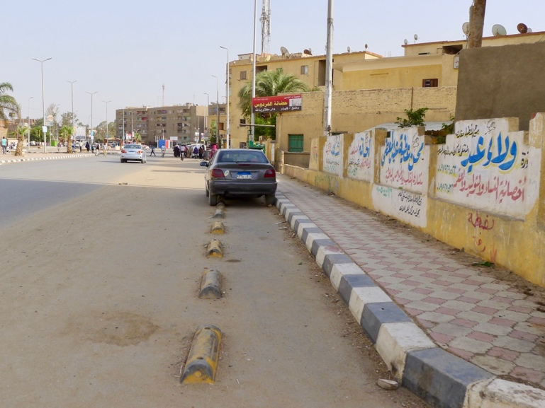
Previous experience with bike lanes in Egypt

Slide 10
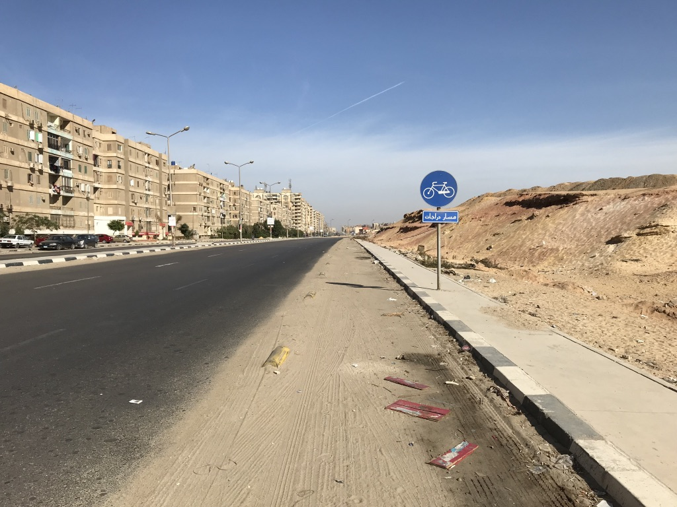
Cairo

Slide 11
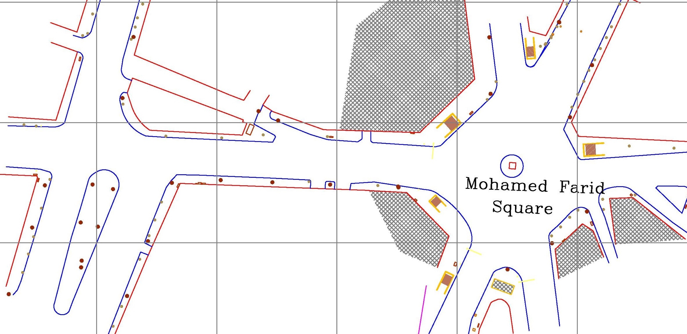
Intersection improvements
Mohamed Farid Square + El Tahrir

Slide 12
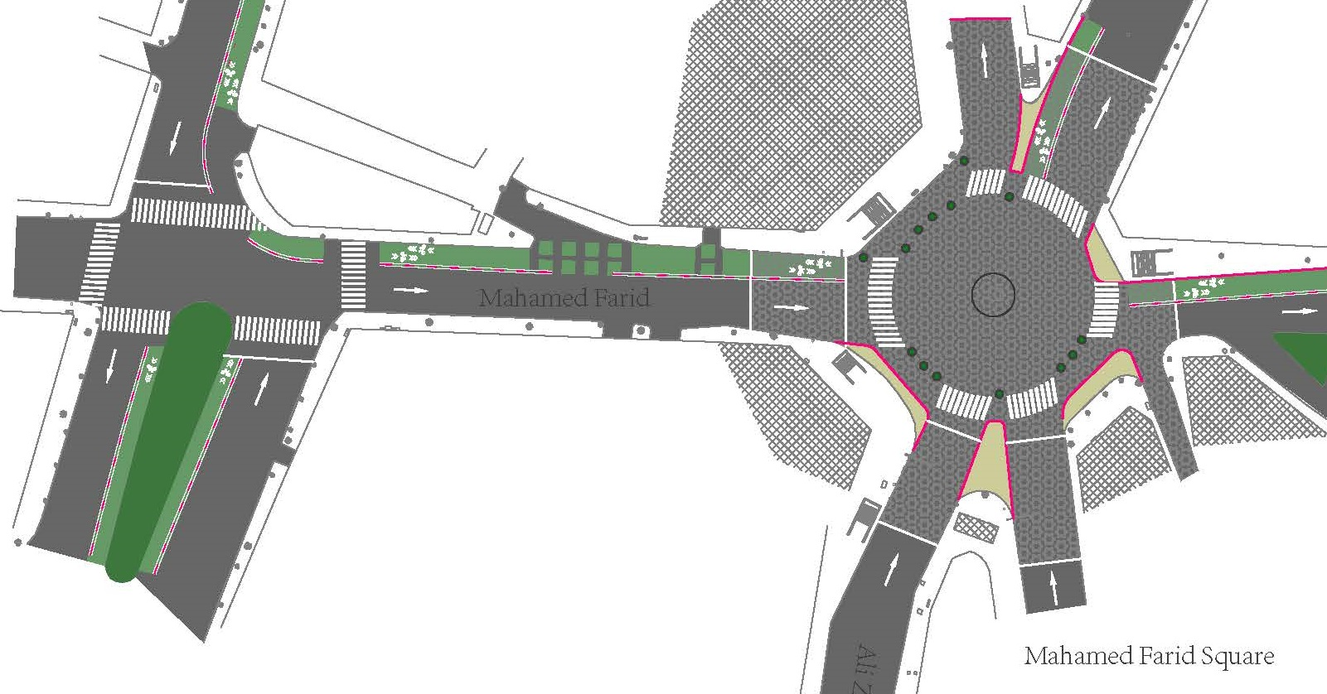
Intersection improvements
Mohamed Farid Square + El Tahrir

Slide 13
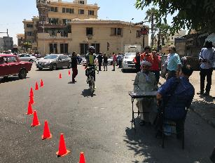
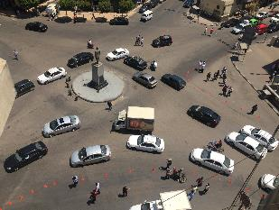
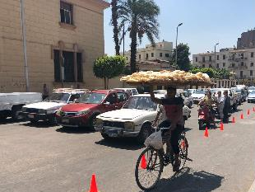
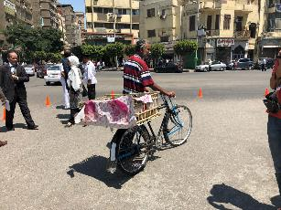
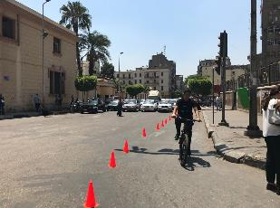
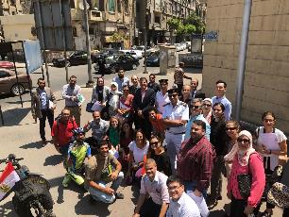
Bike lane trial - Mohamed Farid Square

Slide 14

Mohamed Farid Square trial

Slide 15
Mohamed Farid Square trial

Slide 16
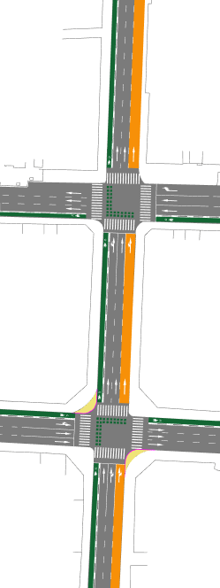
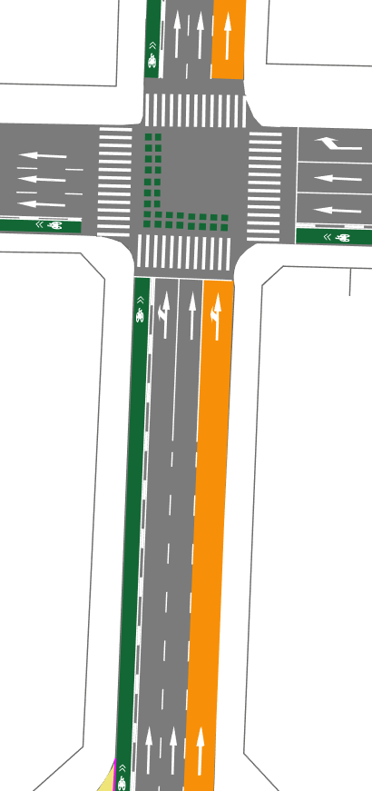
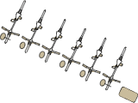
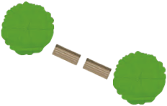
Complete street-Mohamed Farid
Complete street design:
- Space for all users
- More available space for pedestrians, cyclists, public transit users and tourists.
N
Adly
①Bus lane(4m): color pavement and strong enforcement to create independent right of way for buses against interference of vehicles.
② One-way Bike lane(2m) and physical separations(0.5m): color pavement, bike marks and physical separation to create independent right of way for bicycles and protect bicycles from vehicles.
③ Minimize vehicle lane: minimize vehicle lane to control the speed of vehicles when passing through this area.
④Continuous bike lane pavement: warning the vehicles and guide bicycles to cross the intersection orderly.
⑤Bus stops, street trees, benches, bike parking, street lights, and landscaping：add value to street users.*this is a sketch, detail design depends on the road condition.
4
Adly
5
3
1
Mohamed Farid
Mohamed Farid
5
2
Bus stop
Abd El-Khalik Tharwat

Slide 17
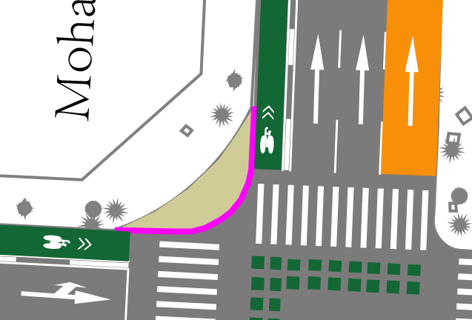
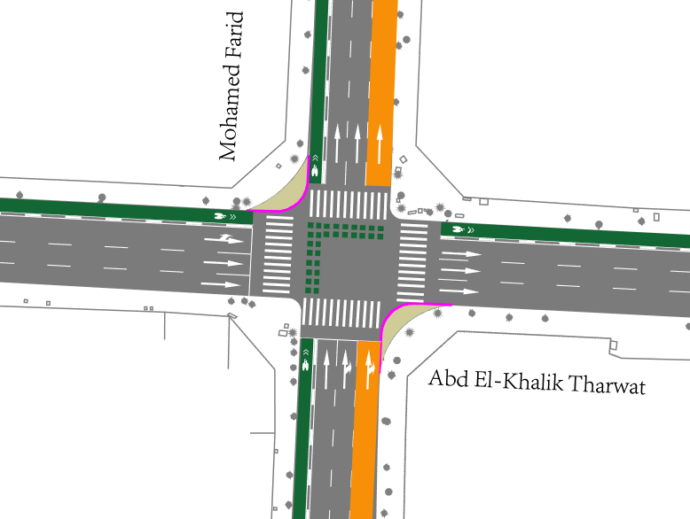
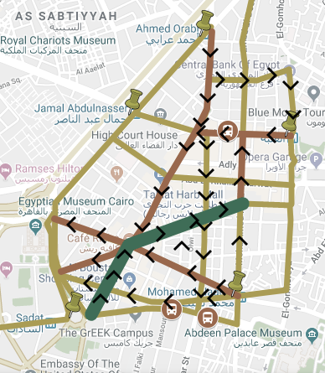
Intersection-Mohamed Farid &
Abd El-Khalik Tharwat
1
2
3
①Curb extension and sidewalk pavement: 5m turning radius to slow down turning speed of vehicles and create more public space for pedestrians.
②One-way Bike lane(2m) and physical separations(0.5m): color pavement, bike marks and physical separation to create independent right of way for bicycles and protect bicycles from vehicles.
③Continuous bike lane pavement: warning the vehicles and guide bicycles to cross the intersection orderly.
④Bus lane: color pavement and strong enforcement to create independent right of way for buses against interference of vehicles.
4

Slide 18
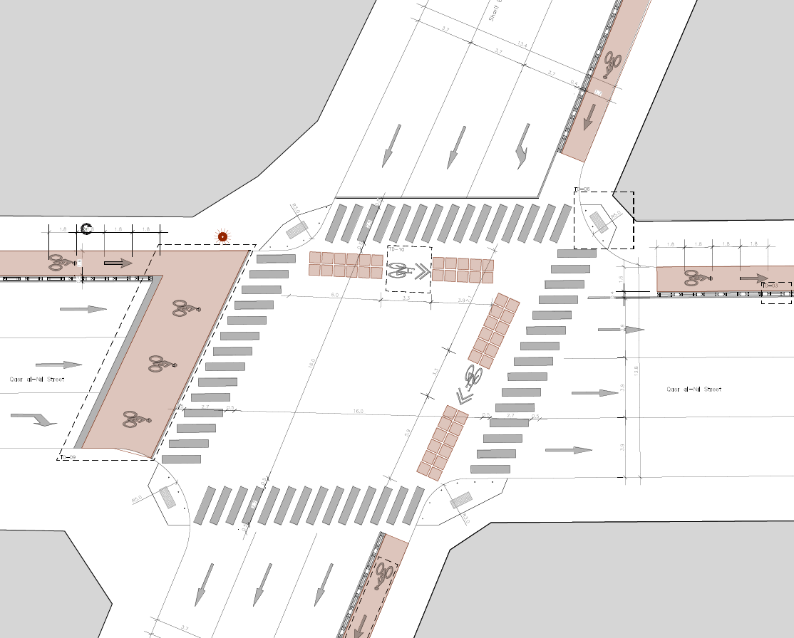
Intersection-Mohamed Farid &
Abd El-Khalik Tharwat (Detailed designs)

Slide 19
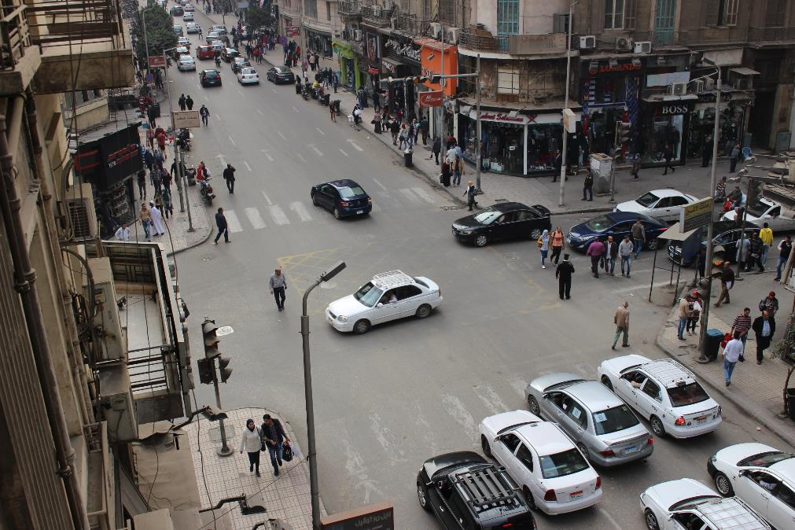
Mohamed Farid &
Abd El-Khalik Tharwat - Before

Slide 20
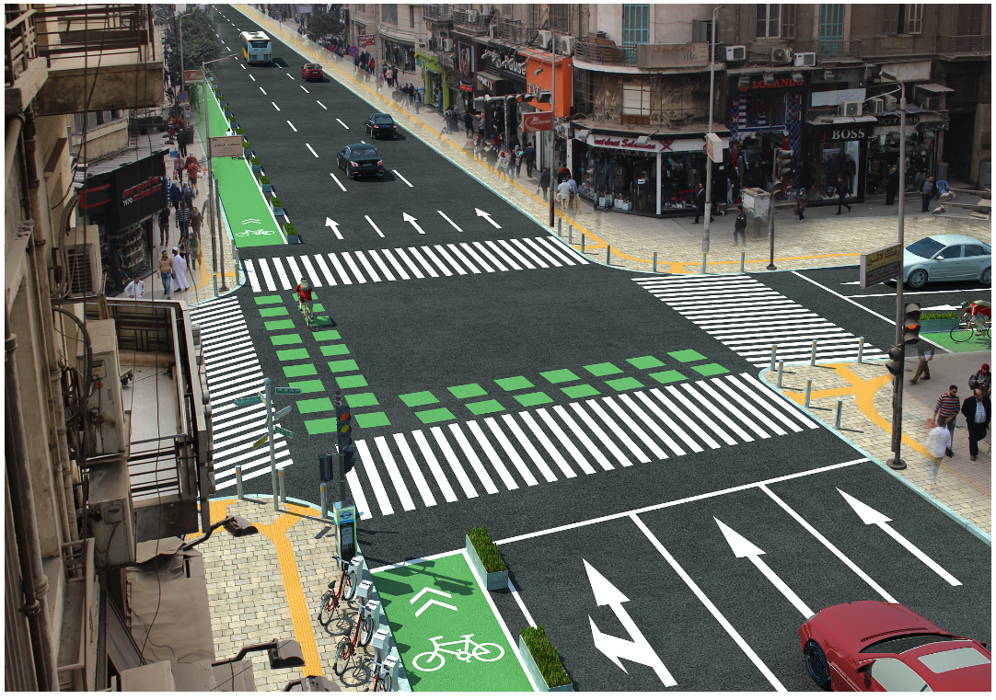
Mohamed Farid &
Abd El-Khalik Tharwat - After

Slide 21
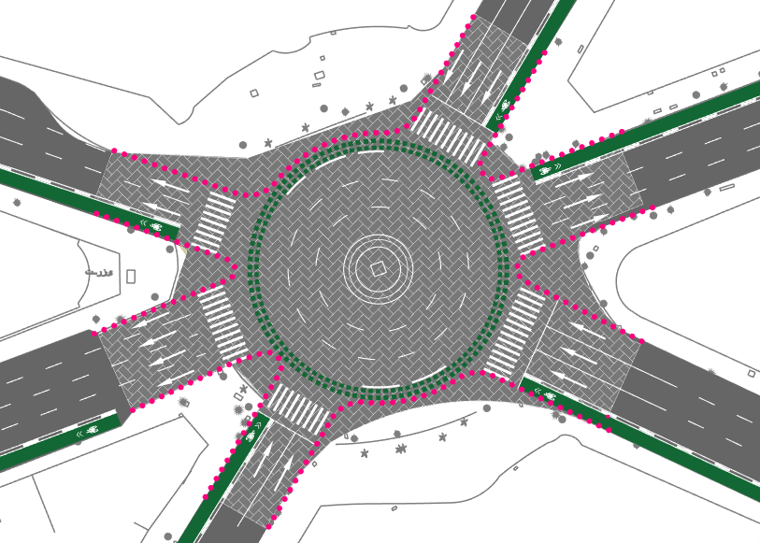
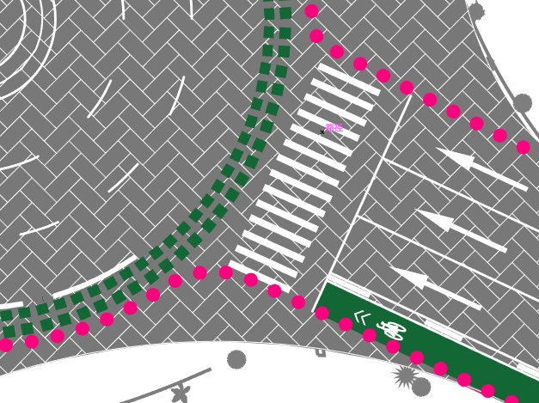
Intersection-Talaat Harb Square
1
①Raised intersection and sidewalk pavement: to slow down the crossing speed of vehicles and make a safe and accessible crossing environment for all, especial for the disable.
②Bollards: use bollards to minimize the turning radius(5m) to slow down turning speed of vehicles, create more public space and reduce crossing distance for pedestrians, and protect the sidewalk from vehicles.
③One-way Bike lane(2m) and physical separations(0.5m): color pavement, bike marks and physical separation to create independent right of way for bicycles and protect bicycles from vehicles.
④Continuous bike lane pavement: warning the vehicles and guide bicycles to cross the intersection orderly.
⑤color marks: color marks to strengthen the warning to protect the bike lane.
2
Kasr El Nile
5
4
3
Talaat Harb
Sabry Abou Alam

Slide 22
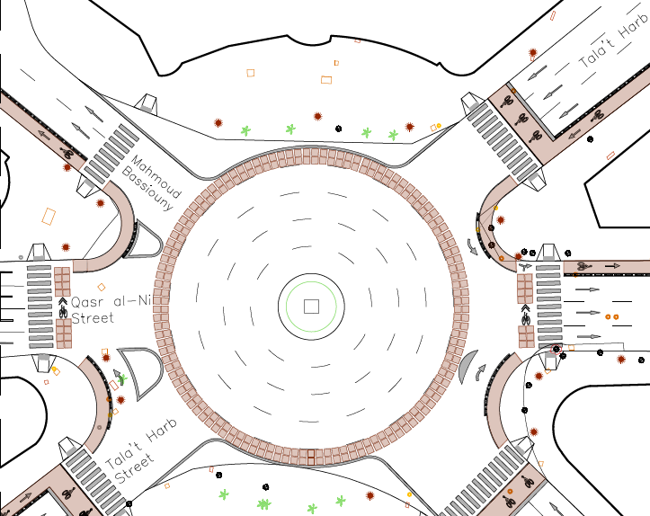
Intersection-Talaat Harb Square (Detailed designs)

Slide 23
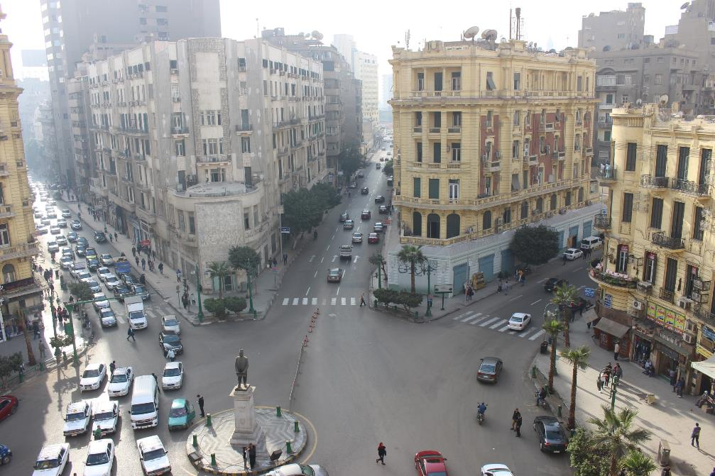
Talaat Harb Square: Before
Talaat Harb Square - Before

Slide 24

Talaat Harb Square: After
Talaat Harb Square - After

Slide 25






From trial to on-ground implementation!
Universal access ramps
Shifting light poles & traffic lights away from intersection
Continuous bike lanes pavement
Cycle tracks

Slide 26

Reclaiming public spaces
El Tahrir Parking: Before

Slide 27

Reclaiming public spaces
El Tahrir Parking: After

Slide 28

Thank you
africa.itdp.org
@itdpafrica

