Slide 1
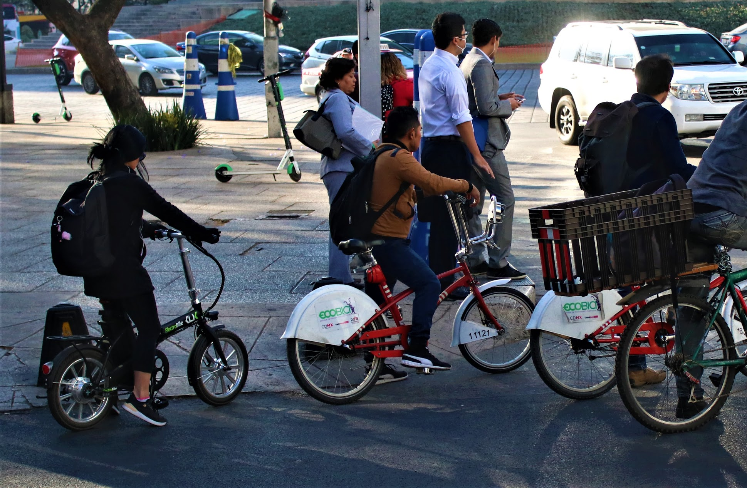
Ranking Ciclociudades
Sonia N. Medina Cardona
Clara Vadillo Quesada
February 27th, 2020

Slide 2
Content
Background
What is the Ranking Ciclociudades?
Methodology
Application
Results
Lessons learned and next steps

Slide 3
Ranking Ciclociudades
Background
The Ranking Ciclociudades is part of the Ciclociudades Strategy, a program created by ITDP Mexico in 2011.
The most representative element of the strategy is the Ciclociudades Manual, which provides technical information to local governments for the development of comprehensive cycling policies.

Slide 4
Ciclociudades Manual
Bicycle mobility as a public policy
Bicycle mobility program
Cycling infrastructure network
Infrastructure
Intermodality
Education and promotion

Slide 5
Ciclociudades Strategy
Ciclociudades
manual content
Ranking ciclociudades indicators

Slide 6
Ranking Ciclociudades
¿What is it?
It is an evaluation project that seeks to measure the evolution of cycling mobility policies in Mexican cities.
It functions as a tool to measure in a practical and coherent way cycling mobility policies.

Slide 7
Ranking Ciclociudades
Objective
Lead bicycle mobility public policies through open information and to everyone who is interested in encouraging bicycle mobility projects and public policies in their area.

Slide 8
The Ranking Ciclociudades throughout the years

Slide 9
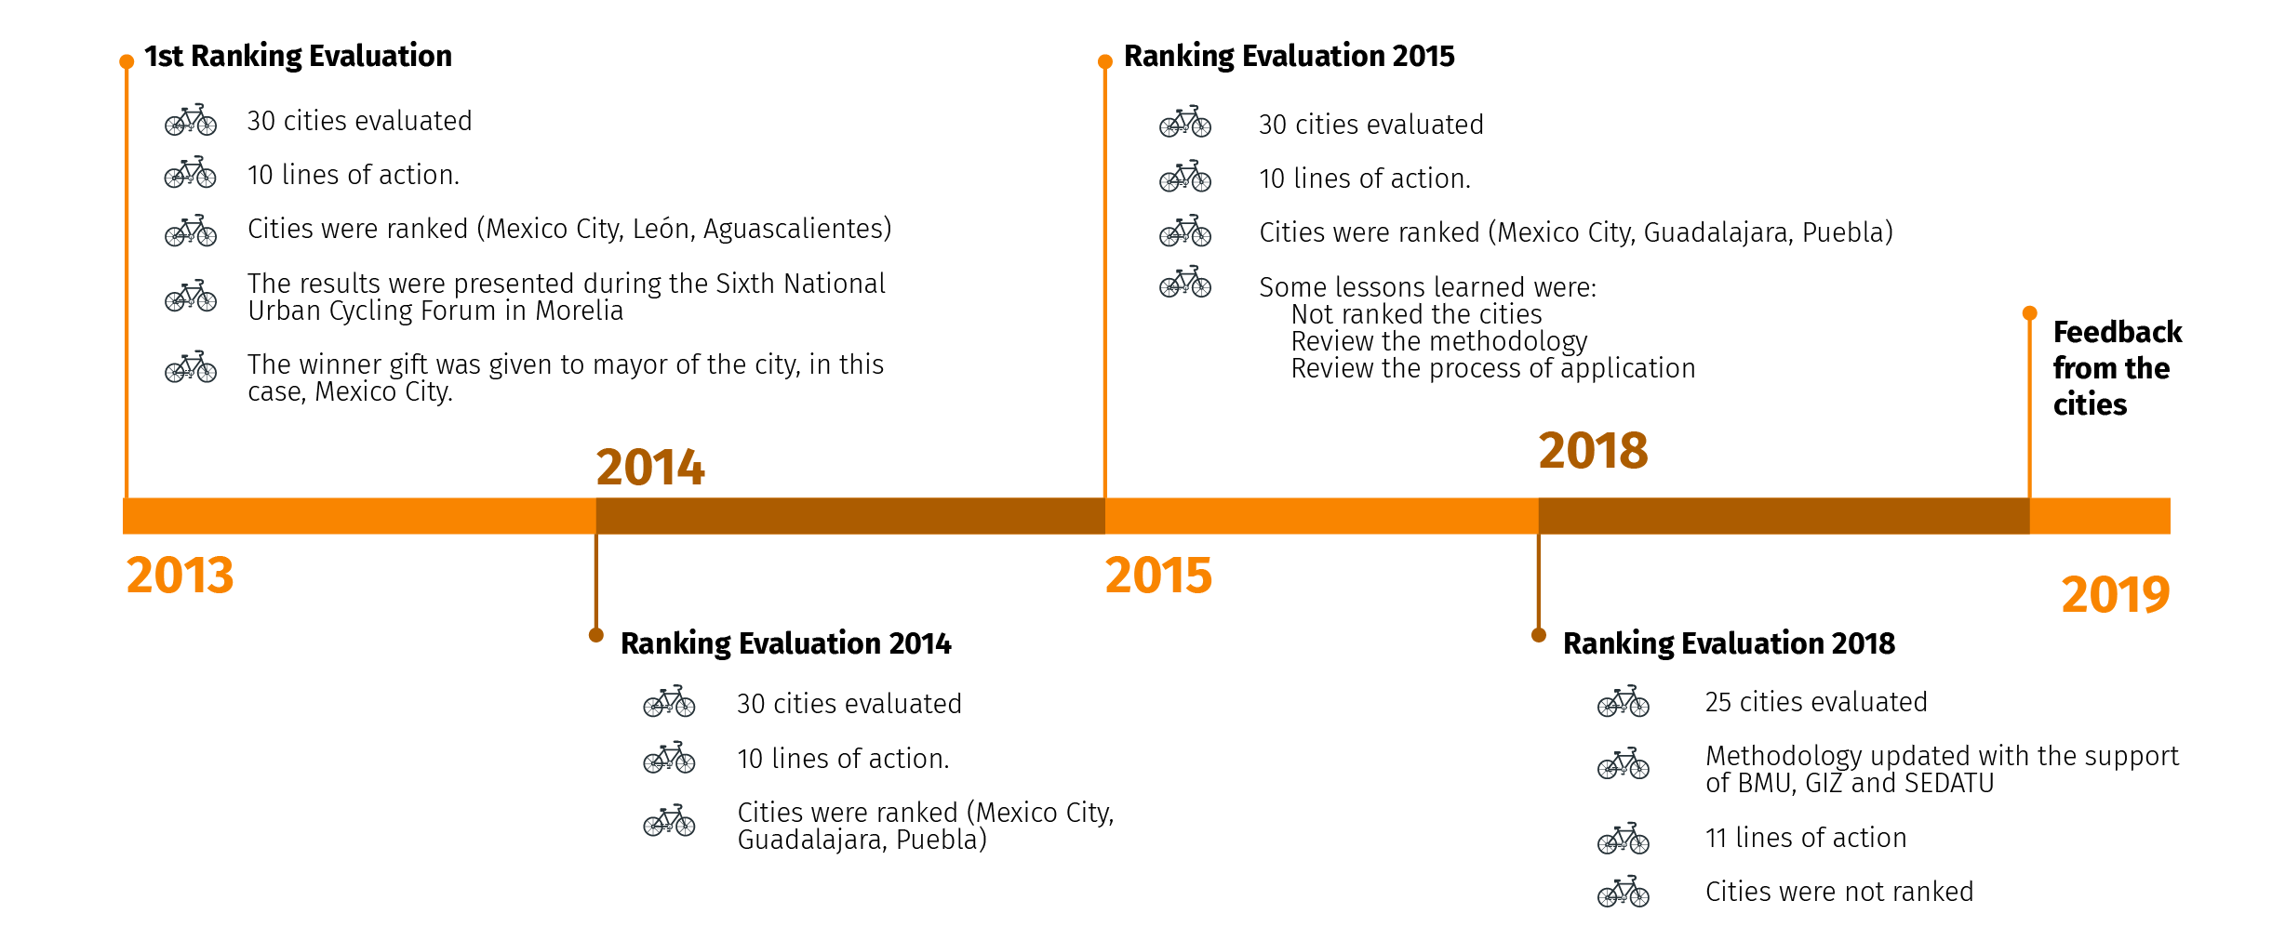
Timeline

Slide 10
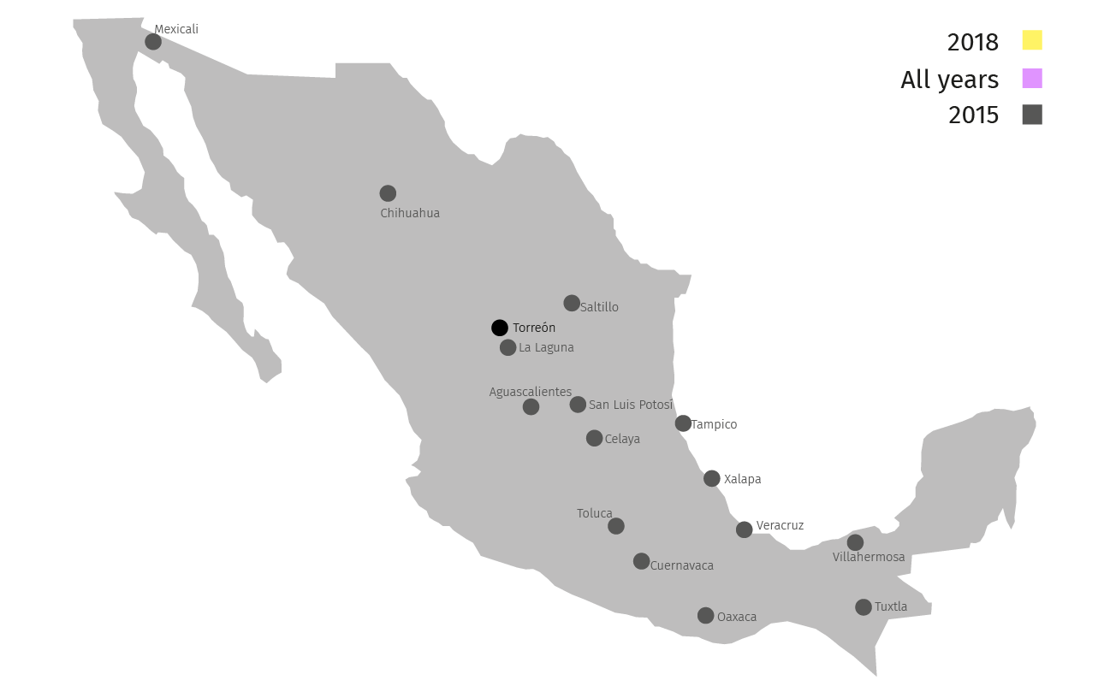
Ranking Ciclociudades
Scope
2013-2015
30 cities with largest population, concentrating 56.3 million inhabitants (more than 50 % of the country’s population)
(Acapulco, Cancún, Mexico City, Ciudad Juárez, Culiacán, Guadalajara, Hermosillo, Mérida, Monterrey, Morelia, Pachuca, Puebla, Querétaro, Tijuana, Toluca, San Luis Potosí, Aguascalientes, Mexicali, among others)

Slide 11
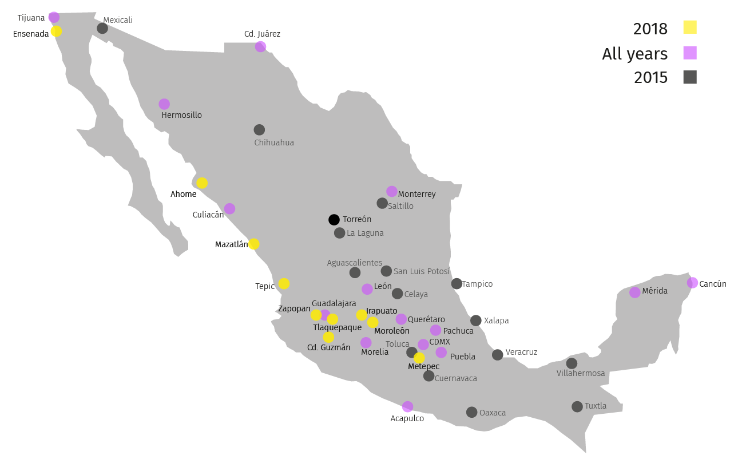
Ranking Ciclociudades
Scope
2018
25 cities:
15 cities evaluated again (besides 2015)
(Acapulco, Cancún, Ciudad de México, Ciudad Juárez, Culiacán, Guadalajara, Hermosillo, Mérida, Monterrey, Morelia, Pachuca, Puebla, Querétaro, Tijuana)
10 new cities
(Ahome, Ciudad Guzmán, Ensenada, Irapuato, León, Mazatlán, Metepec, Moroleón, Tepic, Tlaquepaque, Zapopan)

Slide 12
Ranking Ciclociudades
Methodology
The Ranking Ciclociudades methodology has evolve over the years so we have updated its indicators since it started.

Slide 13
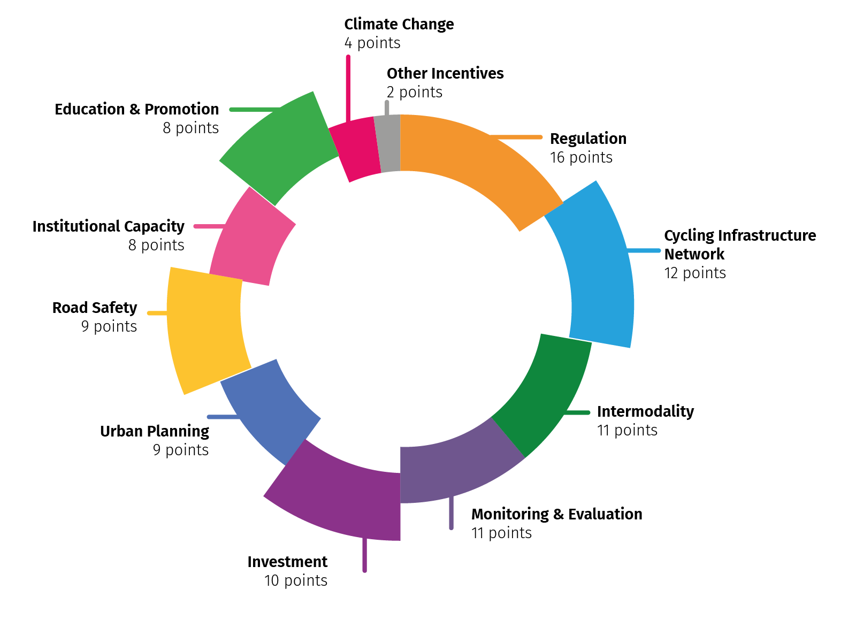
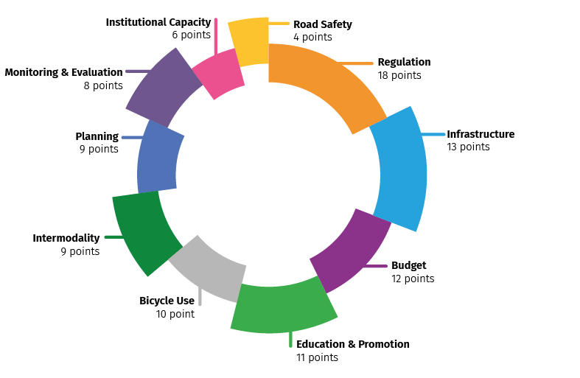
Ranking Ciclociudades
Update
2013 to 2015
2020
10 lines of actions
11 lines of actions

Slide 14
Ranking Ciclociudades
Update
Two new lines of action
Climate Change
Other incentives
Two cross-cutting themes
Gender perspective
Road Safety
Some other adjustments
Infrastructure
Budget
Bicycle use
Monitoring and evaluation
Cycling infrastructure network
Investment
Monitoring and evaluation

Slide 15
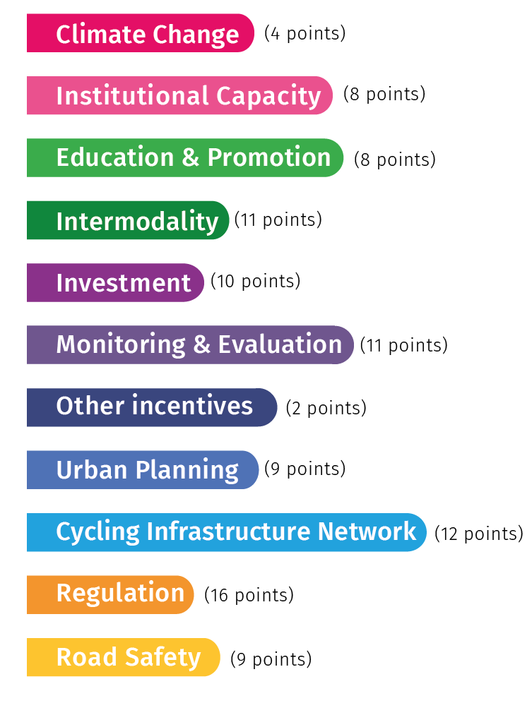
Ranking Ciclociudades
2020 lines of action

Slide 16
What evaluates each line of action?

Slide 17
Lines of action
Plan or program for the mitigation or adaptation to climate change. Strategies integrated in a local planning program or in a regional planning program. Goals of emissions reduction and active mobility are linked.
The city or state has an emissions inventory or an atmospheric monitoring system.
The information is disseminated regularly to the citizens through reports, platforms or air quality applications, environmental education programs among others.
Climate change
Total points
4

Slide 18
Lines of action
Institutional capacity
Area or department formed by a multidisciplinary team, specialized in sustainable urban mobility that oversees cycling mobility.
Coordination at the local and regional/metropolitan level.
Inclusion of women in different areas related to cycling and sustainable urban mobility.
≥ 45 %
Technical capacity of people working at the local government.
≥ 50 %

Slide 19
Lines of action
Remarkable days celebrations related to the use of the bicycle or the reduction of the use of the automobile such as World Bicycle Day, Car Free Day among others.
Urban cyclist manual published or recognized by the local government.
Urban cycling workshops or trainings organized by government or in coordination with cyclist advocates, such as cycling schools and trainings for public transport operators.
Awareness campaigns on the benefits of cycling.
Development of a “Ciclovía recreativa”.
Cycling schools during school time.
Education & promotion
Total points
8

Slide 20
Lines of action
50% of the public transport system stations have cycling parking facilities for short-duration in around 200 mts.
Bicycle are allowed to travel on board of the public transport system at least in some hours or the buses have racks to transport bicycles.
Cycling parking facilities for long-durations close to other public transport systems.
Bike sharing or micro mobility systems.
Presence of cycling cabs in the city.
Safe and comfortable infrastructure in 1 km radio of a bus terminals.
Intermodality
Total points
11

Slide 21
Lines of action
Investment
Measured through:
The resources allocated to cycling infrastructure (per inhabitant) coming from federal funds. (Bicycle lanes building. Bike sharing systems. Bicycle Parking. Infrastructure projects. Planning for cycling mobility).
The resources allocated to cycling infrastructure (per inhabitant) coming from local funds. (Bicycle lanes building. Bike sharing systems. Bicycle Parking. Infrastructure projects. Planning for cycling mobility). Also if the money is used for bicycle schools, communication campaigns, “Ciclovia recreativa”, among others)
as compared to the previous analysis period.
Financial resources allocated to cycling infrastructure, per inhabitant.
Total points
10

Slide 22
Lines of action
Existence of a baseline of cycling counts / cyclists’ profile.
Information on the current conditions of cycling infrastructure.
Cyclists represent 1 to 2%, or more than 2% of trips.
Annual publication of a report on the evolution of cycling mobility.
Origin and destination surveys (updates every 10 years or done after 2010) or any other survey that inform the bicycle modal split in the city.
Existence of city programs that oversees the obstruction of bicycle lanes.
Monitoring & evaluation
Total points
11

Slide 23
Lines of action
Urban planning
Urban cycling is mentioned and provided for urban development and environmental programs, transit regulations and mobility laws .
There is a recent (less than 5 years) mobility program with a transversal gender perspective and inclusion.
There is a cyclists mobility plan, program, strategy or study (with less than 5 years) that contains a proposal for a network of cycling infrastructures, with goals, evaluation indicators and a transversal gender perspective and inclusion.
Total points
9

Slide 24
Lines of action
Cycling infrastructure forms a network and follows adequate criteria: coherence, directness, safety, comfort and attractiveness.
Cycling infrastructure has grown in reference to the last year of evaluation.
Cycling-inclusive projects such as 30 km/hr zones or accessibility for people with disabilities.
The city has guidelines to link green infrastructure with cycling infrastructure (shared or segregated) with greenery that creates shade and regulates microclimates.
Cycling infrastructure network
Total points
12

Slide 25
Lines of action
Transit:
The bicycle is recognized as a vehicle
It is not mandatory for cyclists to use cycling infrastructure when it exists
Safety:
The speed limit in main roads is 50 km/hr
Helmet use is not mandatory
Design:
The construction of cycling parking facilities is included in regulation (construction norms for instance)
Regulation
Total points
16

Slide 26
Lines of action
Reduction in road traffic serious injuries and fatalities in which cyclist are involved: Cyclists fatalities rate for each 100,000 inhabitants.
Operative existences of an intersectoral working group: board to prevent road traffic fatalities or a road traffic serious injuries observatory (local or regional).
Safe road design based in fatalities data or in priority zones of action.
Identification of high incidence or risk points and related projects.
Application of road safety inspections or audits and related projects.
Road safety campaigns focusing in the protection of pedestrian and cyclists.
Road safety
Total points
9

Slide 27
Lines of action
Other incentives
Existence of parking meters in the city.
Economic incentives for people to
bike to work.
Total points
2

Slide 28
Ranking Ciclociudades
Application
A form is filled in either by government, civil society, or both (together or separate), in a given period of time.
ITDP receives the information and fact-checks it, mainly through desk research.
Notes:
Además, con los resultados, se generan insumos para fortalecer la planeación de movilidad en bicicleta y con ello un diagnóstico para que las ciudades puedan avanzar en las metas establecidas a nivel local.

Slide 29
2018 results
Facilitado por:

Slide 30
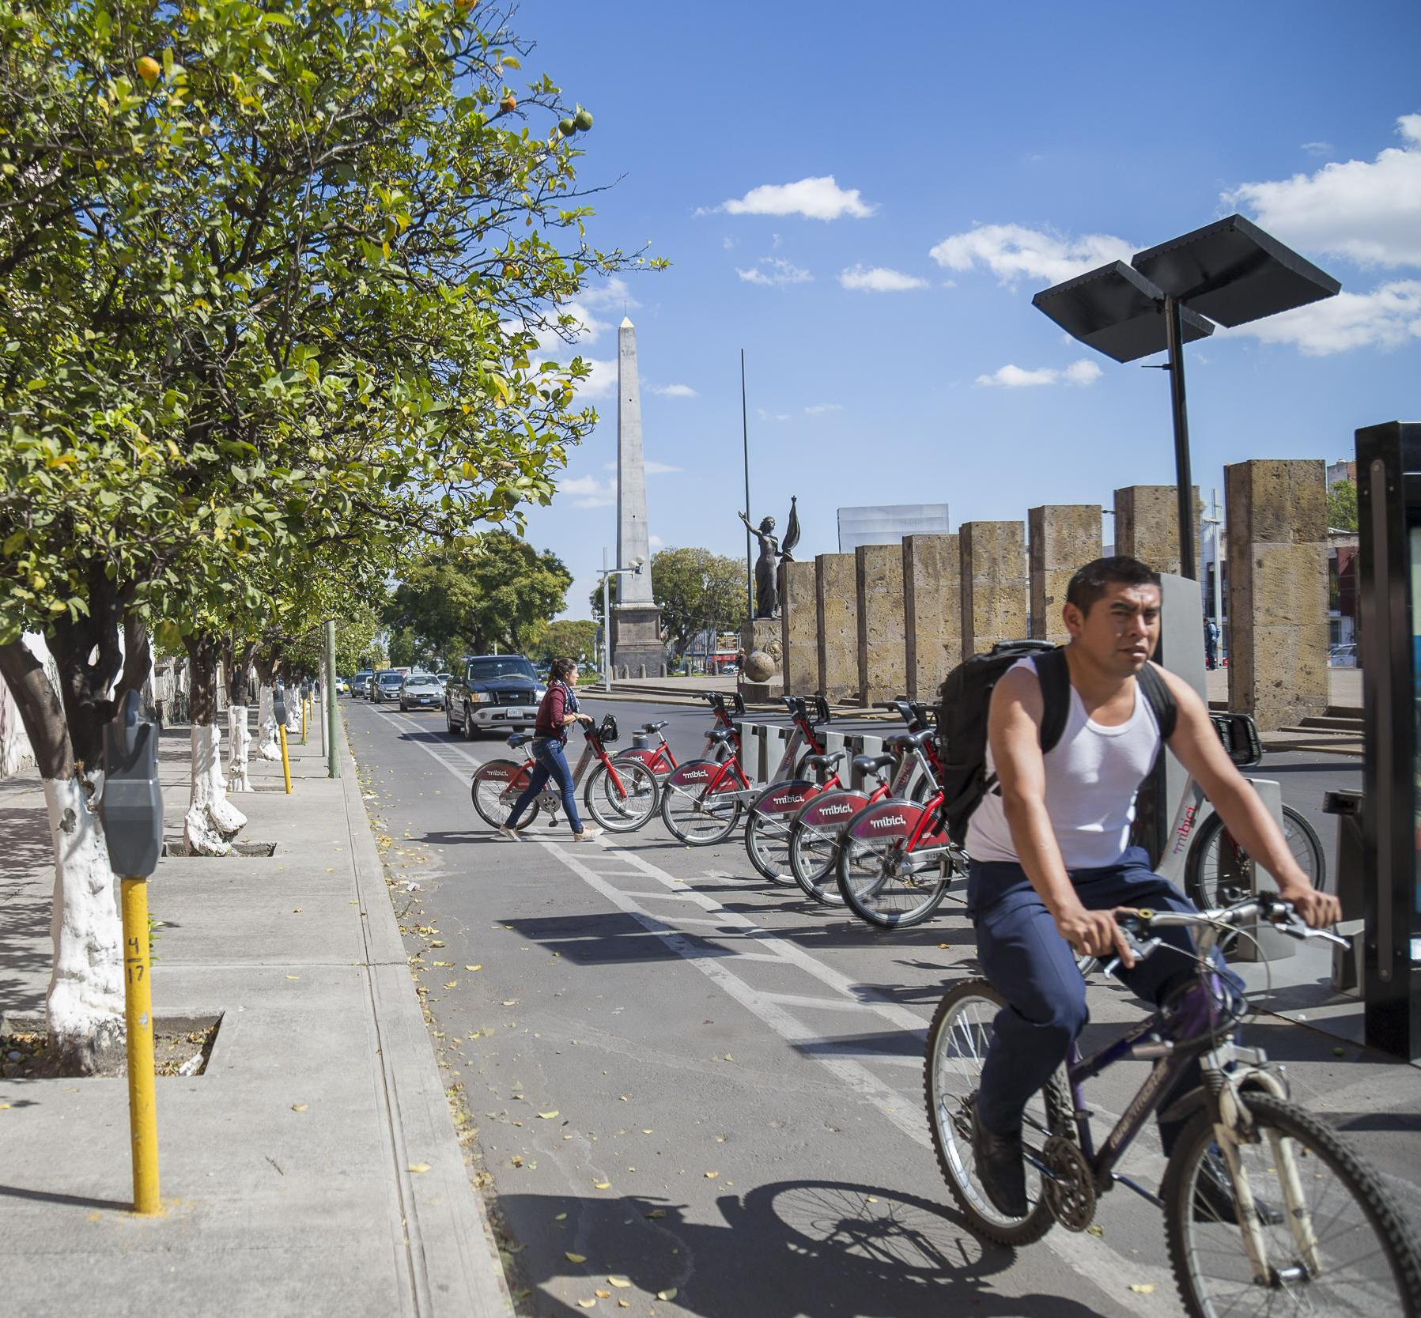
2018 results
Investment
Guadalajara
5/10
13%
12%
Notes:
The metropolitan area of Guadalajara invested 162 million pesos / 8.5 million USD coming from a federal fund to create the public bike share system and low speed zones in historic centers in two municipalities. In 2017, 32% of the budget allocated to mobility went to cycling infrastructure only.

Slide 31
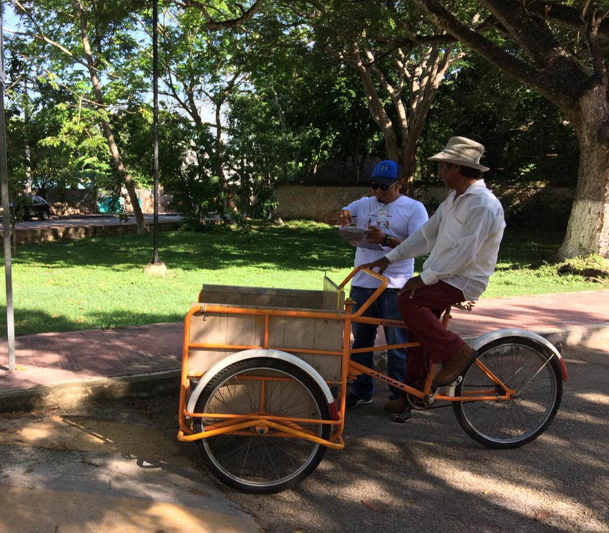
2018 results
Monitoring & evaluation
Mérida
7/11
Notes:
Cycling counts on strategic points of the city for the planning of cycling infrastructure construction. Cyclists profile: qualitative information about sociodemographic characteristics of cyclists in the city, why they cycle, the barriers they encounter to keep on doing so, and other pieces of information that could not have been gathered.

Slide 32
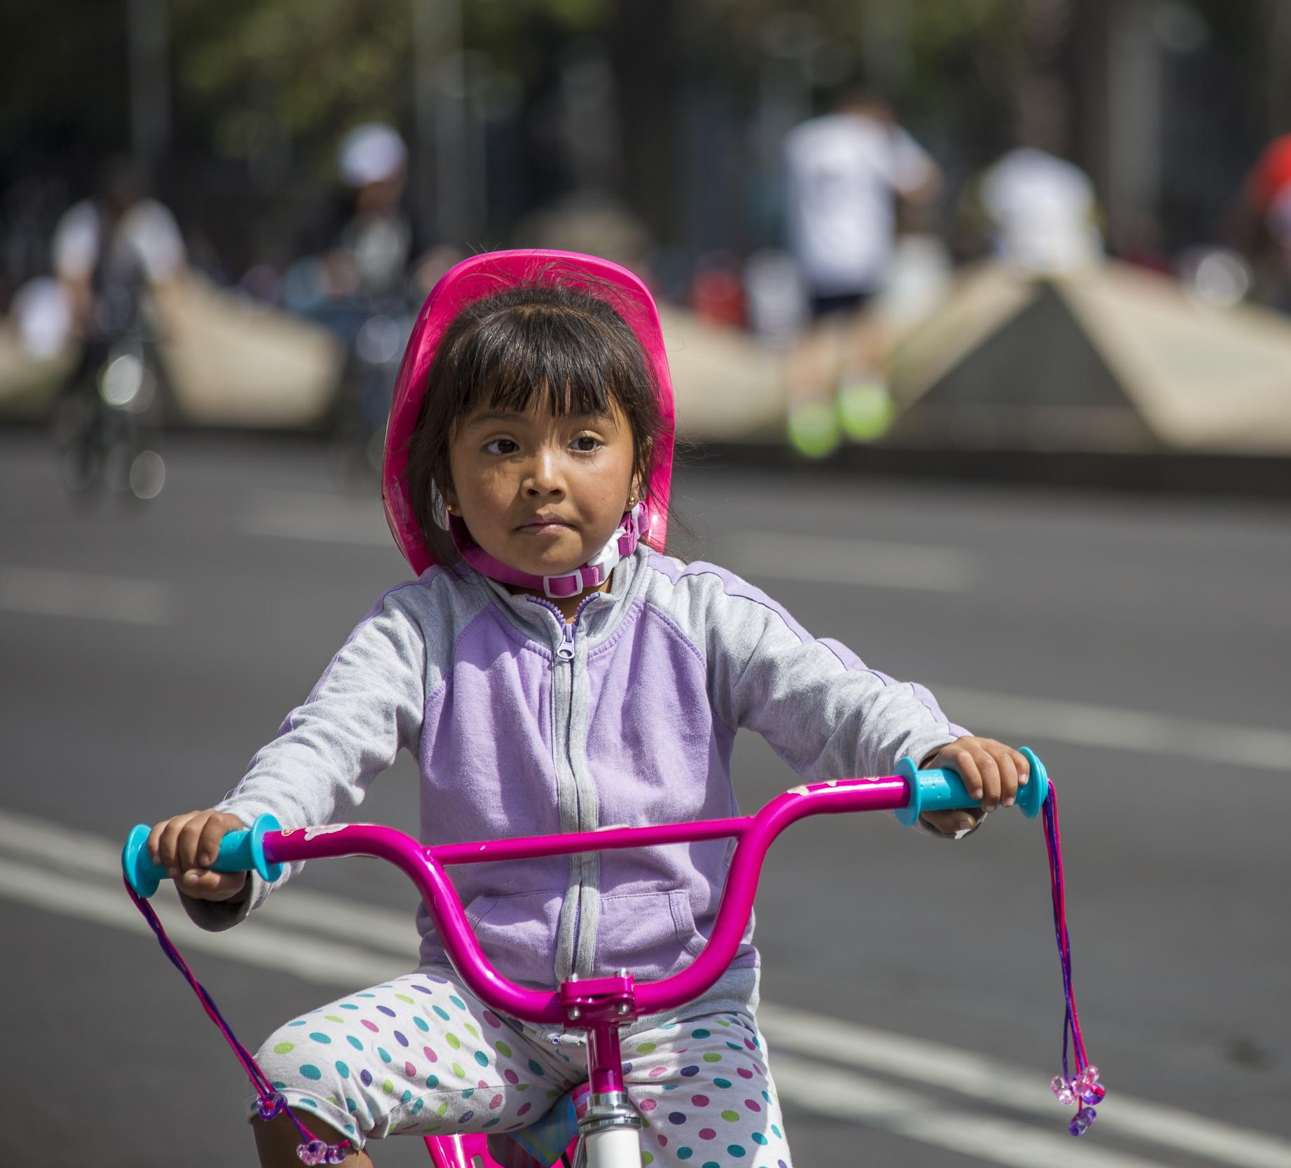
2018 results
Education & promotion
Mexico City
6/8
39%
30%
Notes:
Mexico City has several cycling schools distributed around the city who teach children and adults how to ride a bike. The classes are free and have allowed X people to use their bike as a mode of transport.

Slide 33
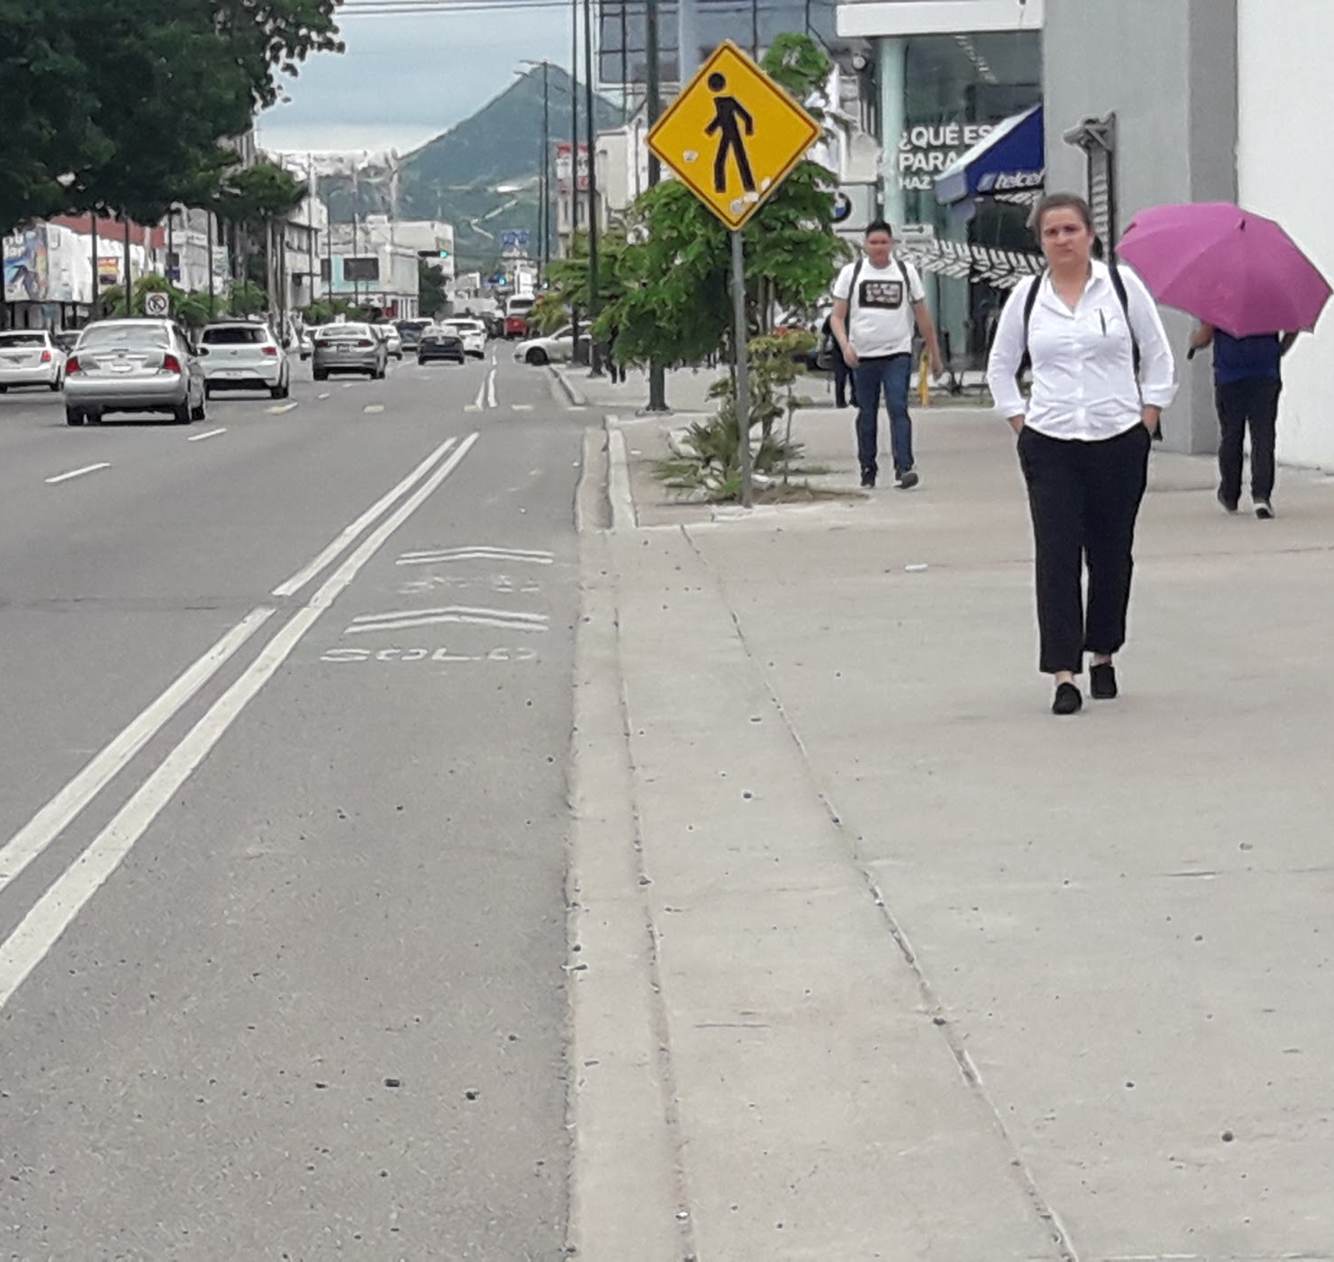
2018 results
Cycling infrastructure network
Hermosillo
3/12
35%
10%
Notes:
Hermosillo has created X km of cycling infrastructure in a very short period of time. It also has a manual for green infrastructure that offers technical guidelines for the inclusion of local vegetation in urban projects; this manual is the first of its kind among Mexican cities.
Cities such as Guadalajara and Zapopan have 9 out of 12 points, Mexico City 8

Slide 34
2018 results
Other incentives
Ahome | 2 puntos
Ciudad de México | 2 puntos
Guadalajara | 2 puntos
Hermosillo | 2 puntos
Metepec | 2 puntos
Puebla | 2 puntos
Querétaro | 2 puntos
Zapopan | 2 puntos
Total points
2

Slide 35
Did something change?

Slide 36
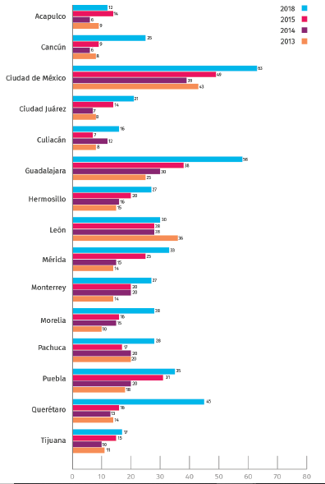
Evolution of city scores 2015-2018
From 2015 to 2018, the average score of cities rose from 11.08 to 28.68 points.

Slide 37
Evolution of city scores 2015-2018
From 2015 to 2018, the average score of cities rose from 11.08 to 28.68 points.
But there still is much to be done:
Investment has stagnated
Lack of technical capacities and of metropolitan coordination
Insufficient road safety data and isolated actions
Women in technical and decision-making positions

Slide 38
How is it useful to cities?

Slide 39
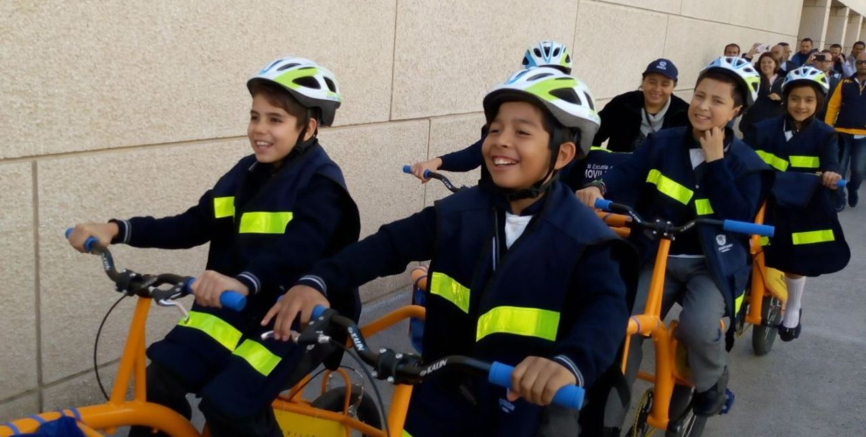
Evolution of city scores 2015-2018
Querétaro
Source: Noticiero Televisa

Slide 40
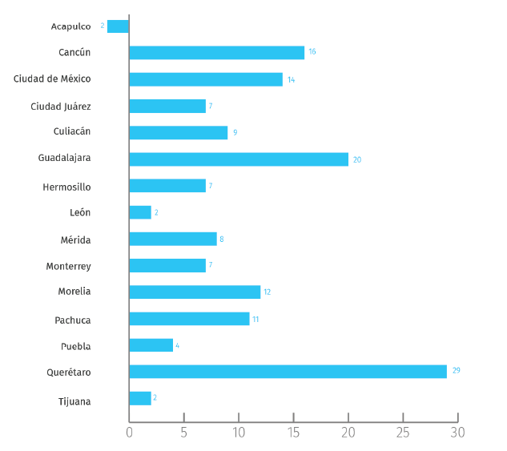
Evolution of city scores 2015-2018
...and the improvement is visible.
Notes:
L

Slide 41
The Ranking is no longer a contest, but a tool to identify the strengths and weaknesses of each city and measure progress.

Slide 42
Ranking Ciclociudades
Lessons learned and next steps
Open and accessible information is key to monitor and evaluate progress made in cycling mobility policies.
Participation from civil society and government is fundamental.
The ranking is useful even if not much is going on in your city yet: it’s a starting point for future improvement.

Slide 43
México se sube a la bici

Slide 44
Thank you!
::: mexico.itdp.org ::: @ITDPmx
sonia.medina@itdp.org
clara.vadillo@itdp.org

