Slide 1
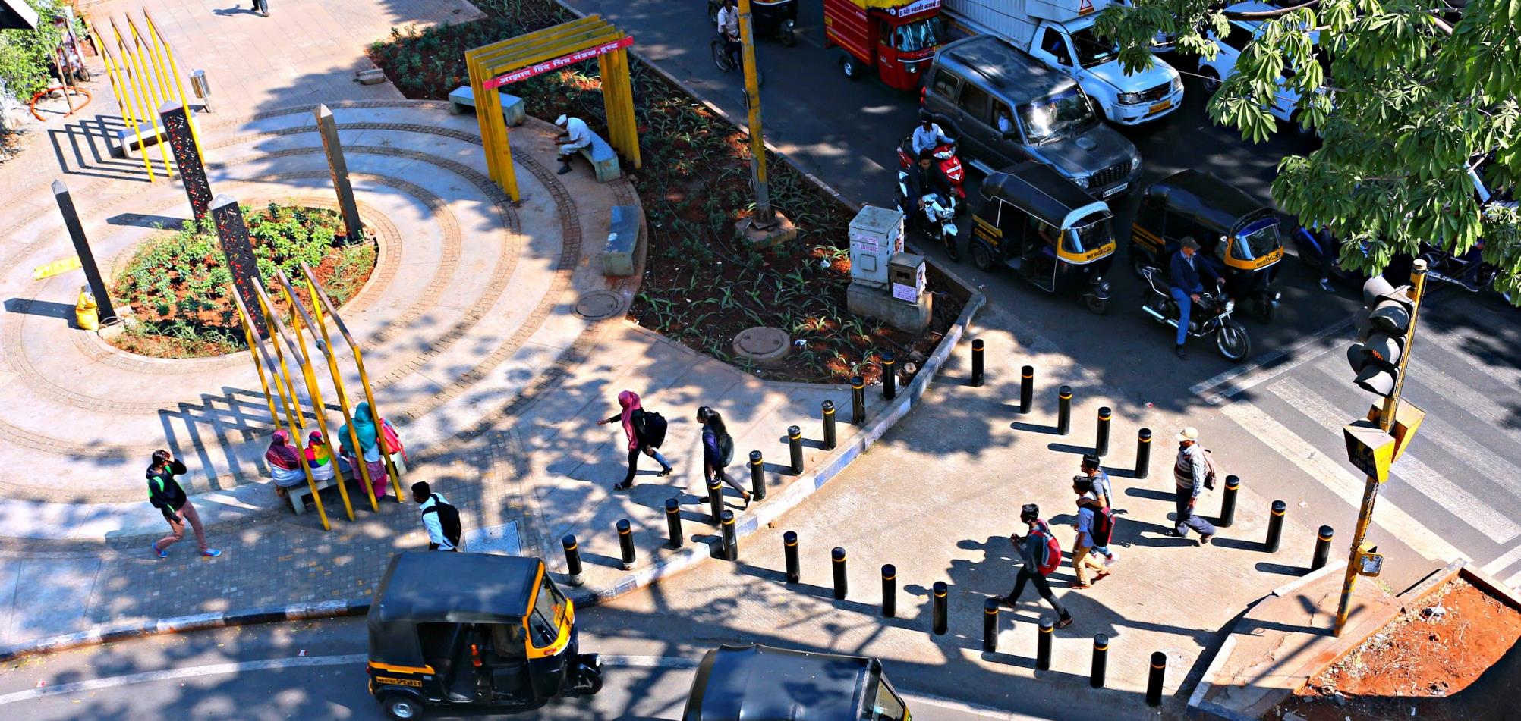
It’s like riding
Better cities through better streets
Your Own ITDP PowerPoint Template
Notes:
Hello everyone, I am Aswathy Dilip. Welcome to today’s webinar on Creating better cities through better streets.

Slide 2
Better cities through better streets
Creating better streets
in Indian cities:
The journey
Notes:
Over the next hour, I will take you through ITDP India’s journey inspiring Indian cities to create better streets;

Slide 3
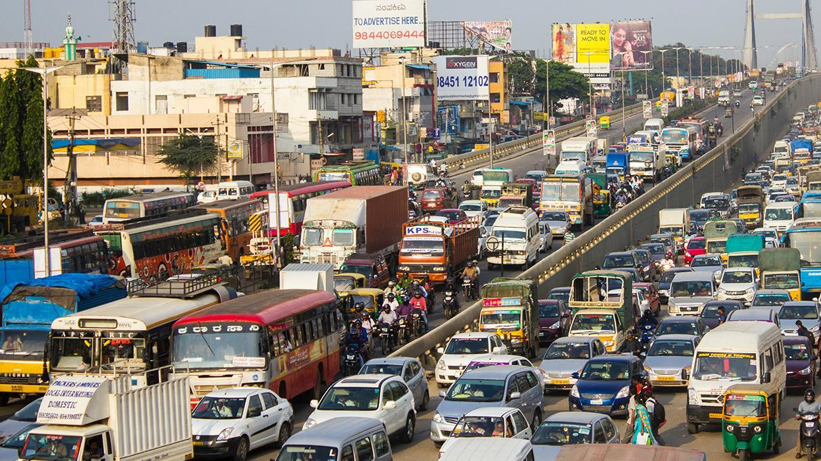
Notes:
2009: Chennai’s vehicle population is rising at an alarming pace. We have 30.25 lakh registered vehicles in the city. We need more space for them!

Slide 4
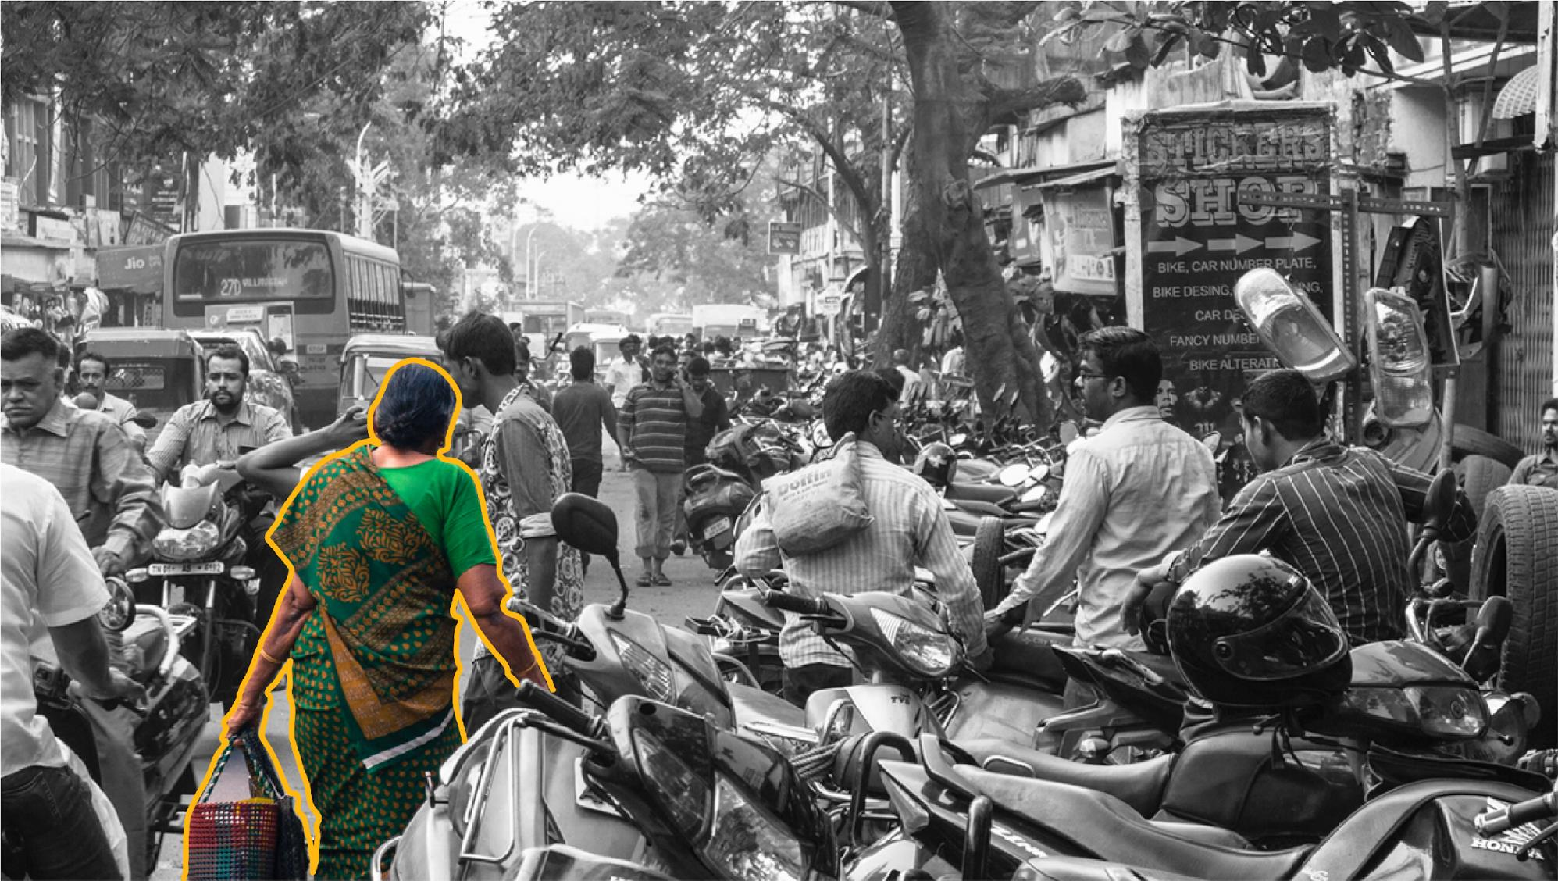
“I walk with my heart in my hand.”

Slide 5
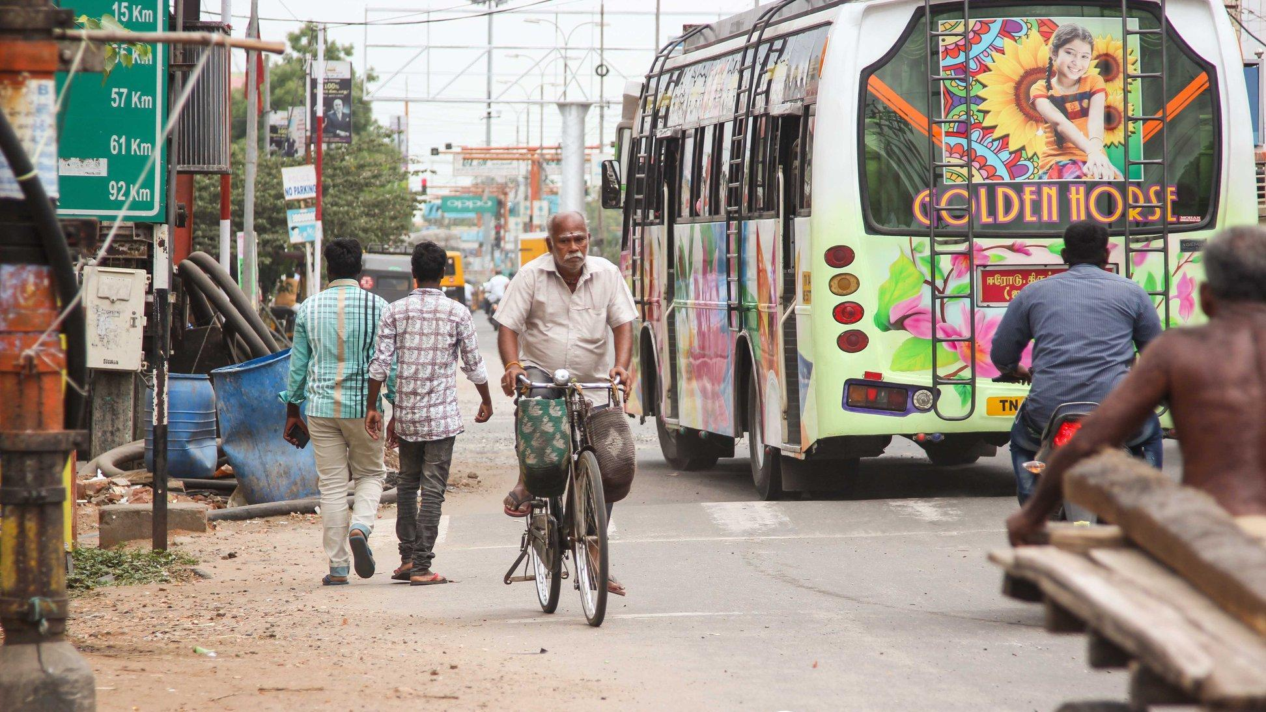
“I have been cycling for more than 40 years.”

Slide 6
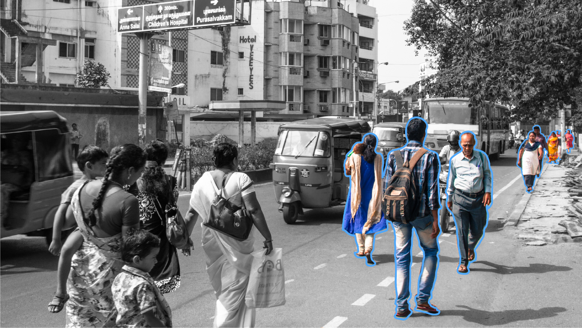
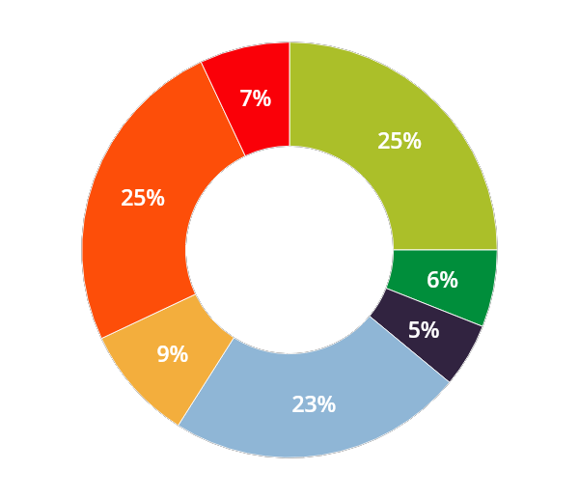
Two third of all trips are by walk, cycle or public
transport

Slide 7
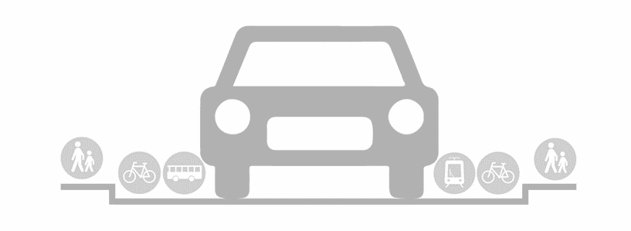
Yet, the design of our streets tends to push the vulnerable users to the fringes of the road
How most cities are designed
How world’s best cities are designed

Slide 8
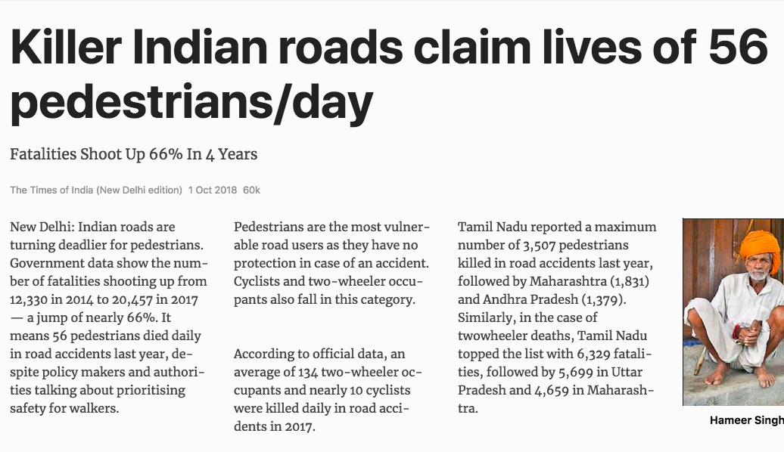
3507
Resulting in loss of precious lives every day
pedestrians killed in Tamil Nadu in 2017.
Other states:
1831-Maharashtra
1379-Andhra Pradesh

Slide 9
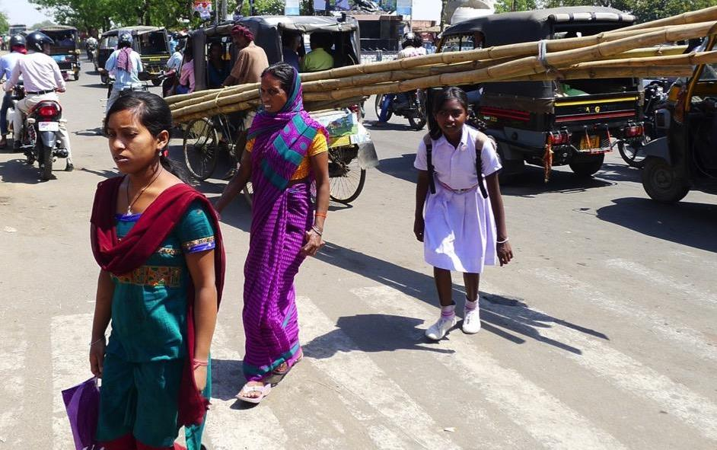
8/10 trips by women are on foot or public transport

Slide 10
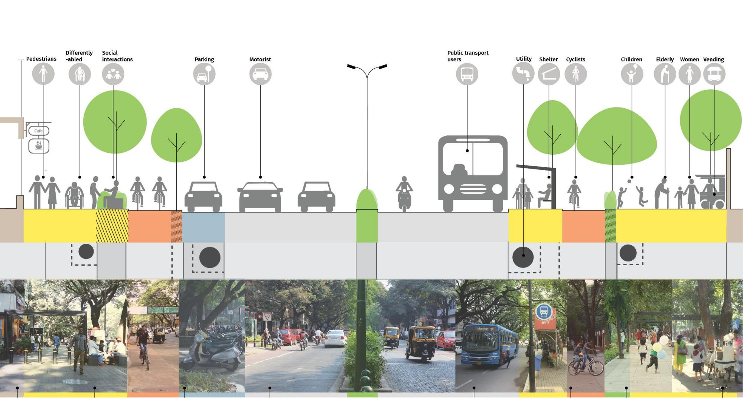
Designing ‘Complete Streets’ for all users and uses

Slide 11
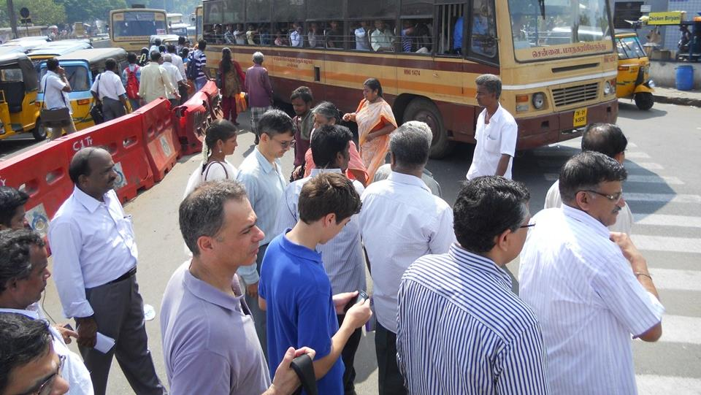
Inspiring champions and building
partnerships
A

Slide 12
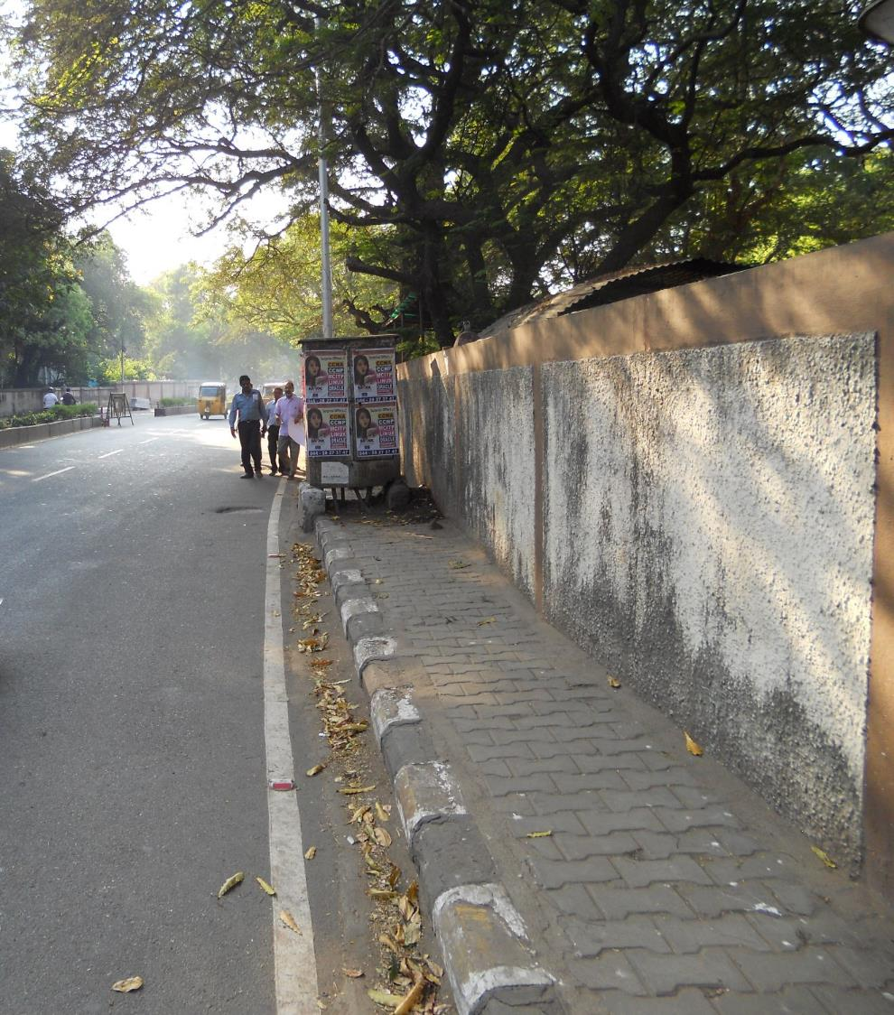
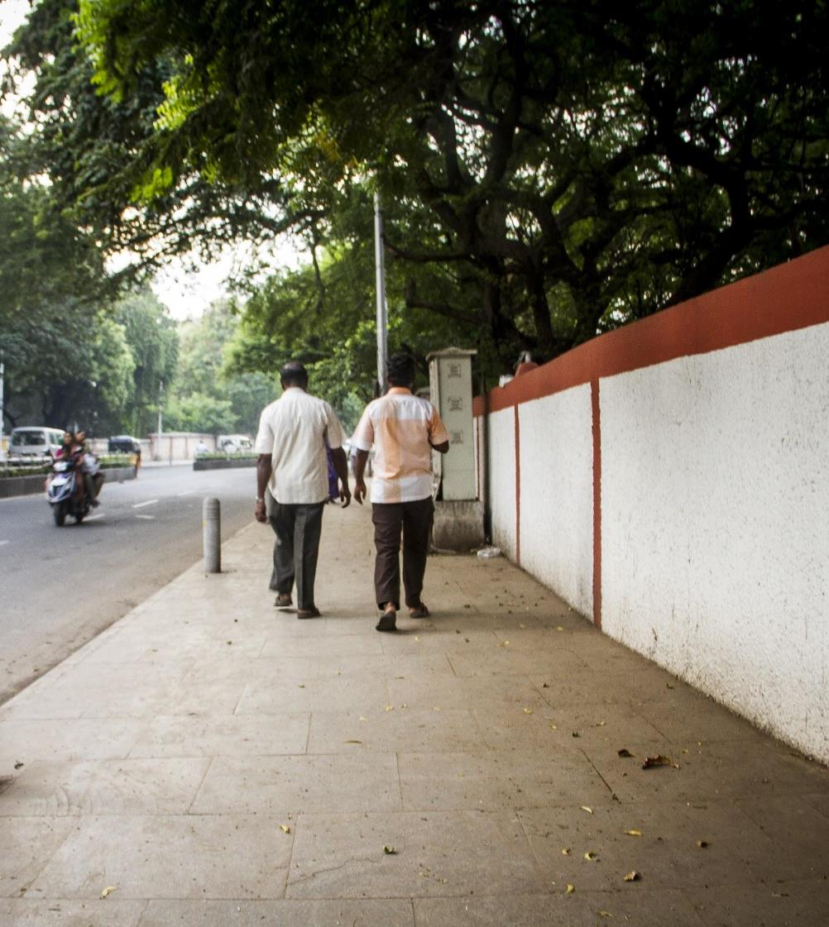
Pilots in collaboration with local designers

Slide 13
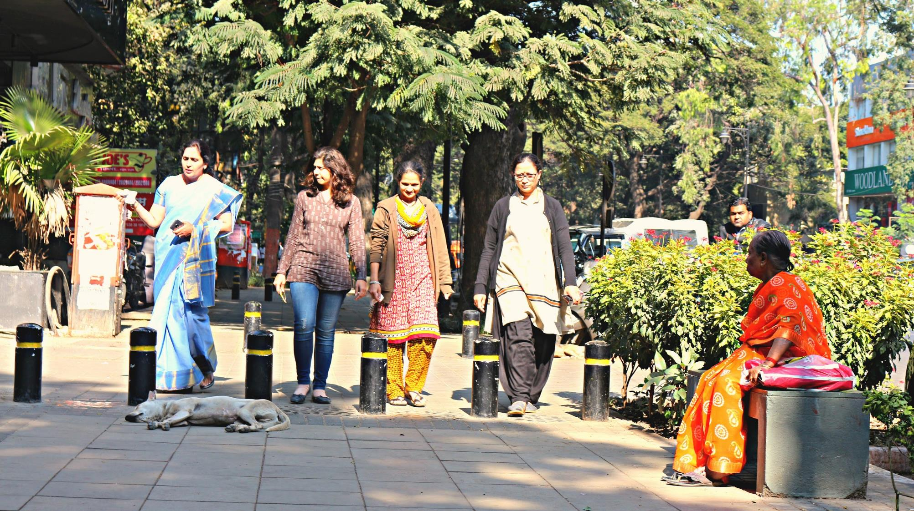
Embed changes through standards and
policy adoption
B

Slide 14
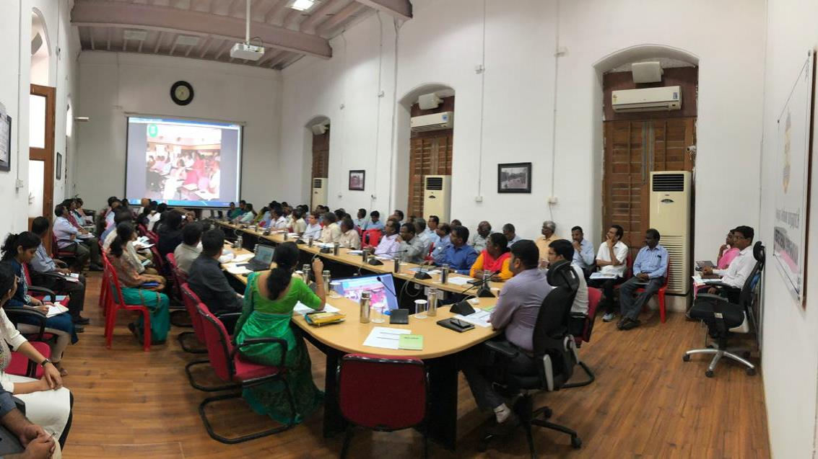
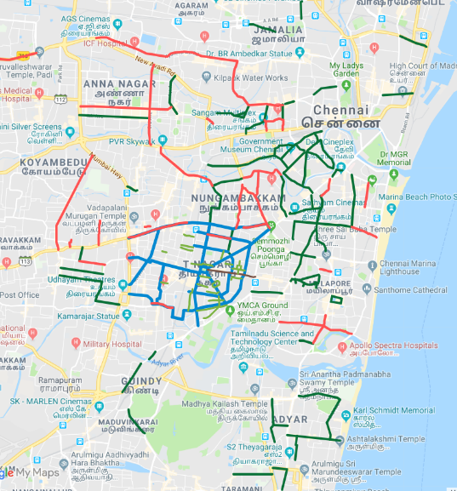
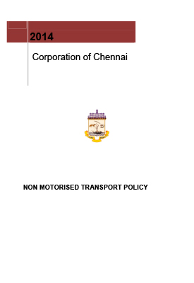
From 100kms to city-wide network plan

Slide 15
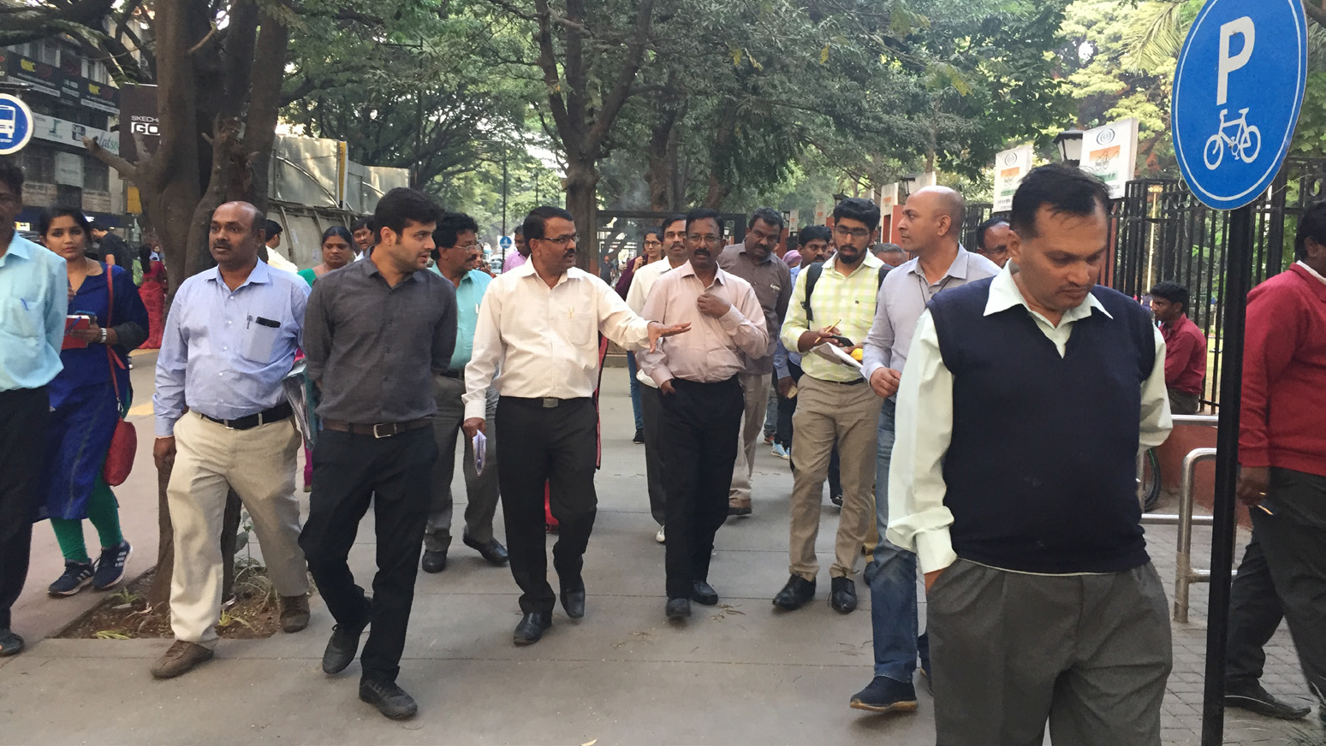
Expanding transformation: Institutional
reforms and capacity building
C

Slide 16
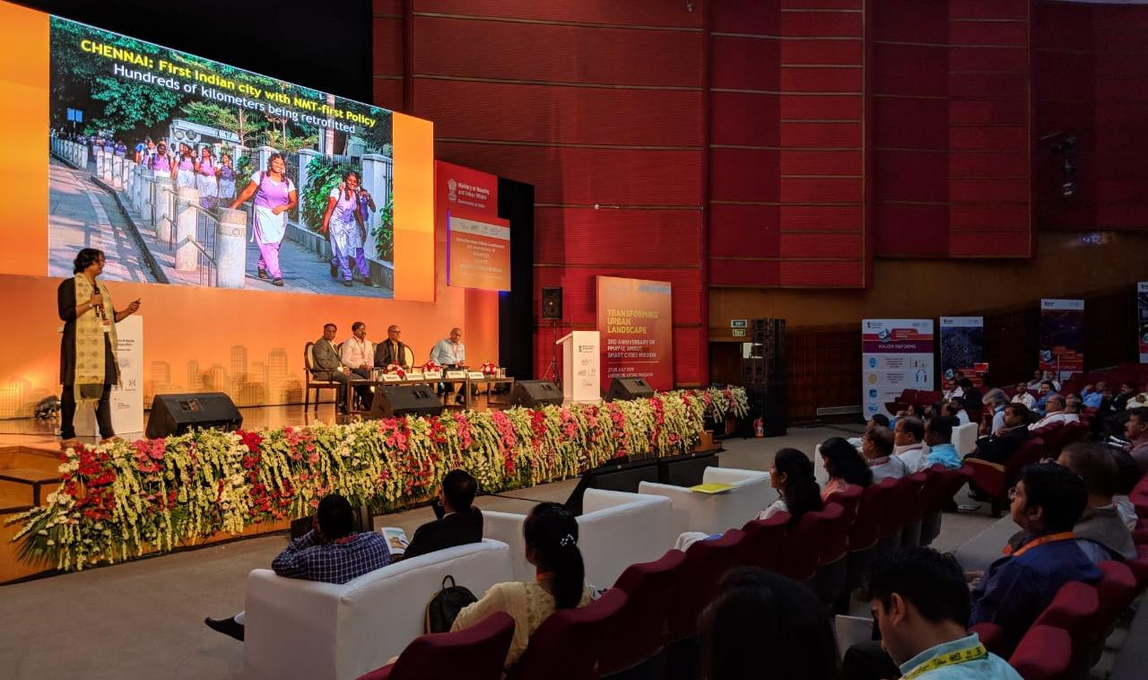
National Smart City Mission — a catalyst
Notes:
2015

Slide 17
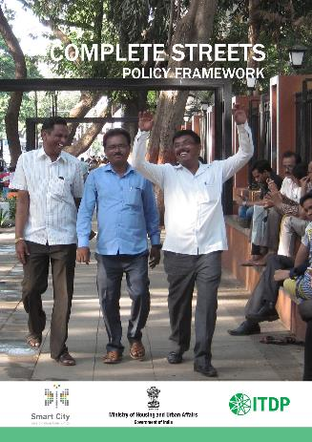
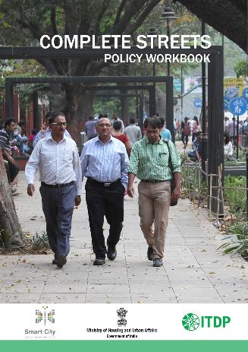
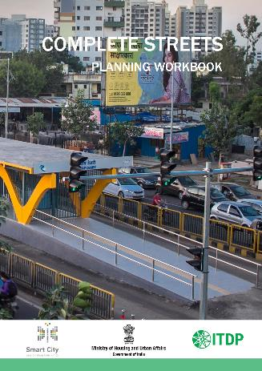
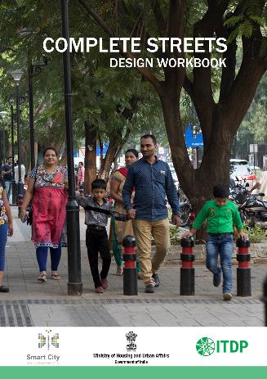
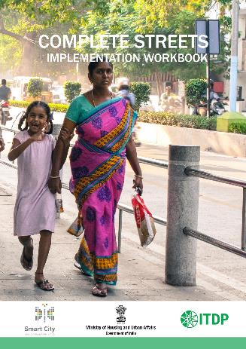
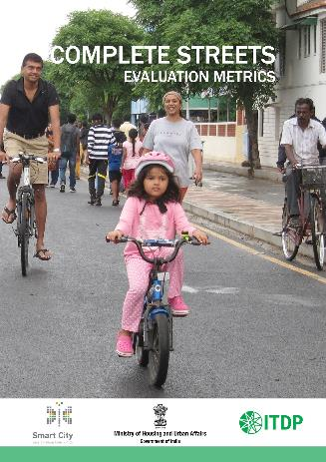
Developing national best practice standards

Slide 18
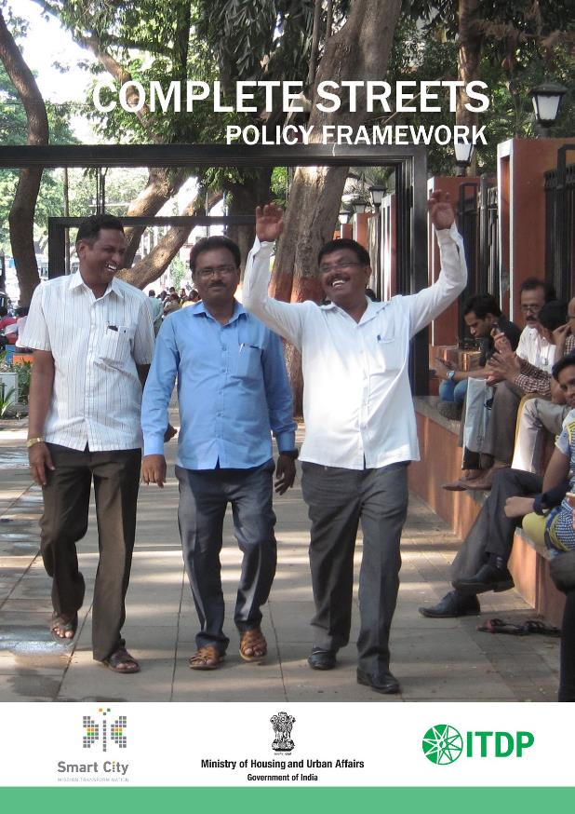
Better cities through better streets
Complete Streets:
Policy Framework

Slide 19
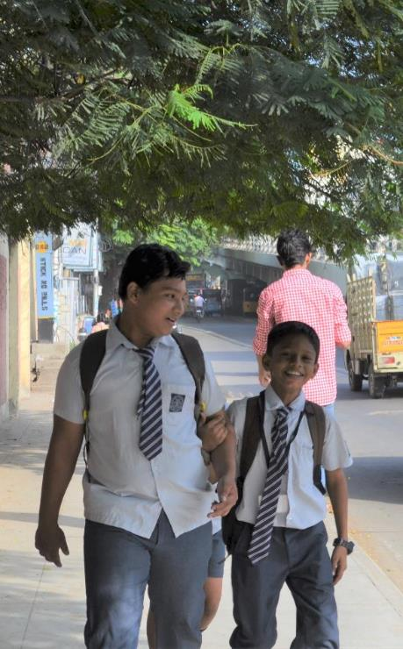
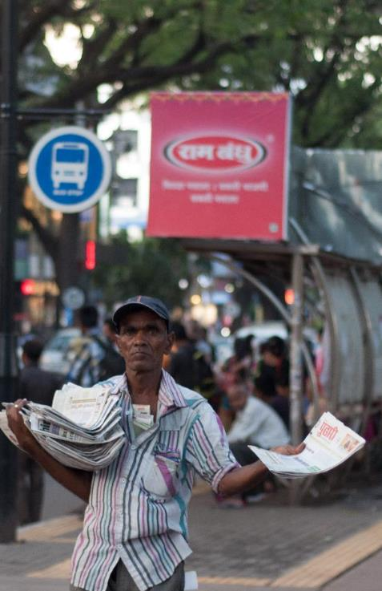
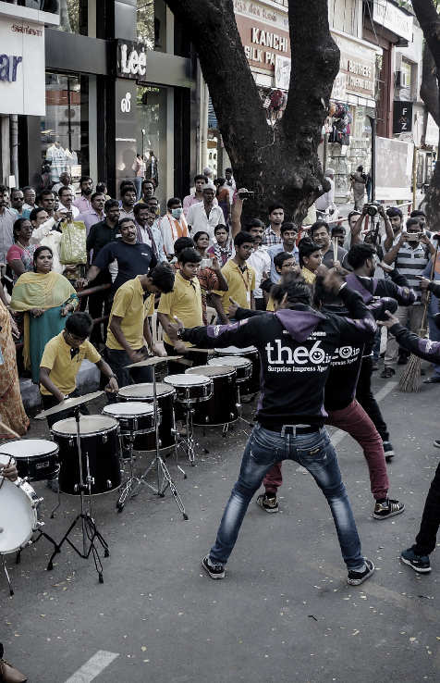
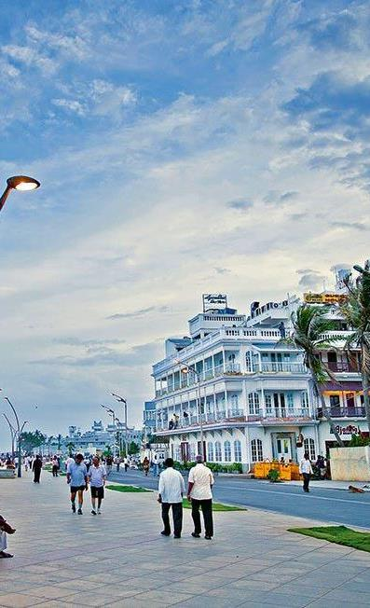
A street provides
Access to jobs, education and amenities
Economic Opportunities
Social and Recreational Opportunities
An identity to a city

Slide 20
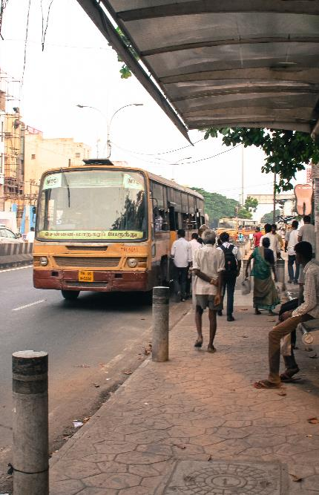
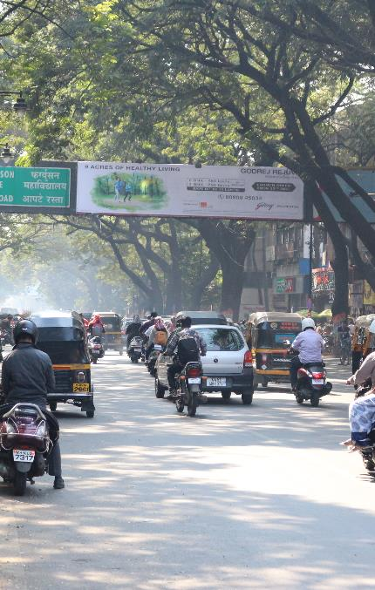
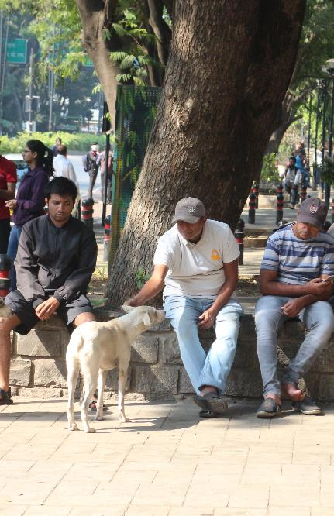
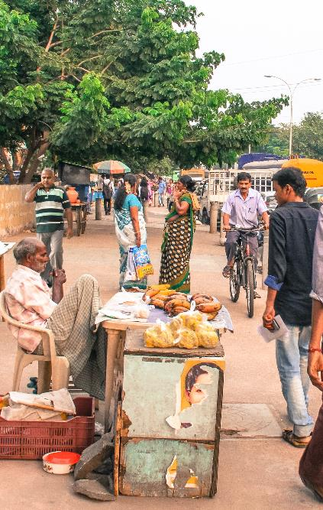
A street has many uses
For mobility & service infrastructure
Also as a public space
Walking and Cycling
Formal & Informal Public Transport
Personal Motor Vehicles – mobile and parked: Utilities
Gathering
Vending & Shopping : Eyes on the street

Slide 21
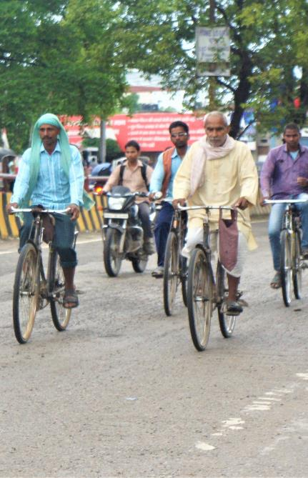
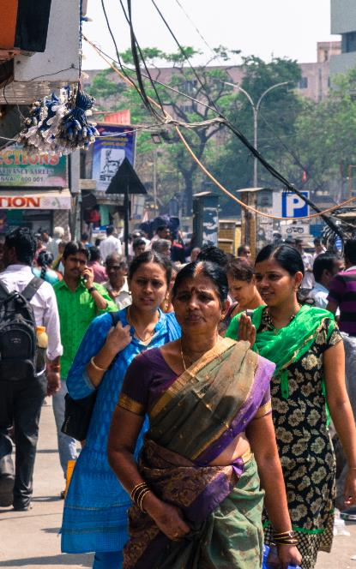
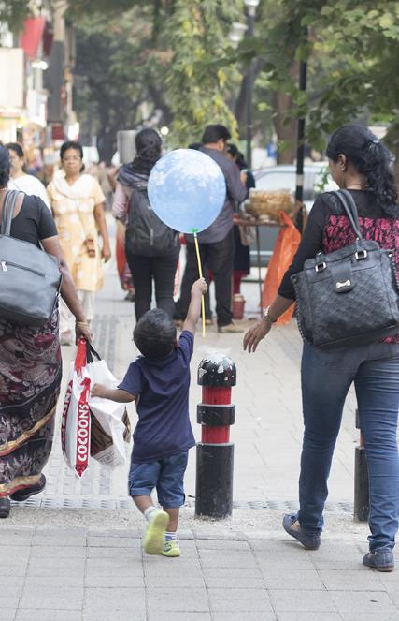
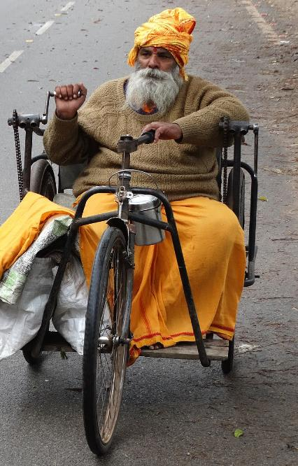
A street hosts many people
Of different transport modes and gender, Different age groups and physicalities
Pedestrians and Cyclists
Women as much as men
Dependent and independent children and elderly
The differently abled

Slide 22
Designing ‘Complete Streets’ for all users and uses

Slide 23
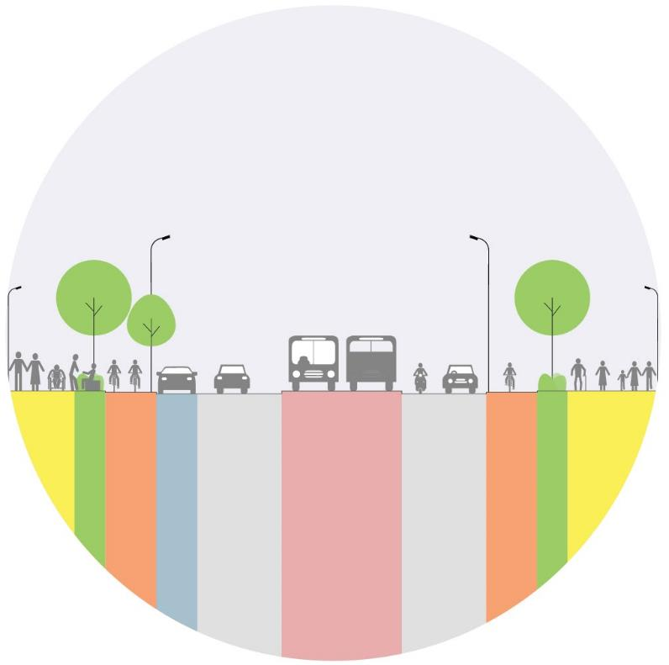
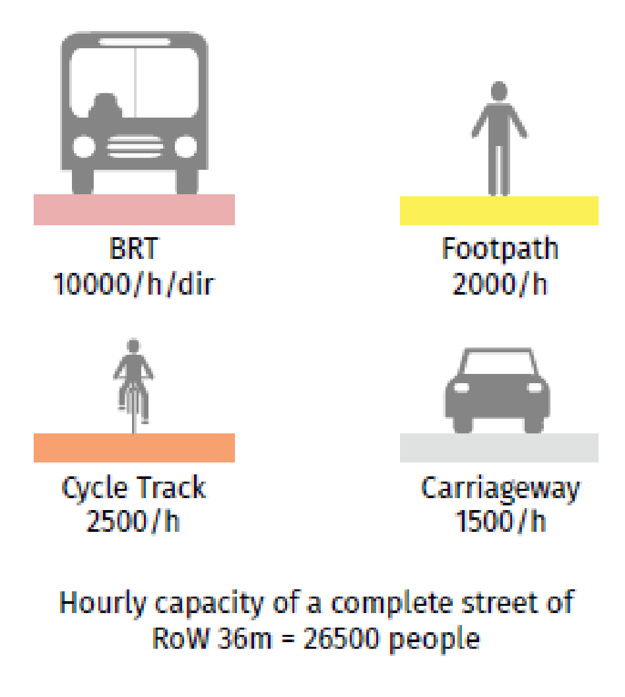
PRINCIPLES
1. Efficient Mobility Multiple modes of travel
High quality facilities for public and non-motorised transport
Allocating space equitably for all users
Principles of Complete Streets

Slide 24
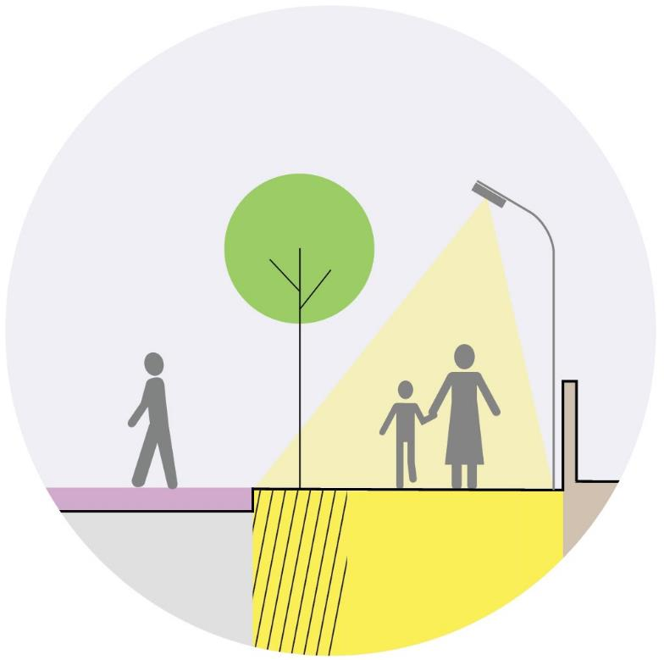
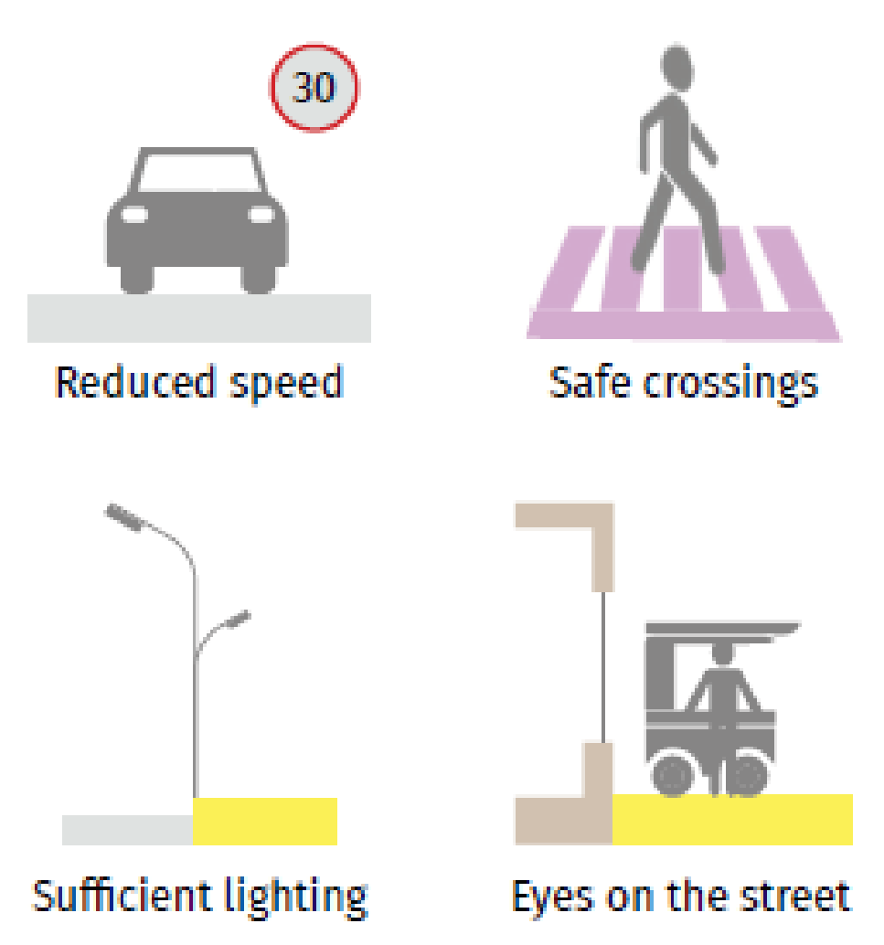
PRINCIPLES
2. Safety Safe for all user groups
Segregated spaces for each
Traffic calming measures
Personal safety good lighting
Active edges and vending
Principles of Complete Streets

Slide 25
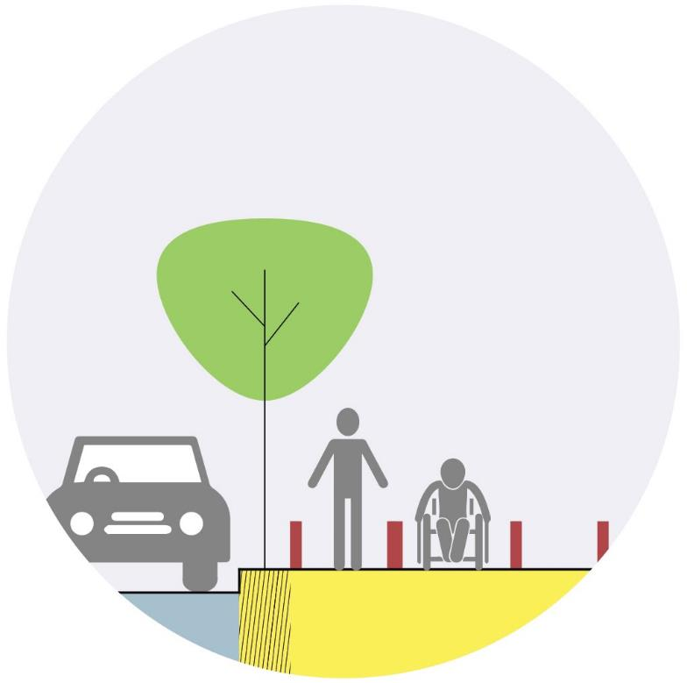
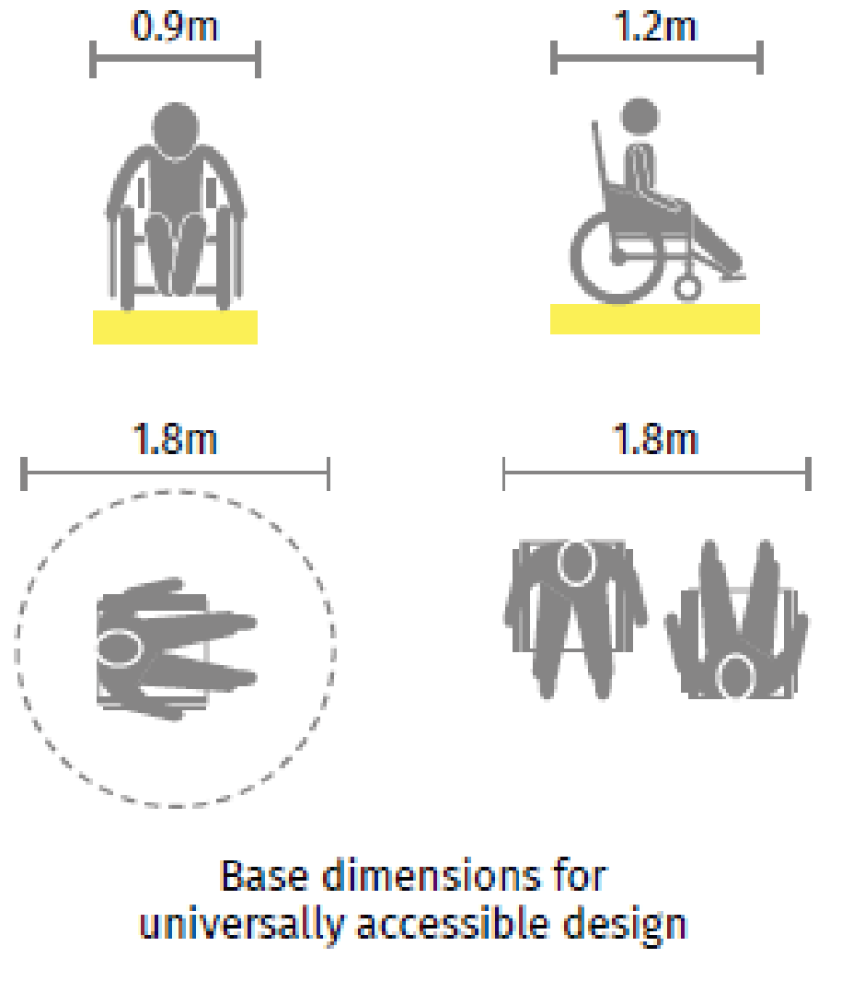
PRINCIPLES
3. Universal Accessibility Accessible by all
Continuous and even-surfaced footpaths
Table top crossings and ramps
Tactile pavers wherever level differences occur
Principles of Complete Streets

Slide 26
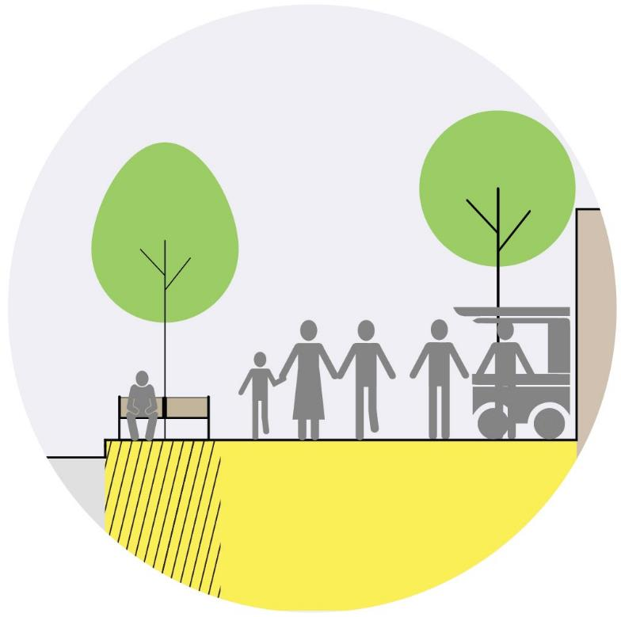
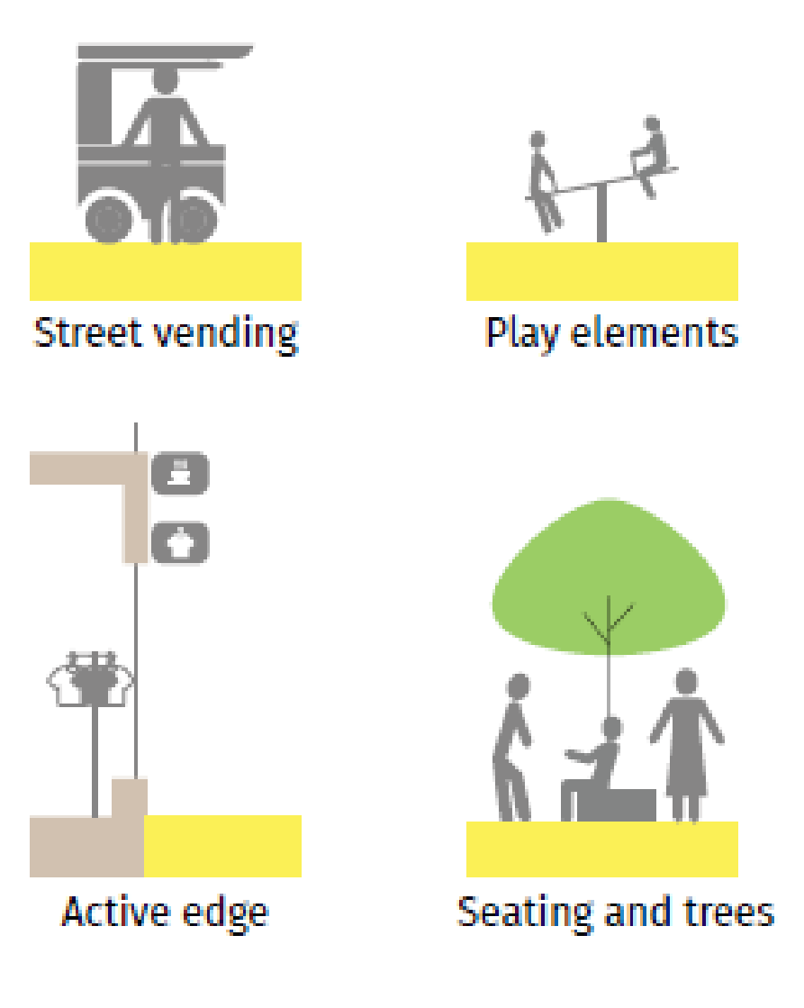
PRINCIPLES
4. Liveability Full of life - elements that improve activity attracts more users
Increases retail activity for all users - transforms the street into a vital public space
Principles of Complete Streets

Slide 27
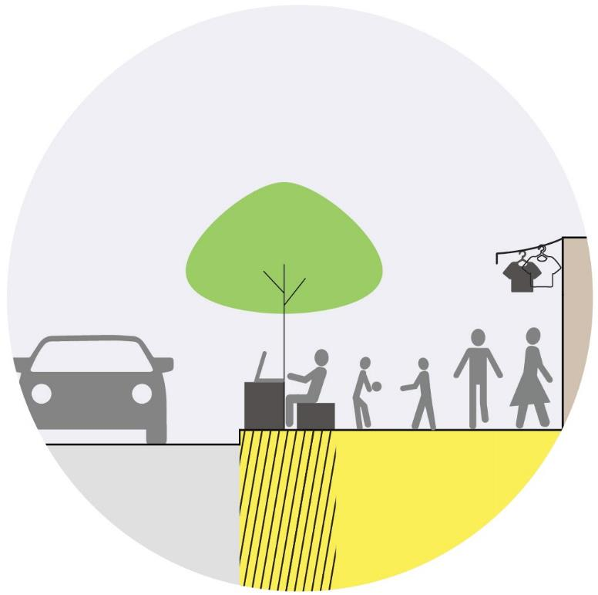
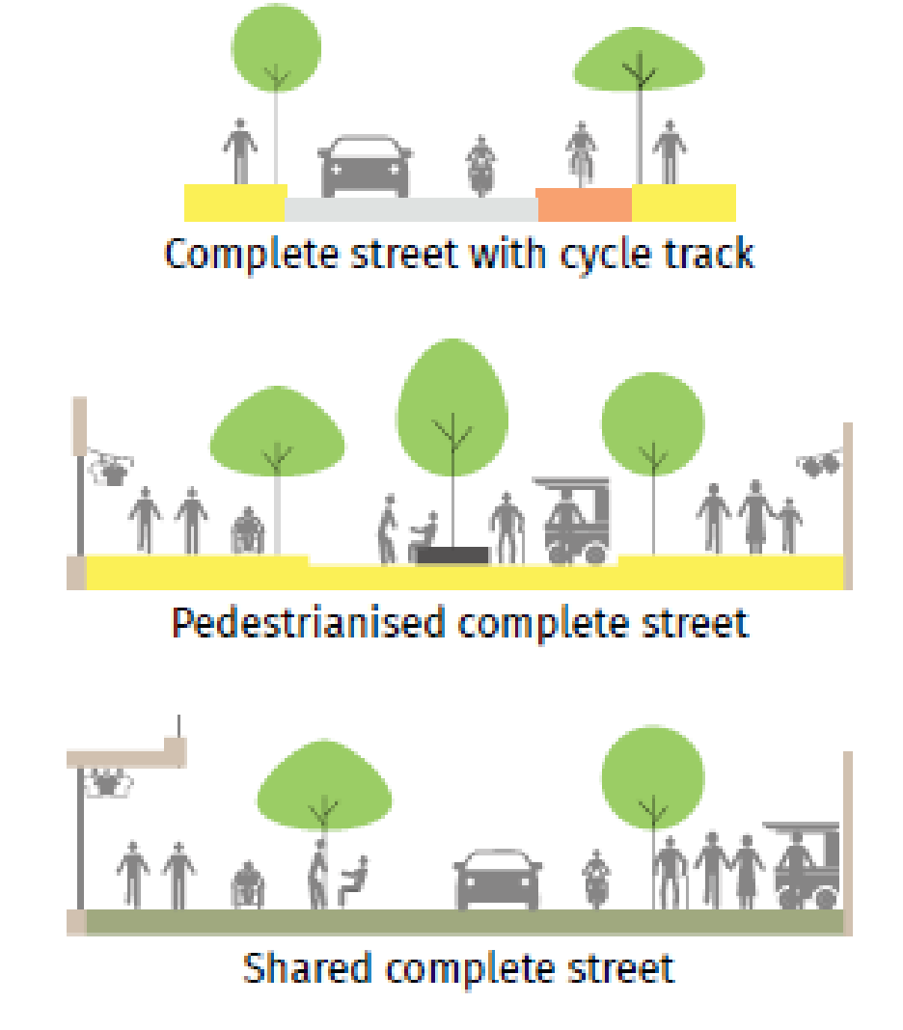
PRINCIPLES
5. Sensitivity to Local Context Designed to suit the local context
Factoring in local street activities
Patterns of pedestrian movement
Nearby land uses and the needs of the people
Principles of Complete Streets

Slide 28
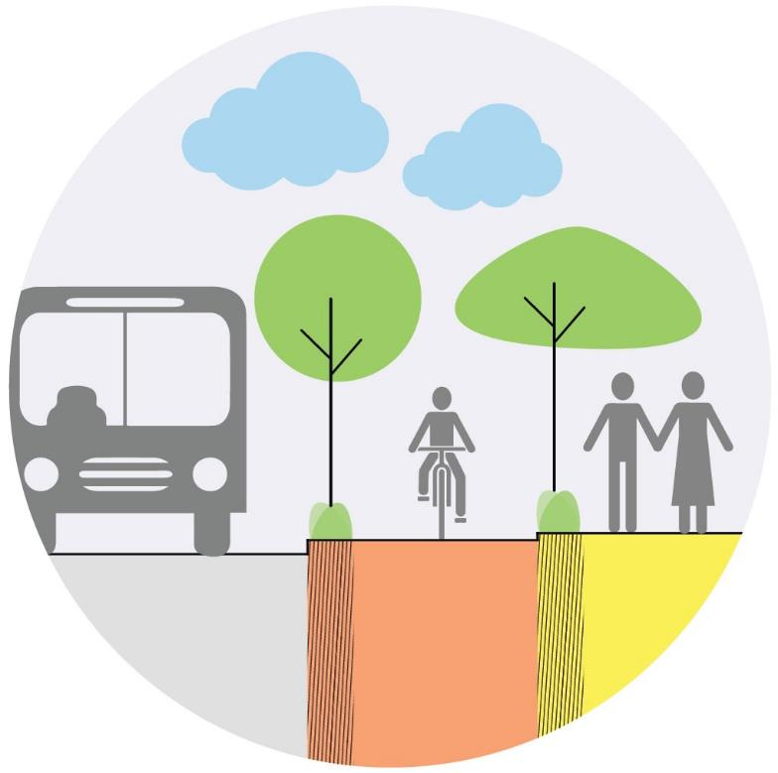
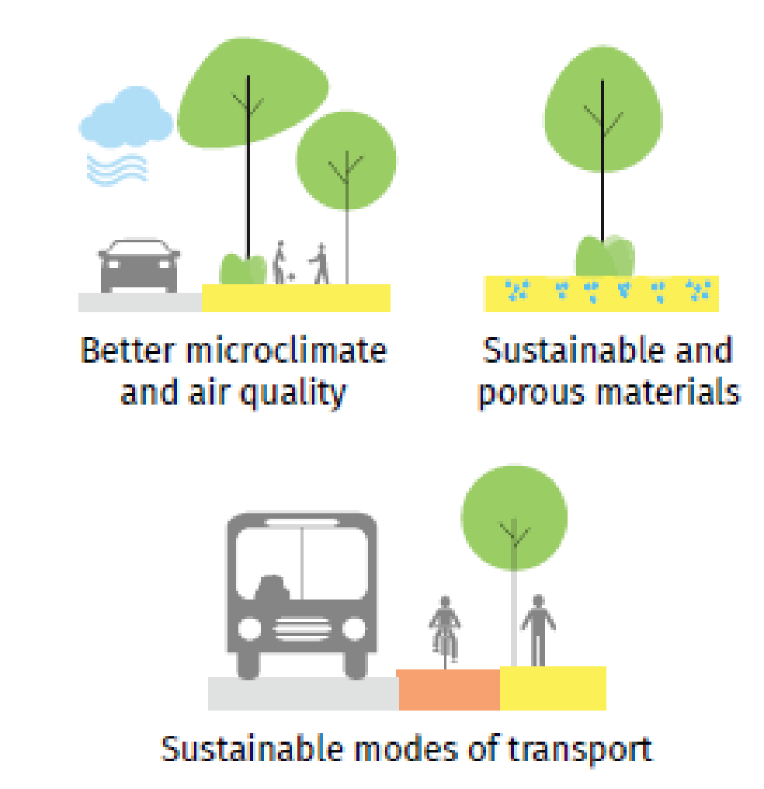
PRINCIPLES
6. Environmental Sustainability Promotes sustainable modes of transport
Improves local climatic conditions
Reducing pollution and heat
Capture and channel rainwater through design
Principles of Complete Streets

Slide 29
Improves Sustainable Mode Share
Case: St .Mark's road, Bangalore
With the revamped
design, pedestrian volumes have gone up by
250%
Benefits of Complete Streets
BEFORE
AFTER

Slide 30
Improves Vibrancy
Case: Strøget, Copenhagen
The revamp led to 6 times
more area for
pedestrians and
buses with
145 people/min
Benefits of Complete Streets
BEFORE
AFTER

Slide 31
Reduces Fatalities
Case: Plaza program, New York City
The plaza program help reduce
pedestrian accidents by
35%
Benefits of Complete Streets
BEFORE
AFTER

Slide 32
Allows Equitable Mobility for all
Case: Avenida 9 de Julio, Buenos Aires
The revamped street
reduced bus travel
time by
63%
Benefits of Complete Streets
BEFORE
AFTER
Notes:
positively impacting the lives of over 200,000 commuters

Slide 33
Better cities through better streets
Complete Streets:
Policy Workbook

Slide 34
Complete Streets Policy Process
01 Creation of Complete Streets Policy
02 Institutional Framework

Slide 35
Invite all stakeholders — representatives from all road owning agencies, ULB, development authority, civil bodies, academia etc.
Present the draft vision and goals and build consensus
Creating a shared vision with all stakeholders
Notes:
positively impacting the lives of over 200,000 commuters

Slide 36
“What kind of city do we want to live in?”
“How will mobility – in particular walking and cycling - in the cities in the future differ from what it is today?”
Creating a shared vision with all stakeholders
Notes:
positively impacting the lives of over 200,000 commuters

Slide 37
To improve coordination between various agencies at the city level
To ensure consistent engagement with all stakeholders
Institutional Framework: Apex committee
Notes:
positively impacting the lives of over 200,000 commuters

Slide 38
To support planning, designing of streets.
To oversee and monitor the work produced by design consultants, contractors as well as general maintenance of streets.
Institutional Framework: Complete Streets Cell
Notes:
positively impacting the lives of over 200,000 commuters

Slide 39
Better cities through better streets
Complete Streets:
Planning Workbook

Slide 40
Creating continuous networks, not discontinuous segments
Completed in Phase 1
Ongoing street design packages

Slide 41
Complete Streets Planning Process

Slide 42
PLANNING METHODOLOGY
Creating complete streets masterplan
NMT Master plan
+
+
Pedestrian Network
Greenways Network
Cycle Network
Streets with segregated footpaths
Pedestrian only streets
Only NMT - PT streets
NMT Priority Streets
15/30 kmph zones around schools
Network of canals, lakes and other natural features
Streets with segregated cycle tracks
Cycle priority routes
Once the pedestrian, greenways and cycle networks are prepared, they should then be superimposed to create the NMT master plan.

Slide 43
PLANNING METHODOLOGY
Determining the budget and phasing
NMT Master plan
+
+
Design Recommendations
Project Packaging
Project
Costing & Timeline
Based on the RoW and land use of each street, design recommendations for each street is provided.
Minimum 15-25 km depending on the total street network
Arterial street - the entire length be given to one consultant to ensure design continuity
Based on the type of project and the total length of the street, costs are calculated.

Slide 44
Better cities through better streets
Complete Streets:
Design Workbook

Slide 45
Complete Streets Design

Slide 46
Complete Streets Design

Slide 47
Design Process

Slide 48
Street Design Elements

Slide 49
FOOTPATH

Slide 50
FOOTPATH
zones

Slide 51
FOOTPATH
Multi-utility zone
Pedestrian zone
Frontage zone
zones

Slide 52
Design templates
Intersection templates
Transit systems and the street
Street materials
Participatory street design
Street design templates
24M RoW
18M RoW
12M RoW
Notes:
positively impacting the lives of over 200,000 commuters

Slide 53
Better cities through better streets
Complete Streets:
Implementation Workbook

Slide 54
Implementation process

Slide 55
Implementation process
01 Pre construction Process
02 Construction Process
03 Post -Construction Process

Slide 59
Better cities through better streets
Complete Streets:
Evaluation Metrics

Slide 60
Complete Streets: Key indicators
Outcome Indicators:
Core Output Indicators:
Efficient Mobility
1 | Mode Share
2 | Registered vehicles data
3 | Daily Bus Ridership
Liveable, accessible and comfortable streets
4 | Share of mixed use along streets
5 | Active street segments
6 | Non-walking activities along the street
Safety
7 | Traffic injuries
8 | Traffic fatalities
Environmental Sustainability
9 | Annual mean particulate matter concentration at street level
1 | Extend of footpath ⬤ ⬤ ⬤ ⬤
2 | Share of footpath with adequate lighting ⬤ ⬤ ⬤ ⬤
3 | Extent of cycle track ⬤ ⬤ ⬤ ⬤
4 | Share of cycle track with adequate lighting ⬤ ⬤ ⬤ ⬤
5 | Share of paid parking under demand-pegged IT management system ⬤
6 | Ratio of parking revenue to property rent ⬤
7 | Operating buses per lakh population ⬤ ⬤ ⬤
8 | Ratio of monthly public transport travelling cost to EWS income ⬤ ⬤ ⬤
9 | Percentage of transport budget allocated for Complete Streets projects ⬤ ⬤ ⬤ ⬤
10 | No. of air quality monitoring stations at street level ⬤ ⬤ ⬤ ⬤

Slide 61
I. Efficient Mobility:
Tracks behavioural change from usage of person motor vehicles to walking, cycling and usage of public transport as better sustainable transport infrastructure is provided.
Outcome indicators
INDICATOR | DATA SOURCE | FREQUENCY | LEVEL OF DIFFICULTY | BENCHMARK
1. Mode Share - disaggregated by: Walk, Cycle, Bus, Rail, Metro, IPT, personal two-wheelers and personal four-wheelers | Household Survey | Every 5 years | ⬤ | 20% or more increase in walking and cycling from baseline
2. Registered vehicles data for last (financial/ calendar) year and for the preceding decade | Regional Transport Office (RTO) | Every year | ⬤ | Relative percentage decrease from baseline.
3. Daily ridership of buses (disaggregated by age, gender and ability) | Primary survey | Every year | ⬤ | 20% or more increase in ridership from baseline by women, children (5-15 years), elderly (more than 60 years), and people with disabilities
Notes:
positively impacting the lives of over 200,000 commuters

Slide 62
Core Output indicators
INDICATOR | DATA SOURCE | FREQUENCY | LEVEL OF DIFFICULTY | BENCHMARK
1. Accessibility/ Safety Percentage of street length with Continuous Barrier-free walking zone width as per IRC:103-2012 Maximum footpath height of 150mm | Accessibility audit | Every year | ⬤ | 1: 75% to 100% 2. 50% to 74% 3. 25% to 49% 4. Less than 24 %
2. Personal Security: Percentage of footpath with adequate lighting of 30 lux | Accessibility Audit between 7 - 9 pm | Every year | ⬤ | 1: 75% to 100% 2. 50% to 74% 3. 25% to 49% 4. Less than 24 %
I. Extent of Walking Envionment
Measures the accessibility, and security of the walking environment.
Notes:
positively impacting the lives of over 200,000 commuters

Slide 63
Better cities through better streets
Complete Streets:
Best Practices

Slide 64
TN MEGA STREETS PROGRAMME
Before | DP Road, Pune

Slide 65
TN MEGA STREETS PROGRAMME
After | JM Road, Pune

Slide 66
TN MEGA STREETS PROGRAMME
After | DP Road, Pune

Slide 67
TN MEGA STREETS PROGRAMME
After| JM Road, Pune

Slide 68
TN MEGA STREETS PROGRAMME
After | JM Road, Pune

Slide 69
TN MEGA STREETS PROGRAMME
After | DP Road, Pune

Slide 70
TN MEGA STREETS PROGRAMME
After | Harrington Road, Chennai

Slide 71
TN MEGA STREETS PROGRAMME
Before | Harrington Road, Chennai

Slide 72
TN MEGA STREETS PROGRAMME
After | Harrington Road, Chennai

Slide 73
TN MEGA STREETS PROGRAMME
After | Harrington Road, Chennai

Slide 74
TN MEGA STREETS PROGRAMME
Before | Police Commissioner Road, Chennai

Slide 75
TN MEGA STREETS PROGRAMME
After | Police Commissioner Road, Chennai

Slide 76
TN MEGA STREETS PROGRAMME
Before | Raman Street, Chennai

Slide 77
After | Raman Street, Chennai

Slide 78
TN MEGA STREETS PROGRAMME
Shared street | Church Street, Bangalore

Slide 79
TN MEGA STREETS PROGRAMME
Pedestrian priority street | Ped plaza, Chennai

Slide 80
TN MEGA STREETS PROGRAMME
Pedestrian street | SM Street, Kozhikode

Slide 81
Better cities through better streets
By Aswathy Dilip
aswathy.dilip@itdp.org
www.itdp.in
fb.com/itdpindia
twitter.com/itdpindia
india.itdp.org
india@itdp.org

